Slide 1


Querying Linked Geospatial Data with Incomplete Information
Charalampos Nikolaou Manolis Koubarakis
charnik@di.uoa.gr koubarak@di.uoa.gr
Department of Informatics & Telecommunications
National and Kapodistrian, University of Athens

Slide 2
Outline
Linked geospatial data (motivation)
Querying complete geospatial information
(exact geometries)
Querying qualitative geospatial information
Querying incomplete geospatial information
The RDF^{i} framework
Future work
2

Slide 3
Motivation
Linked geospatial data
  GeoNames
  http://www.geonames.org/ontology/
  LinkedGeoData (OpenStreetMap)
  http://linkedgeodata.org/
  Administrative geography of Great Britain
  (Ordnance Survey)
  http://data.ordnancesurvey.co.uk/.html
  Greek Administrative Geography
  http://linkedopendata.gr/
  Corine Land Cover of Greece
  http://linkedopendata.gr/
  Global Administrative Areas (GADM)
  http://www.gadm.org/
  DBpedia
  http://dbpedia.org/
3

Slide 4
Motivation
over 9.5 million geometries
(points, linestrings, polygons)
4

Slide 5
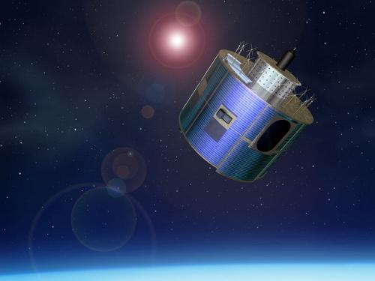
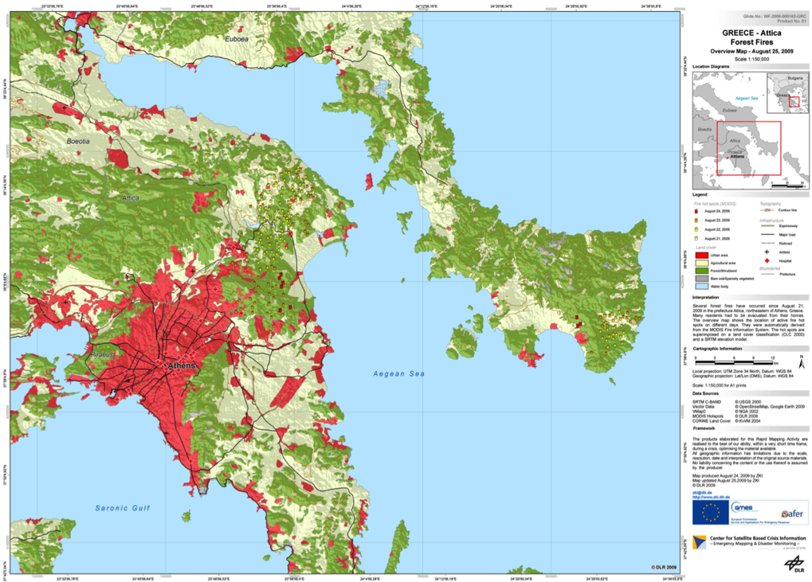
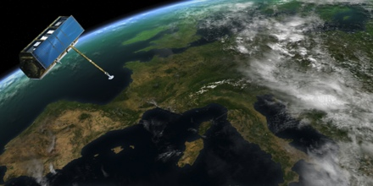
Motivation (cont’d)
Exploitation
Earth observation
  National Observatory of Athens (NOA)
    Fire monitoring and burnt scar mapping
    Risk assessment
5

Slide 6
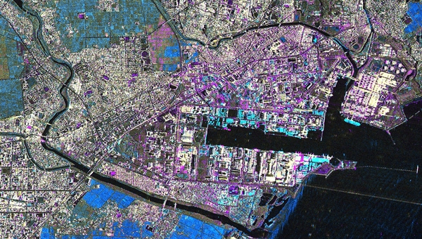
Motivation (cont’d)
Earth observation
  German Aerospace Center (DLR)
    Management of environmental disasters (oil spills, tsunamis, floods, etc.)
    Land use and regional/urban planning
6

Slide 7
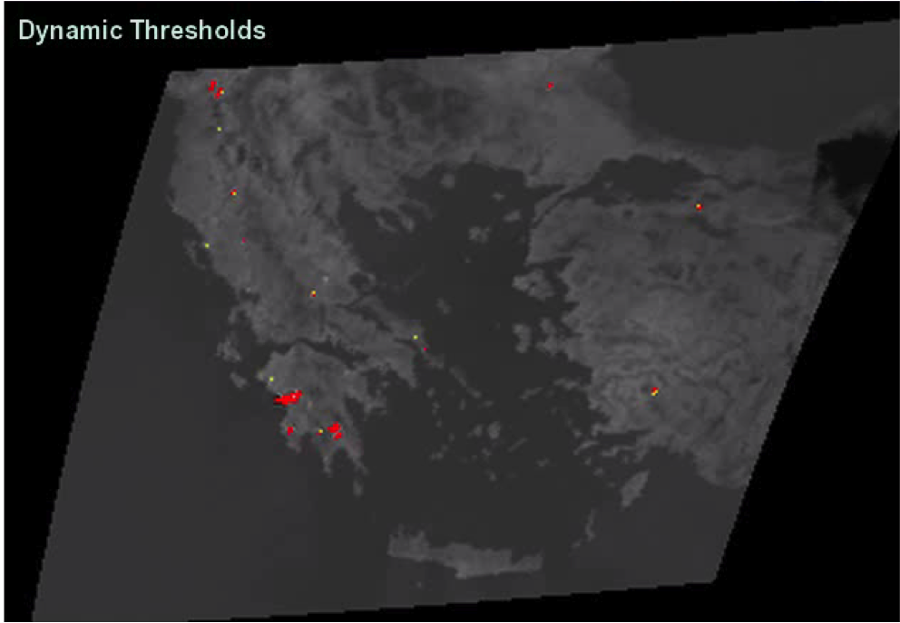
NOA’s representation of hotspots
(24.825668, 35.310643)
noa:hotspot1
7

Slide 8
NOA’s representation of hotspots (cont’d)
Representation using stRDF
noa:hotspot1 rdf:type noa:Hotspot .
noa:fire1 rdf:type noa:Fire .
noa:hotspot1 noa:correspondsTo noa:fire1 .
noa:fire1 noa:occuredIn noa:region1 .
noa:region1 strdf:hasGeometry
"POINT(24.825668 35.310643)"^^strdf:WKT .
Encoding of geometries using RDF literas in WKT format
(OGC standard)
8

Slide 9
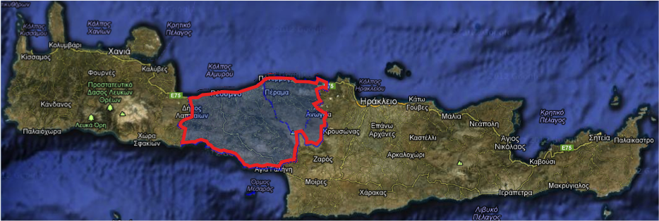
NOA’s representation of hotspots (cont’d)
Querying using stSPARQL
Find all fires and hotspots inside Rethymno
SELECT ?f ?h
WHERE {
?h rdf:type noa:Hotspot ;
noa:correspondsTo ?f .
?f rdf:type noa:Fire ;
noa:occuredIn ?r .
?r strdf:hasGeometry ?rgeo .
gag:Rethymno strdf:hasGeometry ?rethGeo .
FILTER (strdf:contains(?rethGeo, ?rgeo))
}
Greek Administrative Geography
Spatial filtering
9

Slide 10
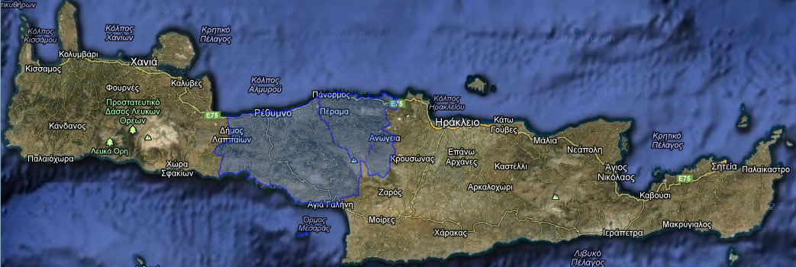
Extending the previous example with topological information
gag:Rethymno
  gag:Rethymno rdf:type gag:Perfecture .
10

Slide 11
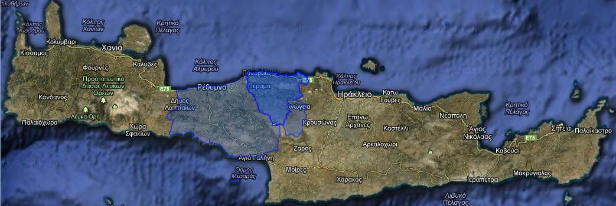
Extending the previous example with topological information
gag:Mylopotamos
gag:Rethymno
noa:region1
  gag:Rethymno rdf:type gag:Perfecture .
  gag:Mylopotamos rdf:type gag:Municipality .
  gag:Rethymno geo:sfContains gag:Mylopotamos .
  gag:Mylopotamos geo:sfContains noa:region1.
Topology vocabulary extension of GeoSPARQL
11

Slide 12
Extending the previous example with topological information (cont’d)
Querying using GeoSPARQL
Topology vocabulary extension of GeoSPARQL
12
Find all fires and hotspots inside Rethymno
SELECT ?f ?h
WHERE {
?h rdf:type noa:Hotspot ;
noa:correspondsTo ?f .
?f rdf:type noa:Fire ;
noa:occuredIn ?r .
gag:Rethymno geo:sfContains ?r .
}

Slide 13
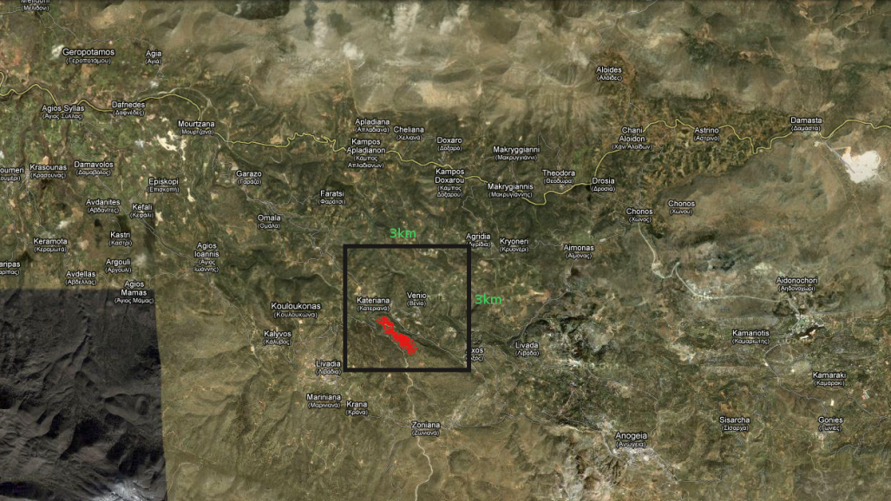
NOA’s representation of hotspots (revisited)
Incomplete information
_region1
noa:hotspot1
noa:fire1
13

Slide 14
NOA’s representation of hotspots (revisited)
Representation using RDF^{i}
  noa:hotspot1 rdf:type noa:Hotspot .
  noa:fire1 rdf:type noa:Fire .
  noa:hotspot1 noa:correspondsTo noa:fire1 .
  noa:fire1 noa:occuredIn _region1 .
  _region1 geo:sfWithin "POLYGON((24.81 35.32, 24.84 35.33, 24.84 35.30, 24.81 35.30, 24.81 35.32));<http://spatialreference. org/ref/epsg/4121/>"^^strdf:geometry
e-literal
RCC-8
Qualitative spatial constraint
14

Slide 15

Visualization of a certainty query
15

Slide 16
Certainty queries
New (modal) operator
New topological operator
16
Find all fires that have certainly occurred inside the rectangle defined in WKT as POLYGON((24.79 35.34, 24.85 35.34, 24.85 35.29, 24.79 35.29, 24.79 35.34))
CERTAIN SELECT ?F
WHERE {
?F rdf:type noa:Fire ;
noa:occuredIn ?R .
FILTER(geof:sfWithin(?R, "POLYGON((24.79 35.34, 24.85 35.34, 24.85 35.29, 24.79 35.29, 24.79 35.34))"))
}

Slide 17

Extending the previous example with topological information
gag:Mylopotamos
gag:Rethymno
POLYGON((24.81 35.32 ...))
noa:fire1
_region1
  gag:Rethymno rdf:type gag:Perfecture .
  gag:Mylopotamos rdf:type gag:Municipality .
  gag:Mylopotamos geo:sfWithin gag:Rethymno .
  _region1 geo:sfWithin "POLYGON((24.81 35.32...))"^^strdf:WKT
17

Slide 18
Extending the previous example with topological information
gag:Mylopotamos
gag:Rethymno
POLYGON((24.81 35.32 ...))
noa:fire1
_region1
Beyond stSPARQL and the topology vocabulary extension of GeoSPARQL
  gag:Rethymno rdf:type gag:Perfecture .
  gag:Mylopotamos rdf:type gag:Municipality .
  gag:Mylopotamos geo:sfWithin gag:Rethymno .
  _region1 geo:sfWithin "POLYGON((24.81 35.32...))"^^strdf:WKT
18

Slide 19
Certainty queries
19
Find all fires that have certainly occurred inside Rethymno
CERTAIN SELECT ?F
WHERE {
?F rdf:type noa:Fire ;
noa:occuredIn ?R .
FILTER(geof:sfWithin(?R, gag:Rethymno))
}

Slide 20
Computing the answer
  gag:Mylopotamos geo:sfWithin gag:Rethymno .
  gag:Mylopatamos strdf:hasGeometry "POLYGON((<M>))"^^strdf:WKT .
  gag:Rethymno strdf:hasGeometry "POLYGON((<R>))"^^strdf:WKT .
  _region1 geo:sfWithin "POLYGON((<H>))"^^strdf:WKT
Geometry for Mylopotamos
D
A
T
A
B
A
S
E
Geometry for
Rethymno
Geometry for
Hotspot
strdf:Inside("POLYGON((<H>))", "POLYGON((<M>))")
_region1 geo:sfWithin "POLYGON((<H>))"
_region1 geo:sfWithin gag:Mylopotamos
gag:Mylopotamos geo:sfWithin gag:Rethymno
_region1 geo:sfWithin gag:Rethymno
"POLYGON((<H>))" geo:sfWithin "POLYGON((<M>))"
Vocabulary translation
Qualitative
spatial reasoning
Combined
algorithm
20

Slide 21
Computing the answer
  gag:Mylopotamos geo:sfWithin gag:Rethymno .
  gag:Mylopatamos strdf:hasGeometry "POLYGON((<M>))"^^strdf:WKT .
  gag:Rethymno strdf:hasGeometry "POLYGON((<R>))"^^strdf:WKT .
  _region1 geo:sfWithin "POLYGON((<H>))"^^strdf:WKT
Geometry for Mylopotamos
D
A
T
A
B
A
S
E
Geometry for
Rethymno
Geometry for
Hotspot
strdf:Inside("POLYGON((<H>))", "POLYGON((<M>))")
_region1 geo:sfWithin "POLYGON((<H>))"
_region1 geo:sfWithin gag:Mylopotamos
gag:Mylopotamos geo:sfWithin gag:Rethymno
_region1 geo:sfWithin gag:Rethymno
"POLYGON((<H>))" geo:sfWithin "POLYGON((<M>))"
Vocabulary translation
Qualitative
spatial reasoning
Combined
algorithm
21

Slide 22
Computing the answer
  gag:Mylopotamos geo:sfWithin gag:Rethymno .
  gag:Mylopatamos strdf:hasGeometry "POLYGON((<M>))"^^strdf:WKT .
  gag:Rethymno strdf:hasGeometry "POLYGON((<R>))"^^strdf:WKT .
  _region1 geo:sfWithin "POLYGON((<H>))"^^strdf:WKT
Geometry for Mylopotamos
D
A
T
A
B
A
S
E
Geometry for
Rethymno
Geometry for
Hotspot
strdf:Inside("POLYGON((<H>))", "POLYGON((<M>))")
_region1 geo:sfWithin "POLYGON((<H>))"
_region1 geo:sfWithin gag:Mylopotamos
gag:Mylopotamos geo:sfWithin gag:Rethymno
_region1 geo:sfWithin gag:Rethymno
"POLYGON((<H>))" geo:sfWithin "POLYGON((<M>))"
Vocabulary translation
Qualitative
spatial reasoning
Combined
algorithm
22

Slide 23
Computing the answer
  gag:Mylopotamos geo:sfWithin gag:Rethymno .
  gag:Mylopatamos strdf:hasGeometry "POLYGON((<M>))"^^strdf:WKT .
  gag:Rethymno strdf:hasGeometry "POLYGON((<R>))"^^strdf:WKT .
  _region1 geo:sfWithin "POLYGON((<H>))"^^strdf:WKT
Geometry for Mylopotamos
D
A
T
A
B
A
S
E
Geometry for
Rethymno
Geometry for
Hotspot
strdf:Inside("POLYGON((<H>))", "POLYGON((<M>))")
_region1 geo:sfWithin "POLYGON((<H>))"
_region1 geo:sfWithin gag:Mylopotamos
gag:Mylopotamos geo:sfWithin gag:Rethymno
_region1 geo:sfWithin gag:Rethymno
"POLYGON((<H>))" geo:sfWithin "POLYGON((<M>))"
Vocabulary translation
Qualitative
spatial reasoning
Combined
algorithm
23

Slide 24
The Framework RDF^{i}
Extension of RDF with incomplete information
New kind of literals (e-literals) for each datatype
  Property values that exist but are unknown or partially known
Partial knowledge: captured by constraints
(appropriate constraint language L)
RDF graphs extended to RDF^{i} databases: pair (G, φ)
G: RDF graph with e-literals
φ: quantifier-free formula of L
Charalampos Nikolaou and Manolis Koubarakis
Incomplete Information in RDF
arXiv:1209.3756v2 [cs.DB] 18 Sep 2012
http://arxiv.org/pdf/1209.3756v2.pdf

Slide 25
RDF^{i} Semantics
hotspot1 type Hotspot .
fire1 type Fire .
hotspot1 correspondsTo fire1 .
fire1 occuredIn _region1 .
_region1 geo:sfWithin "x≥6∧x≤23∧y≥8∧y≤19"
corresponds to
{ }
{ G_{1,} G₂ }
{ G₁ }
{ G_{1,} G_{2,} G_{3,} G_{4,} ... }
{ G_{1,} G_{2,} G₃ }
hotspot1 type Hotspot .
fire1 type Fire .
hotspot1 correspondsTo fire1 .
fire1 occuredIn .
set of RDF graphs
(possible worlds)
"x≥8∧x≤14∧y≥10∧y≤18"
"x≥9∧x≤14∧y≥10∧y≤18"
"x≥10∧x≤21∧y≥10∧y≤15"
"x≥7∧x≤13∧y≥9∧y≤18"

Slide 26
Certain answers
CERTAIN SELECT ?F
WHERE {
?F rdf:type noa:Fire ;
noa:occuredIn ?R .
FILTER(geof:sfWithin(?R, "x≥2∧x≤28∧y≥4∧y≤22"))
}
Cert(q) = q(G₁) ⋂ q(G₂) ⋂ q(G₃) ⋂ q(G₄) ⋂ ...

Slide 27
Certain answers
CERTAIN SELECT ?F
WHERE {
?F rdf:type noa:Fire ;
noa:occuredIn ?R .
FILTER(geof:sfWithin(?R, "x≥2∧x≤28∧y≥4∧y≤22"))
}
How the certain answer is computed?
Cert(q) = q(G₁) ⋂ q(G₂) ⋂ q(G₃) ⋂ q(G₄) ⋂ ...

Slide 28
The Framework RDF^{i} (cont’d)
Formal semantics for RDF^{i} and SPARQL query evaluation
Representation Systems:
  CONSTRUCT with AUF graph patterns
  CONSTRUCT with well-designed graph patterns
Certain Answer: semantics, algorithms, computational complexity when L is a language of spatial topological constraints
Implementation in the system Strabon has started with L being PCL (topological constraints between variables and polygon constants)
Charalampos Nikolaou and Manolis Koubarakis
Incomplete Information in RDF
arXiv:1209.3756v2 [cs.DB] 18 Sep 2012
http://arxiv.org/pdf/1209.3756v2.pdf

Slide 29
Future work
How do we implement querying with topological relations in RDF stores for stSPARQL/GeoSPARQL?
How do we implement certainty queries for RDF^{i}?
DL reasoners with RCC-8 support offer topological reasoning already (implementing a path-consistency algorithm)
  RacerPro [Möller et al.], [Wessel-Möller, JAPLL’09]
  PelletSpatial [Stocker-Sirin, OWLED’09]
RDF^{i} goes beyond
  Reason about qualitative and quantitative geospatial information
  Can be used in other application domains (e.g., temporal)

Slide 30
Thank you for your attention!
Questions?

Slide 31
References
[Weiming Liu et al.]
Weiming Liu, Sheng-sheng Wang, Sanjiang Li, Dayou Liu: Solving Qualitative Constraints Involving Landmarks. CP 2011:523-537
[Wessel-Möller, JAPLL’09]
Michael Wessel, Ralf Möller: Flexible software architectures for ontology-based information systems. J. Applied Logic (JAPLL) 7(1):75-99 (2009)
[Stocker-Sirin, OWLED‘09]
Markus Stocker, Evren Sirin: PelletSpatial: A Hybrid RCC-8 and RDF/OWL Reasoning and Query Engine. OWLED 2009

