Slide 1
Querying Incomplete Geospatial Information in RDF
Charalampos Nikolaou and Manolis Koubarakis
Department of Informatics and Telecommunications
National and Kapodistrian University of Athens
International Symposium on Spatial and Temporal Databases (SSTD) 2013
August 23, 2013

Slide 2
Motivation
Increased interest in publishing geospatial datasets as linked data (i.e., encoded in RDF and with semantic links to other datasets)
Geospatial information might be:
  Quantitative (e.g., exact geometric information)
  Qualitative (e.g., topological relations)
  ... and express knowledge that is
  Complete
  Incomplete (or indefinite)

Slide 3
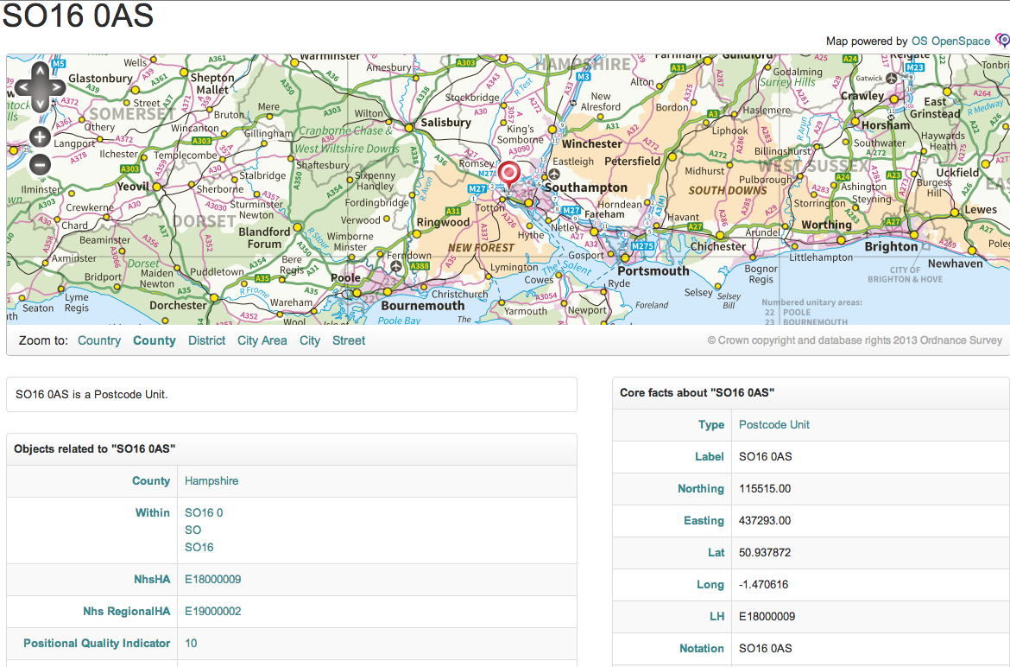
Ordnance Survey (UK)
73,546,231 triples
Notes:
Ordnance Survey is Great Britain's national mapping authority. It offers digital and paper map products for a wide range of business and outdoor uses.

Slide 4
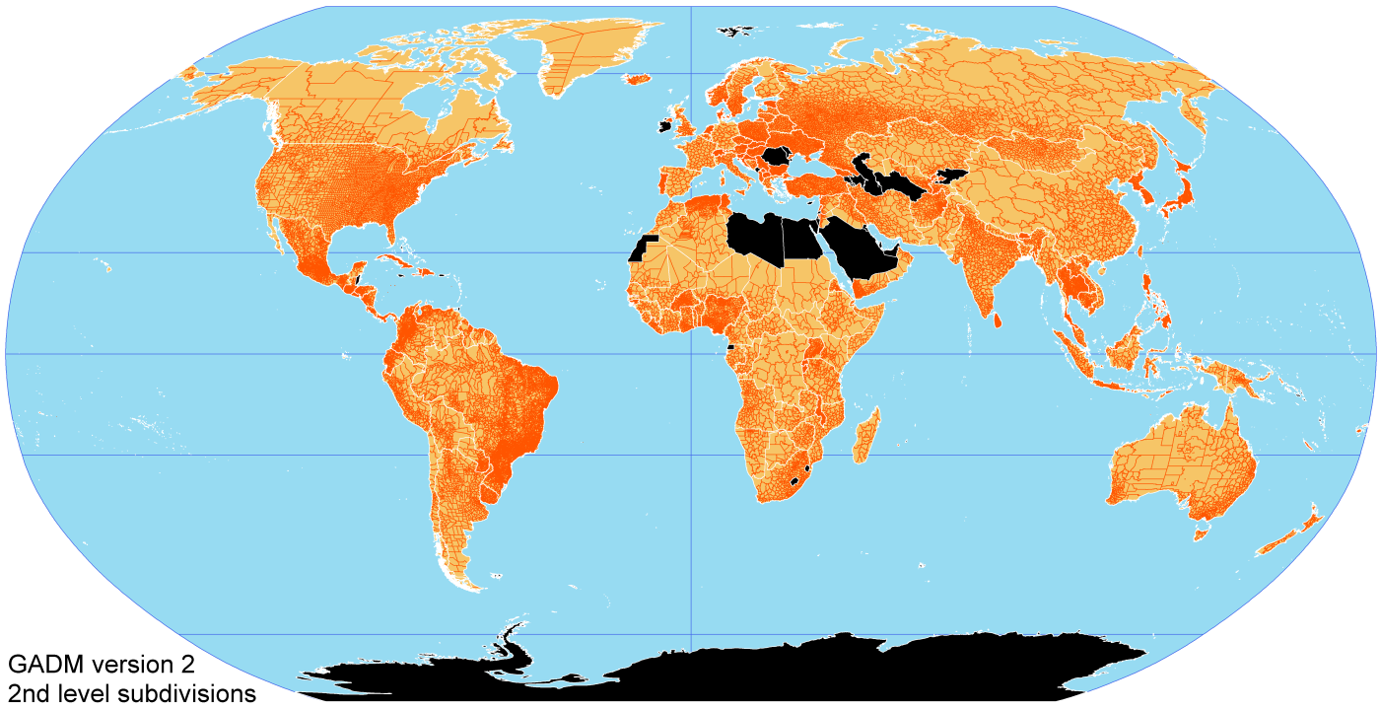
Global Administrative Areas (GADM)
9,896,532
triples
Notes:
GADM is a spatial database of the location of the world's administrative areas for use in GIS and similar software.

Slide 5
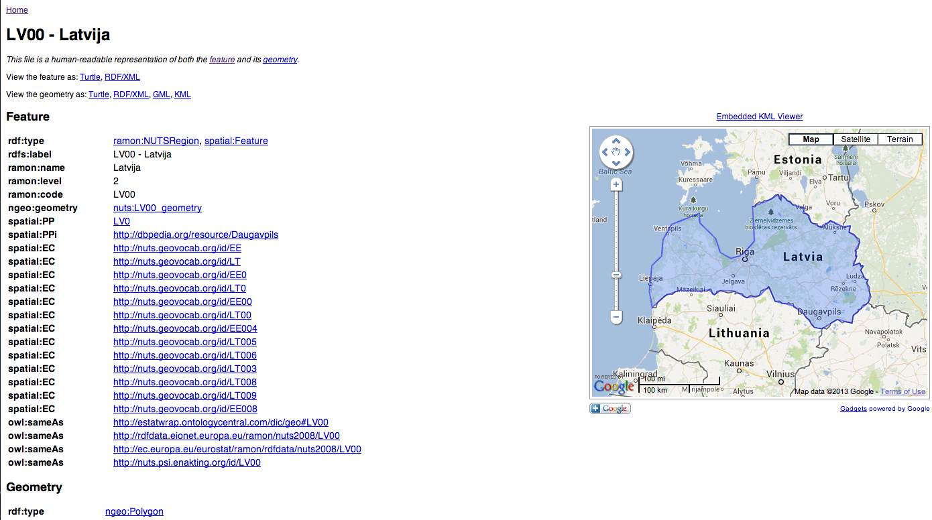
Nomenclature of Territorial Units for Statistics (NUTS)
316,246
triples
Notes:
NUTS is a hierarchical system defined by the Eurostat office of the European Union for dividing the economic territory of EU in 4 levels.

Slide 6
Linked Geospatial Data
~ 62 billion triples

Slide 7
Question
How do we manage (represent, store, query) this data efficiently?

Slide 8
Challenges: Theory
RDF extensions for representing and querying incomplete qualitative and quantitative geospatial information
GeoSPARQL
  Standard OGC query language for RDF data with geospatial information
  Topological relations can be expressed/queried, but no reasoning is offered.
We proposed RDF^{i}
  Can work with any topological/temporal constraint language with/without constant symbols (e.g., RCC-5, RCC-8, IA)
  Formal semantics and algorithm for computing certain answers
  Preliminary complexity results for various constraint languages
No published algorithm for query processing when considering RCC-8 and constants
Open issue

Slide 9
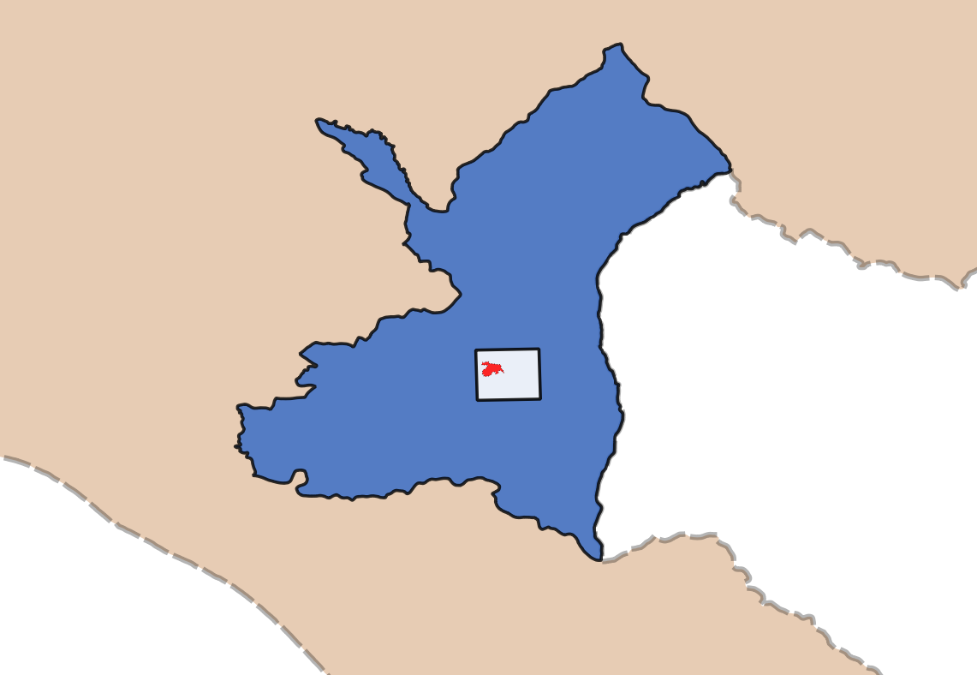
RDF^{i} by example
gag:Region rdfs:subClassOf geo:Feature. gag:WestGreece rdf:type gag:Region. gag:Municipality rdfs:subClassOf geo:Feature.
gag:OlympiaMuni rdf:type gag:Municipality.
noa:Hotspot rdfs:subClassOf geo:Feature. noa:hotspot rdf:type noa:Hospot.
noa:Fire rdfs:subClassOf geo:Feature. noa:fire rdf:type noa:Fire.
West Greece
gag:OlympiaMuni geo:hasGeometry ex:oGeo.
ex:oGeo rdf:type sf:Polygon.
ex:oGeo geo:asWKT "POLYGON((..))"^^geo:wktLiteral.
noa:hotspot geo:hasGeometry ex:rec.
ex:rec geo:asWKT "POLYGON((..))"^^geo:wktLiteral.
gag:WestGreece geo:sfContains gag:OlympiaMuni.
noa:hotspot geo:sfContains noa:fire.
Olympia

Slide 10
RDF^{i} by example (cont’d)
West Greece
Query: Find fires inside the region of West Greece.
GeoSPARQL query:
CERTAIN SELECT ?f
WHERE {
?f rdf:type noa:Fire.
gag:WestGreece geo:sfContains ?f.
}
Olympia

Slide 11
RDF^{i} by example (cont’d)
West Greece
Query: Find fires inside the region of West Greece.
GeoSPARQL query:
CERTAIN SELECT ?f
WHERE {
?f rdf:type noa:Fire.
gag:WestGreece geo:sfContains ?f.
}
contains
contains
contains
contains
Olympia

Slide 12
Challenges: Theory
Efficient computation of the entailment relation
Φ⊨Θ
where Φ and Θ are quantifier-free first-order formulas of a constraint language expressing the topological relations of various frameworks (RCC-8, DE-9IM, etc.)

Slide 13
Challenges: Theory
Computing entailment is equivalent to checking consistency of formulas with constraint networks
Constraint networks:
  Spatial relations among regions
  Regions might be constant ones (exact geometric information) or identified by a URI
Most recent results considered basic and complete RCC-5 networks with polygonal regions
For RCC-8, deciding consistency is NP-complete
No published algorithm for checking consistency
Are there tractable cases?
Open issue

Slide 14
Challenges: Practice
Scale to billions of triples
Reasoners from QSR scale only up to hundreds of regions with complex spatial relations
How do they perform in our case?
Setting:
  Real linked geospatial datasets
  No constants
  Only base RCC-8 relations
  Evaluation of consistency checking using the well-known path-consistency algorithm

Slide 15
Experimental evaluation
after one day
Computation of the complete constraint network
Running time: O(n³)
Memory requirements: O(n²)
n ≈ thousands to millions
hundreds of regions
thousands of regions
thousands of regions
thousands of regions
Setup: Intel Xeon E5620, 2.4 GHz, 12MB L3, 48GB RAM, RAID 5, Ubuntu 12.04

Slide 16
Network structure
We have started working on algorithms taking into account the structure of these networks:
  Node degrees fit a power-law distribution
  Network is sparse

Slide 17
Network structure (cont’d)
Edges of three kinds:
Reflect networks composed of components with hierarchical structure
  R-tree extensions (Papadias, Kalnis, Mamoulis, AAAI’99)
Parallel algorithms combined with backward-chaining techniques for lazy query processing
  Graph partitioning
  Path compression data structures and indexes
  non-tangential proper part
  externally connected
  equals

Slide 18
Related work: Spatial
Qualitative spatial reasoning
  Efficient algorithms for consistency checking of constraint networks (complex spatial relations, few number of regions)
  Does not consider query processing
Description logic reasoners
  PelletSpatial: RCC-8 reasoning (cannot handle disjunctions)
  RacerPro: RCC-8 reasoning

Slide 19
Related work: Temporal
Chaudhuri (VLDB’88)
The knowledge representation language Telos (TOIS’90)
Foundations of temporal constraint databases (Koubarakis, PhD thesis, ‘94)
Qualitative temporal reasoning community (since 80s)
SQL+i system (BNCOD‘96)
Later system (IEEE’97)
Hurtado and Vaisman (2006)
Notes:
Chaudhuri (VLDB’88)
Framework for temporal relationships in a database employing a graph model (limited to definite information)
The knowledge representation language Telos (1991)
Preliminary Prolog implementation by M. Koubarakis and T. Topaloglou. The most efficient implementation of Telos (ConceptBase) does not consider incomplete information.
Foundations of temporal constraint databases (Koubarakis, PhD thesis 1994)
Database models for (indefinite) temporal constraint databases
SQL+i (1996)
Temporal RDBMS for modeling and querying indeterminate temporal facts
Representation and reasoning employing constraint networks
Later system (1997)
Querying of temporal knowledge bases
Limited query language (no disjunctive expressions)

Slide 20
Conclusions
What’s the CHALLENGE?
  Implementing an efficient query processing system for incomplete geospatial information in RDF^{i}
The desired system should:
  reason about qualitative and quantitative spatial information that might be incomplete
  be scalable to billions of triples in the most useful cases

Slide 21
Thank you

Slide 22
Dataset characteristics

