Slide 1





Improving knowledge discovery from synthetic aperture radar images using the linked open data cloud and Sextant
Charalampos Nikolaou, Kostis Kyzirakos, Konstantina Bereta, Kallirroi Dogani, Stella Giannakopoulou, Panayiotis Smeros, George Garbis, Manolis Koubarakis
National and Kapodistrian University of Athens, Greece
Daniela E. Molina, Octavian C. Dumitru,
Gottfried Schwarz, Mihai Datcu
German Aerospace Center (DLR), Germany
ESA-EUSC-JRC 2014 – 9th Image Information Mining Conference: The Sentinels Era
5-7 March 2014
Universitatea Politehnica Bucuresti (UPB), Bucharest, Romania

Slide 2
Outline
Knowledge discovery from EO images in DLR
The linked open data cloud
The tool Sextant
Improving knowledge discovery using Sextant
Conclusions

Slide 3
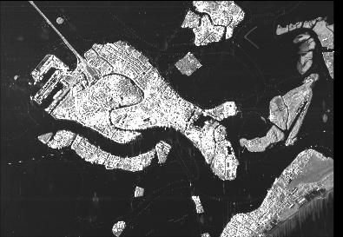
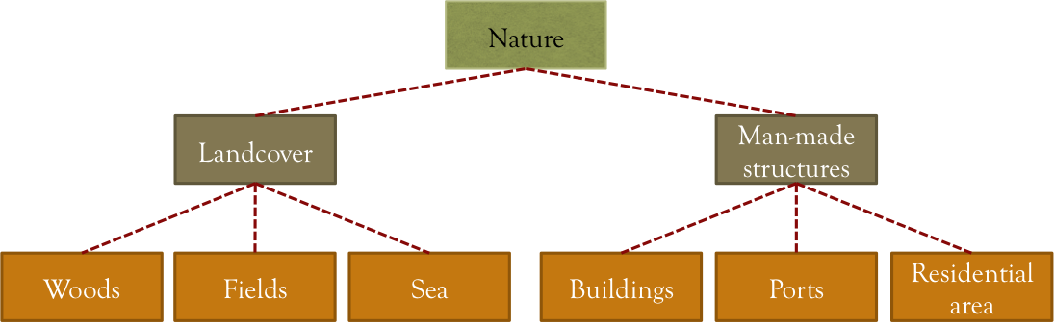

Knowledge discovery and semantic annotation in DLR
feature
extraction
tiling
0 1 5 ... 64 3 17
-4 13 59 ... 4 7 0
1 1 25 ... 0 -4 19
3 21 6 ... 55 1 8
22 99 5 ... 9 4 0
TerraSAR-X
image
patches
relevance
feedback
classification
class1
class2
class3
...
SVM
classifier
semantic
labels
semantic
classes

Slide 4
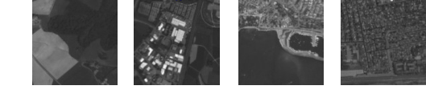
Knowledge discovery and semantic annotation in DLR
Nature
The result of the process
Landcover
Man-made
structures
Woods
Fields
Sea
Buildings
Ports
Residential area

Slide 5
Knowledge discovery and semantic annotation in DLR
No. of scenes / No. of patches | No. of semantic categories | Methodology
109 scenes 110,000 patches | 850 categories | Support Vector Machine Relevance Feedback
Nature
The result of the process
Landcover
Man-made
structures
Woods
Fields
Sea
Buildings
Ports
Residential area
Type of areas | Scene location
Urban and infrastructure areas | Africa – 5 scenes Asia – 21 scenes Europe – 48 scenes Middle East – 8 scenes North America – 16 scenes South America – 11 scenes

Slide 6

Data modeling for knowledge discovery and semantic annotation
Conceptual modeling of the knowledge discovery process and the semantic classes using an OWL ontology
Use geospatial and temporal extensions of the SPARQL query language to query such data
(e.g., GeoSPARQL and stSPARQL)
Benefits
High expressivity
Declarative querying (e.g., “find all satellite images with patches containing water limited on the north by a port”)
Combination with other data sources
  high-quality GIS data
  emerging/dynamic web resources and linked geospatial data

Slide 7
Data modeling for knowledge discovery and semantic annotation
Conceptual modeling of the knowledge discovery process and the semantic classes using an OWL ontology
Use geospatial and temporal extensions of the SPARQL query language to query such data
(e.g., GeoSPARQL and stSPARQL)
Benefits
High expressivity
Declarative querying (e.g., “find all satellite images with patches containing water limited on the north by a port”)
Combination with other data sources
  high-quality GIS data
  emerging/dynamic web resources and linked geospatial data

Slide 8
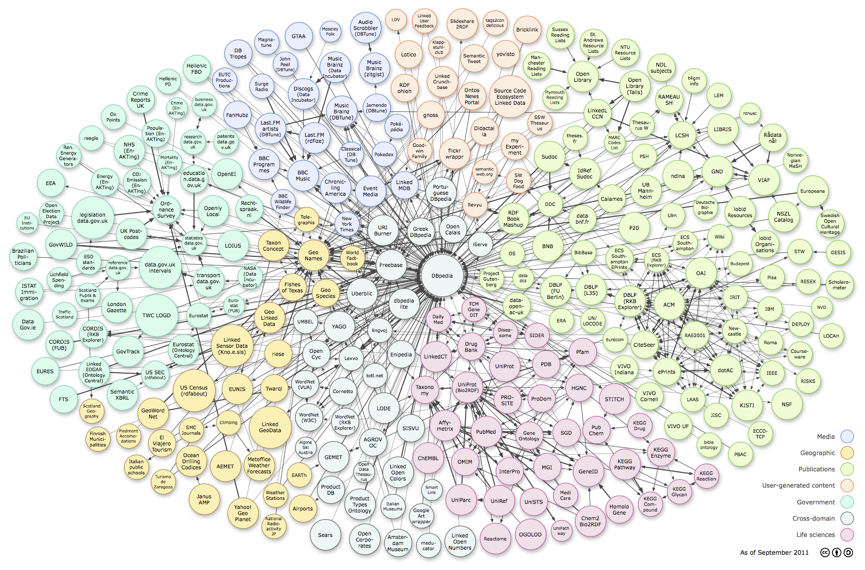
The Linked Open Data cloud

Slide 9
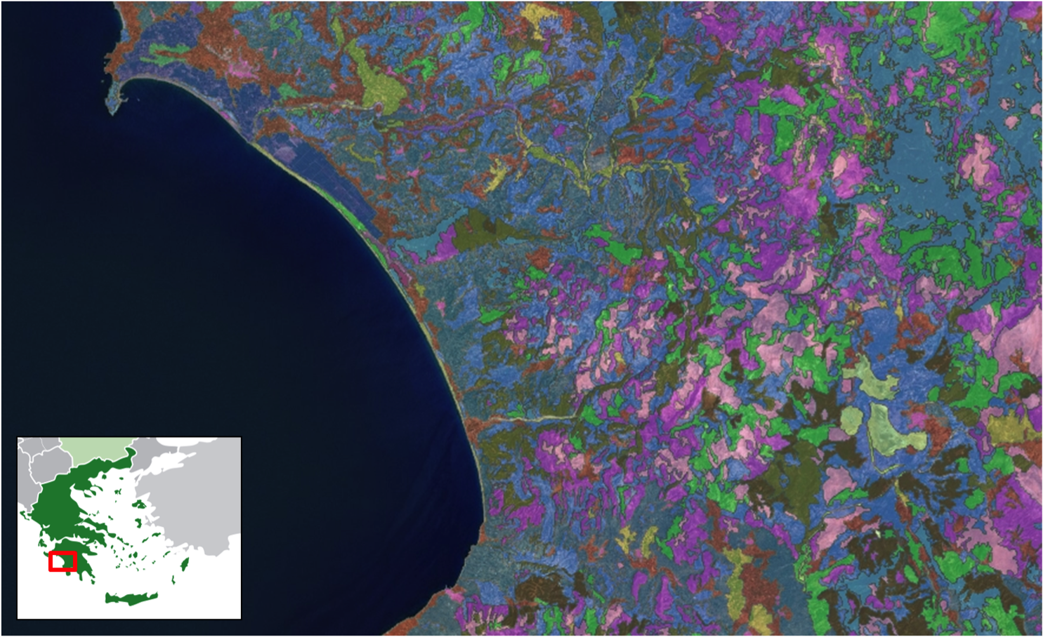


CORINE Land Cover (CLC)
Available on as linked data

Slide 10
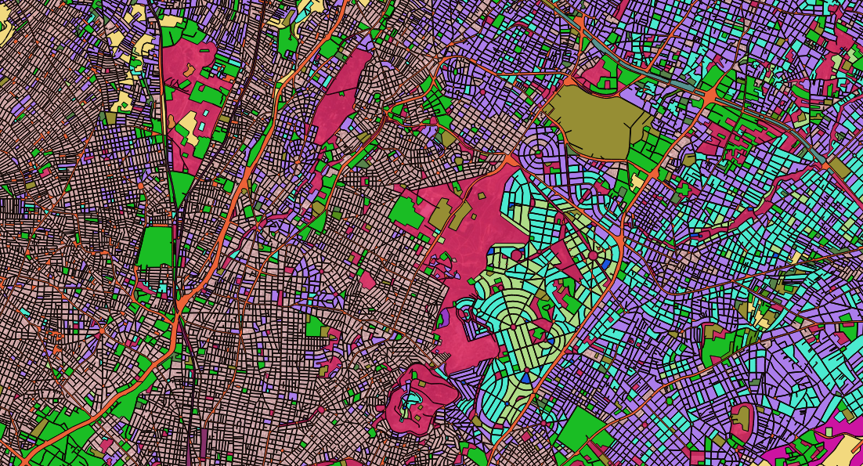
Urban Atlas (UA)
Available on as linked data

Slide 11
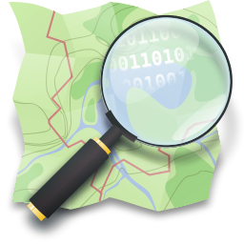
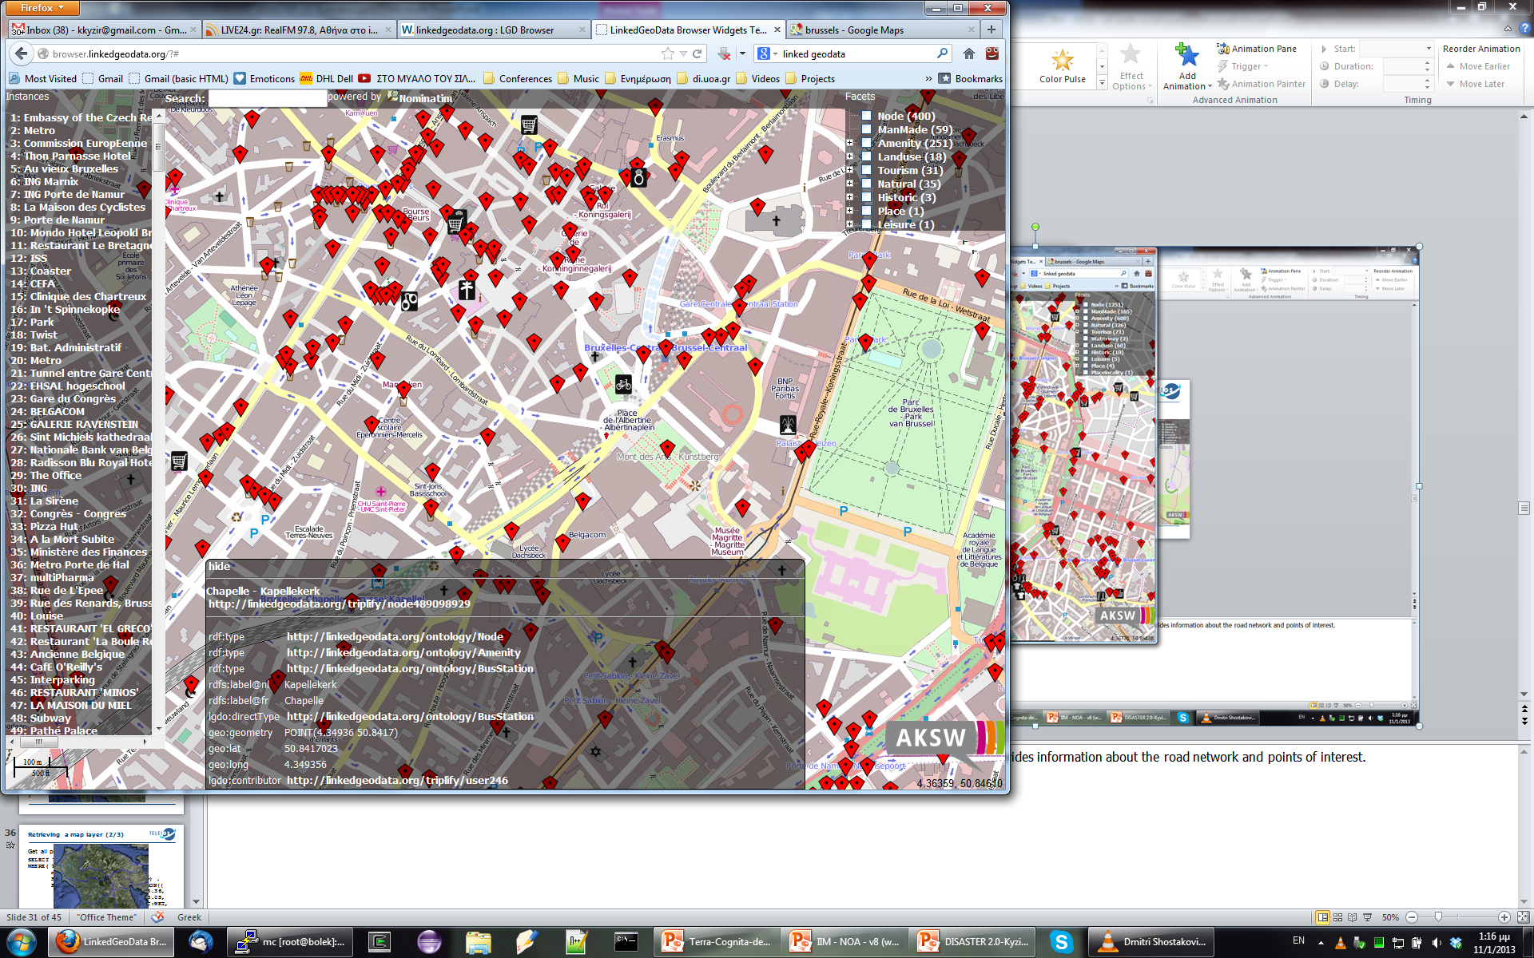
Open Street Map (OSM)

Slide 12


Sextant
A web-based tool for
browsing and exploring linked geospatial data
creating thematic maps produced by querying the spatial and temporal dimensions of linked data and other geospatial data sources in OGC standard file formats (e.g., KML)
sharing and collaborative editing of thematic maps
Open Source
Find more at:
http://sextant.di.uoa.gr/
Interoperable with well-known GIS tools (e.g., ArcGIS, QGIS, Google Earth)

Slide 13
Improving the knowledge discovery process of DLR using Sextant
feature
extraction
tiling
0 1 5 ... 64 3 17
-4 13 59 ... 4 7 0
1 1 25 ... 0 -4 19
3 21 6 ... 55 1 8
22 99 5 ... 9 4 0
TerraSAR-X
image
patches
relevance
feedback
classification
class1
class2
class3
...
SVM
classifier
semantic
labels
semantic
classes

Slide 14
Improving the knowledge discovery process of DLR using Sextant
feature
extraction
tiling
0 1 5 ... 64 3 17
-4 13 59 ... 4 7 0
1 1 25 ... 0 -4 19
3 21 6 ... 55 1 8
22 99 5 ... 9 4 0
TerraSAR-X
image
patches
relevance
feedback
classification
class1
class2
class3
...
SVM
classifier
semantic
labels
semantic
classes

Slide 15
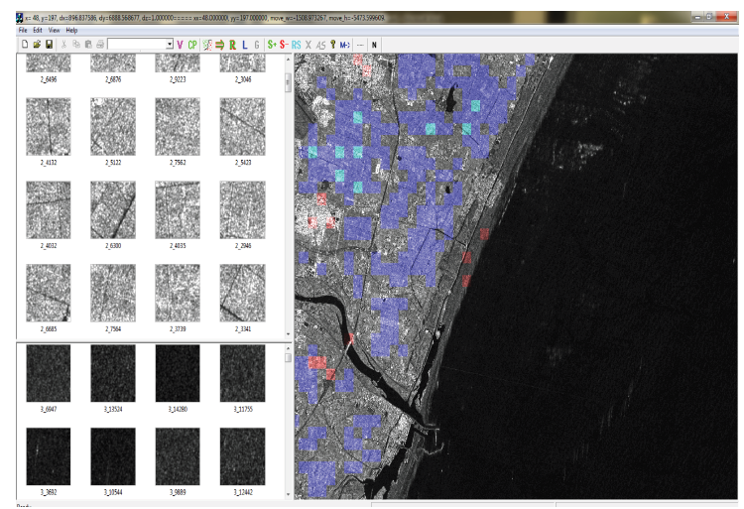
SVM–RF: a semi-automatic process
Iterative annotation of TerraSAR-X image patches using the SVM classifier with a relevance feedback module (RF)
Green patches:
positive examples
Red patches:
negative examples
Blue patches:
classified

Slide 16
SVM–RF: a semi-automatic process
Current status of SVM-RF
Cannot discern the content of a patch
Difficult to work on radar images only
Man in the loop
Bring in auxiliary geospatial data sources
Bring in background maps (and any other WMS layer)
Automate using logical if-then rules
Improvements using Sextant

Slide 17
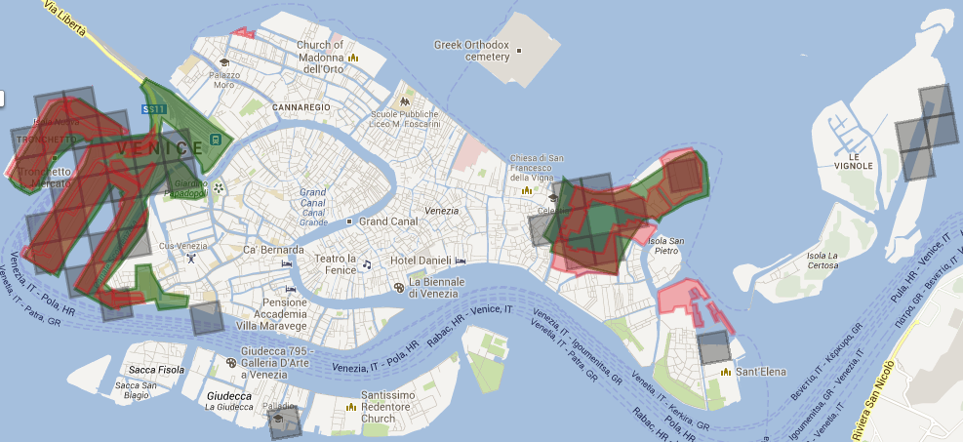
Improving the knowledge discovery process of DLR using Sextant
Validation of patch annotations corresponding to port areas
CLC
DLR
UA
http://bit.ly/sextant-venice-ports

Slide 18

Improving the knowledge discovery process of DLR using Sextant
Validation of patch annotations corresponding to port areas
negative examples for port areas
CLC
DLR
UA
http://bit.ly/sextant-venice-ports

Slide 19
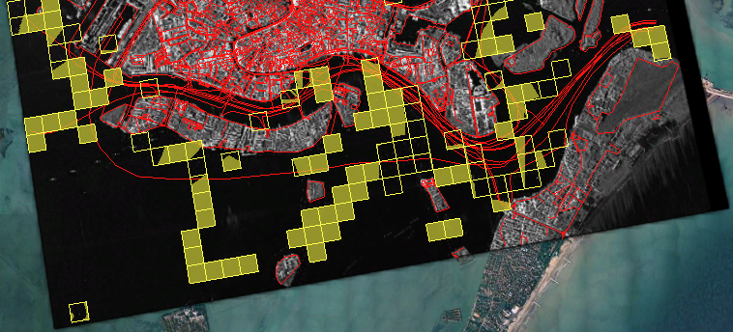
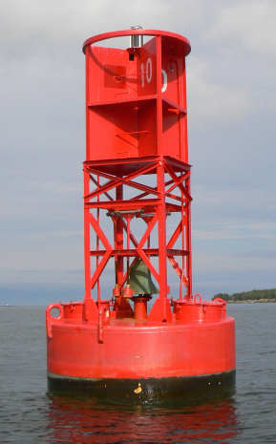
Improving the knowledge discovery process of DLR using Sextant
Validation of patch annotations corresponding to buoys
TerraSAR-X
image
road network
(OSM)
buoys
(DLR)

Slide 20
Improving the knowledge discovery process of DLR using Sextant
Validation of patch annotations corresponding to buoys
logical if-then rules
1 if patch.annotation = "buoy" AND
patch.inside(sea) AND
2 FORALL other_patch.annotation = "water_way"
3 AND ( NOT patch.near(other_patch) OR
patch.intersects(other_patch) )
4 then
5 patch.remove_annotation()
6 fi
TerraSAR-X
image
road network
(OSM)
buoys
(DLR)

Slide 21
Improving the knowledge discovery process of DLR using Sextant
Validation of patch annotations corresponding to buoys
logical if-then rules
1 if patch.annotation = "buoy" AND
patch.inside(sea) AND
2 FORALL other_patch.annotation = "water_way"
3 AND ( NOT patch.near(other_patch) OR
patch.intersects(other_patch) )
4 then
5 patch.remove_annotation()
6 fi
TerraSAR-X
image
road network
(OSM)
buoys
(DLR)

Slide 22
Improving the knowledge discovery process of DLR using Sextant
Validation of patch annotations corresponding to buoys
TerraSAR-X
image
road network
(OSM)
buoys
(DLR)

Slide 23
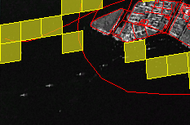
Improving the knowledge discovery process of DLR using Sextant
Validation of patch annotations corresponding to buoys
TerraSAR-X
image
road network
(OSM)
buoys
(DLR)

Slide 24
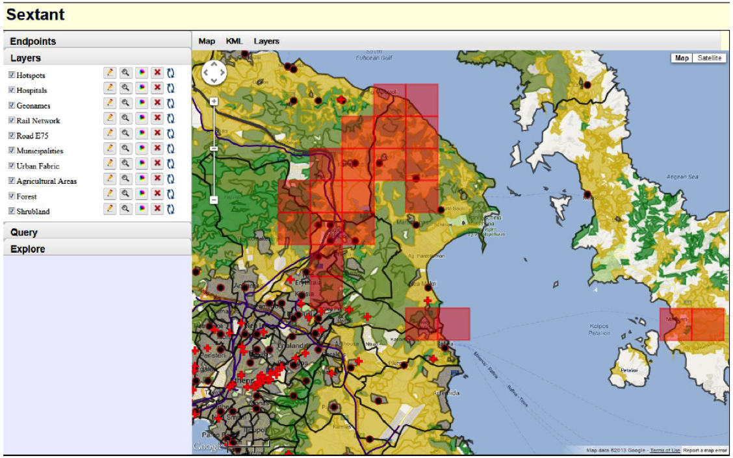



Other applications of Sextant
Rapid mapping
http://bit.ly/sextant-rapid-mapping-attica

Slide 25
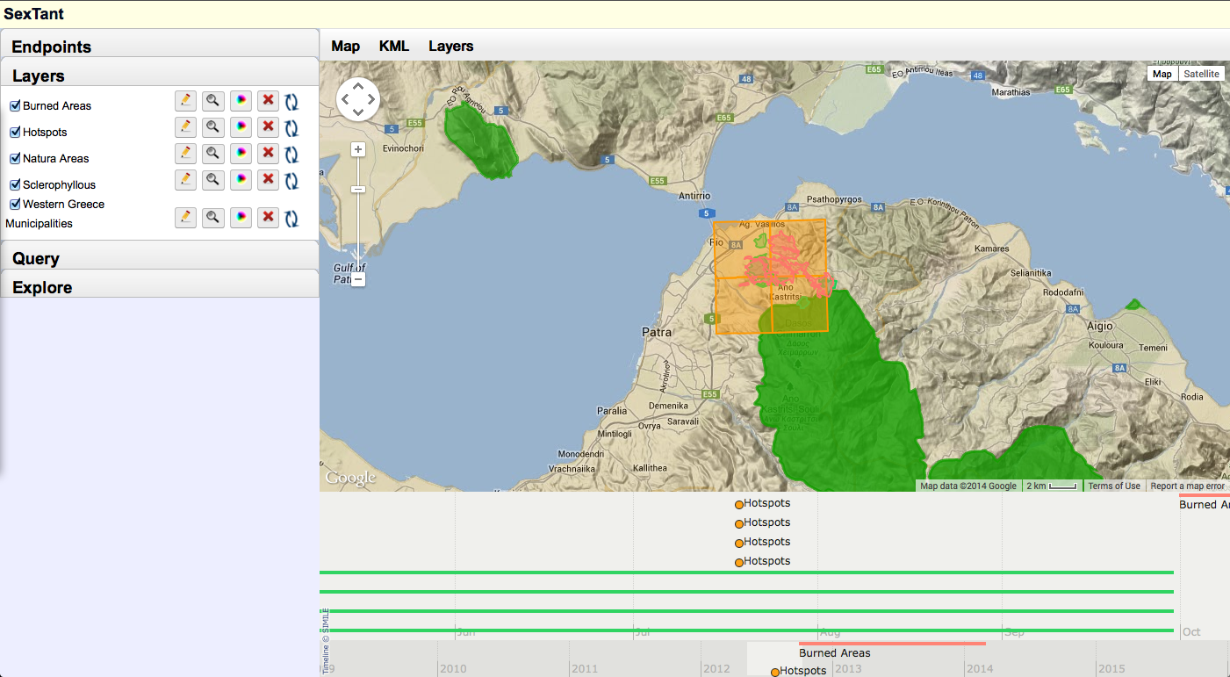
Other applications of Sextant
Evolution of land cover
http://bit.ly/sextant-land-cover-evolution

Slide 26
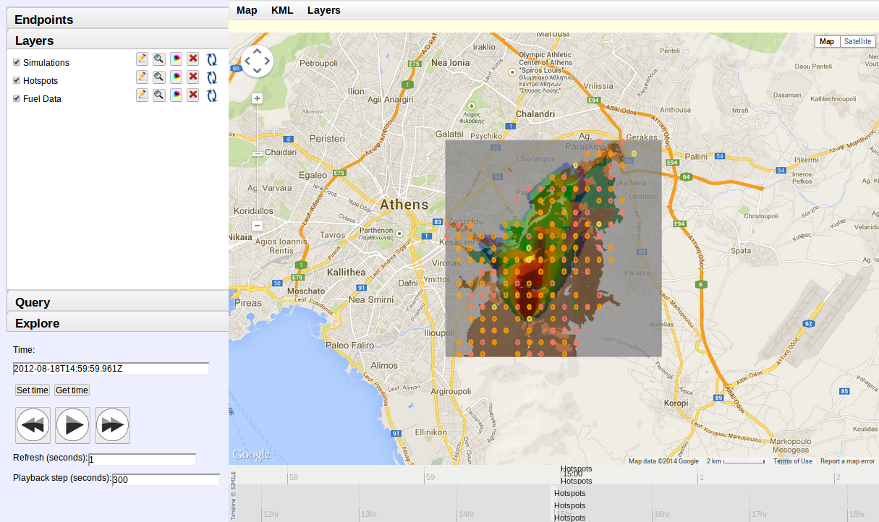
Other applications of Sextant
Monitoring of fire fronts
SWeFS
http://bit.ly/sextant-fire-front-monitor

Slide 27
Sextant is being extended
Map registry
Legend information
Production of statistical maps
Development of appropriate interfaces for mobile platforms
Query builder integration
Support of more file formats: ESRI shapefiles, JPEG JFIF, FITS, etc.
Tell us about your needs!

Slide 28
Conclusions
Knowledge discovery and semantic annotation of TerraSAR-X images in DLR
Linked open data and semantic web technologies can prove useful to (and enhance) EO products
Knowledge discovery
Environmental data
(CLC and UA)
User-contributed maps
(OSM)
The tool Sextant
✓ validation
✓ accuracy
✓ automation

Slide 29
Thank you

Slide 30
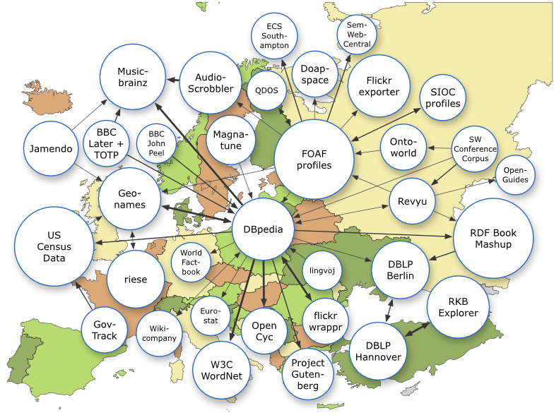
Useful links
TELEIOS project
http://earthobservatory.eu/
Linked EO data
http://datahub.io/organization/teleios
Sextant
http://sextant.di.uoa.gr/
Strabon
http://strabon.di.uoa.gr/

