Slide 1


Visualizing and Exploring Linked Spatiotemporal Data using Sextant
[ESWC2013 (best demo award)]
[ISWC2013]
Konstantina Bereta, Kallirroi Dogani, George Garbis, Manos Karpathiotakis, Kostis Kyzirakos, Charalampos Nikolaou, Manolis Koubarakis
Linked Data Europe: Tools and Applications
March 21st, 2014, Athens, Greece

Slide 2
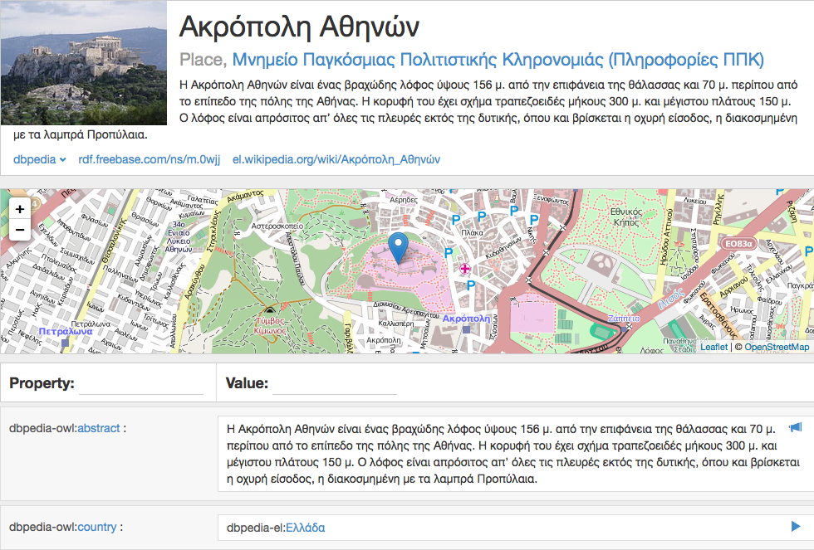

DBpedia
Available on dbpedia.org/ as linked data

Slide 3
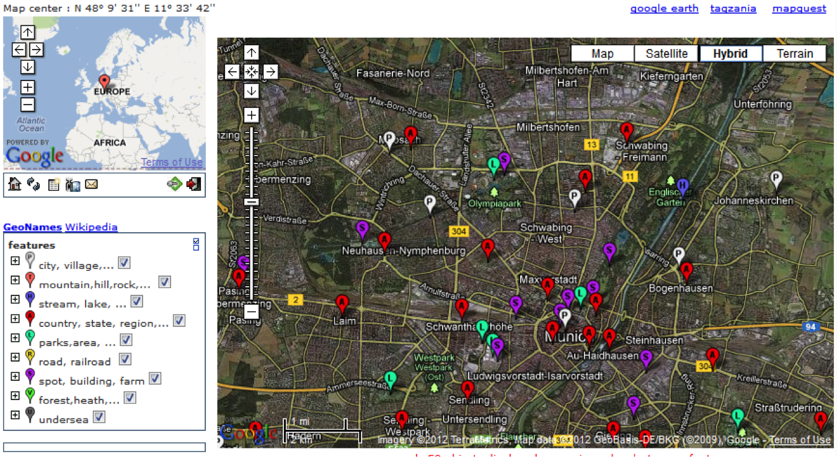

GeoNames
GeoNames
Available on as linked data

Slide 4
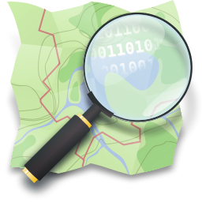
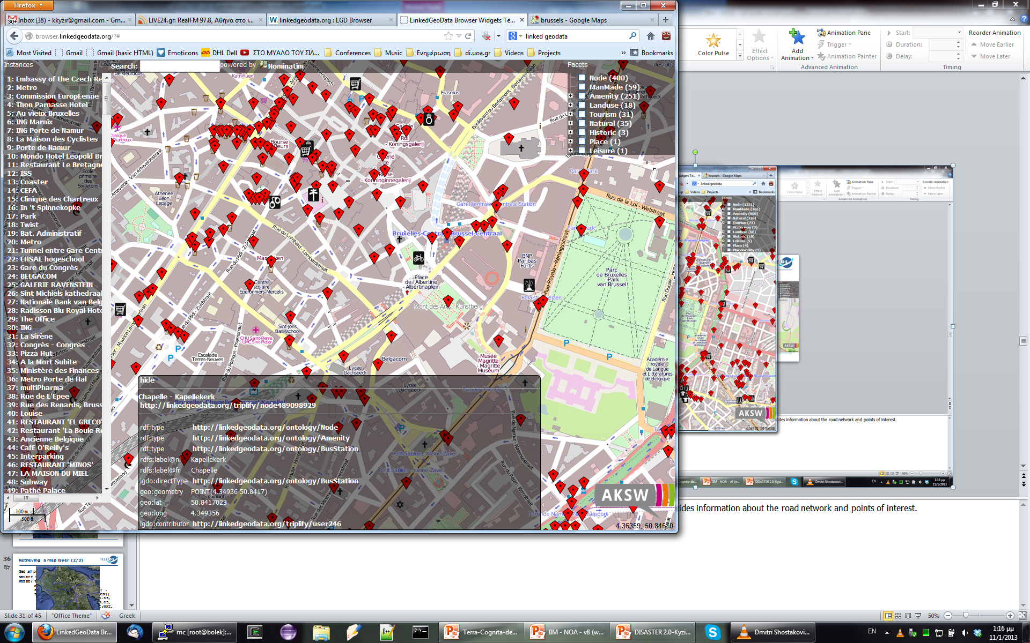

Open Street Map (OSM)
Available on as linked data

Slide 5
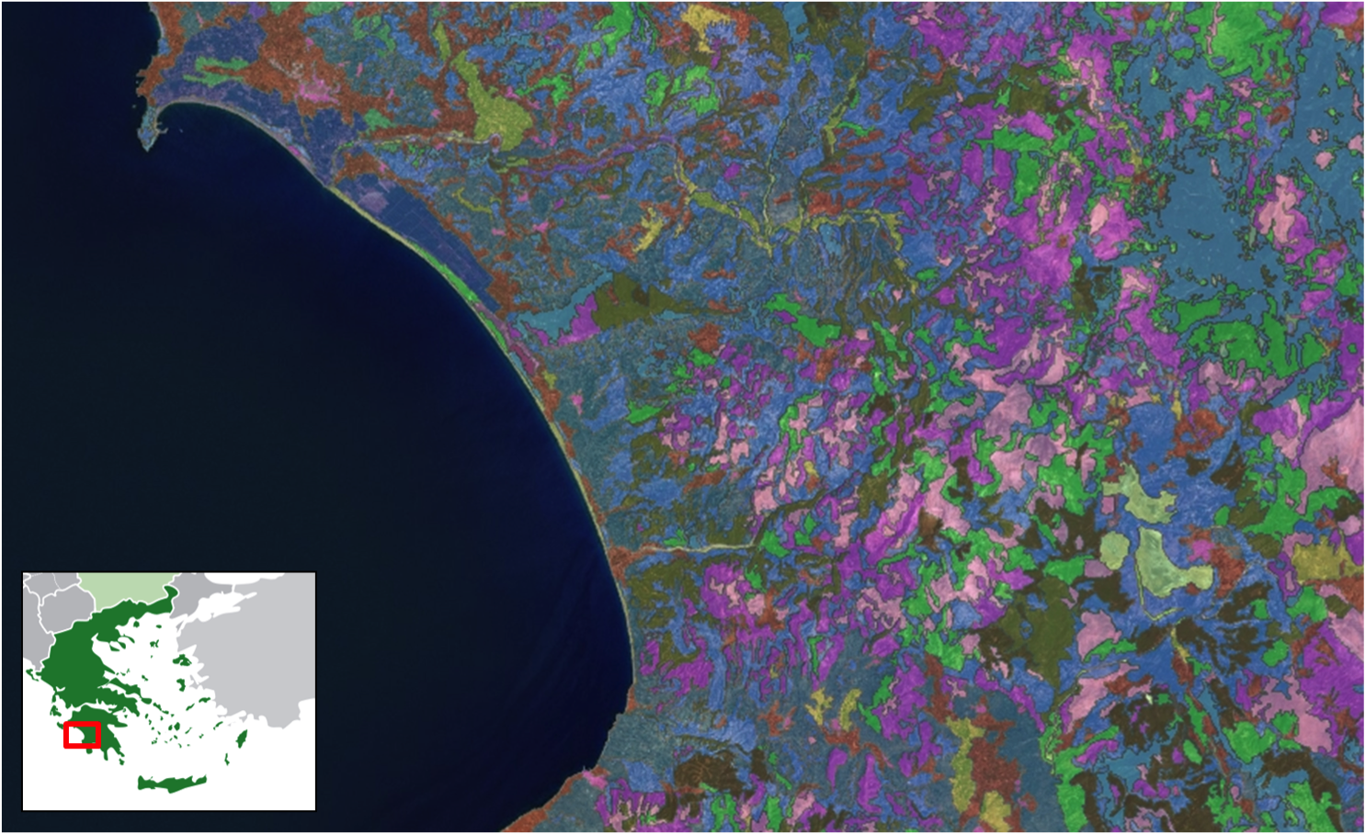


CORINE Land Cover (CLC)
Available on as linked data

Slide 6
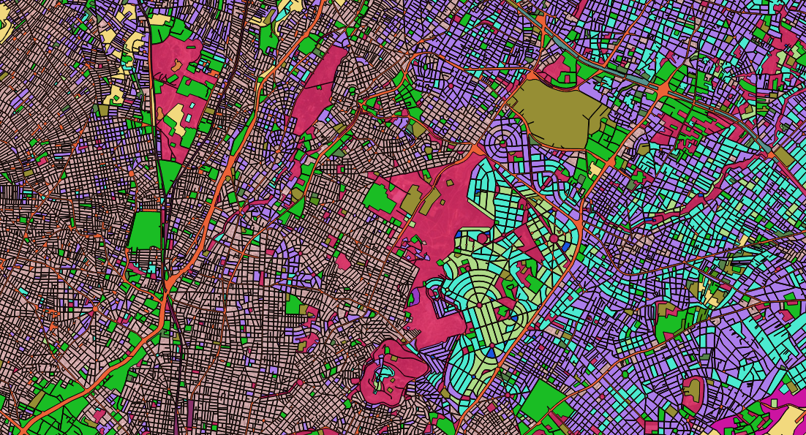
Urban Atlas (UA)
Available on as linked data

Slide 7

European Nomenclature of Territorial Units for Statistics (NUTS)
Available on GeoVocab.org as linked data

Slide 8
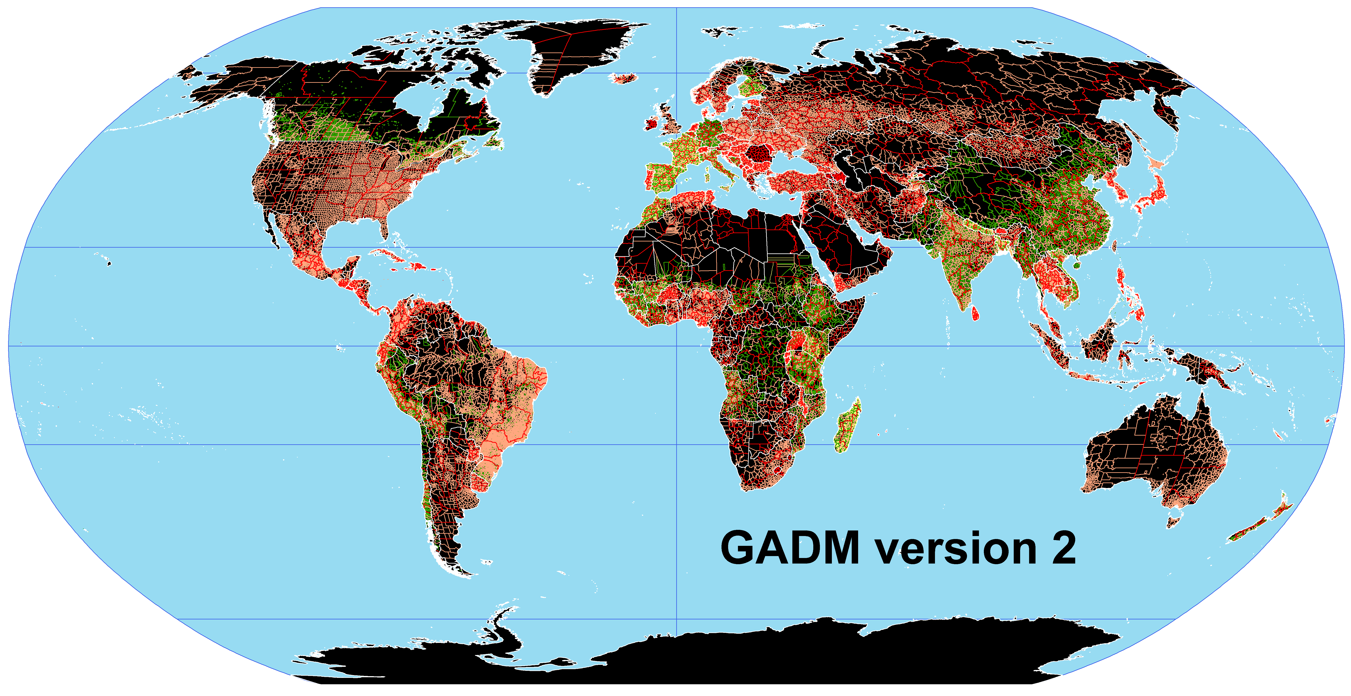
Global Administrative Areas (GADM)
Available on GeoVocab.org as linked data

Slide 9
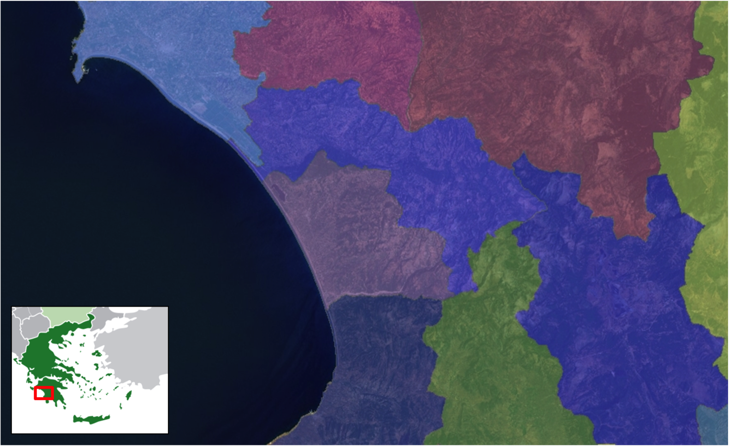
Greek administrative geography (GAG)
Available on linkedopendata.gr as linked data

Slide 10

Where is the temporal dimension?

Slide 11
Time is everywhere
Sensor data (e.g., wind direction)
Earth observation data (e.g., satellite acquisitions, EO standard products)
Simulations of events (e.g., fire spread, oil spill spread)
Evolution (e.g., land cover)
Marine surveillance
Census data (periodically)

Slide 12


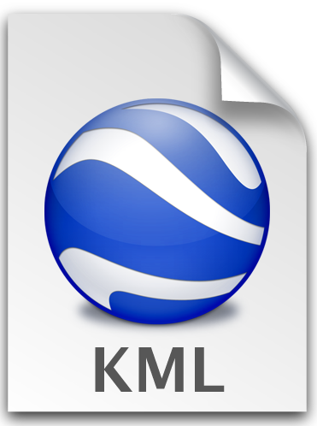


The tool Sextant
Sextant is a web-based tool for:
visualizing and exploring linked spatiotemporal data
creating thematic maps by
  by querying linked spatiotemporal data
  geospatial data sources in OGC standard file formats (e.g., KML)
sharing and collaborative editing of thematic maps
Open Source
SPARQL
stSPARQL
GeoSPARQL
Find more at:
http://sextant.di.uoa.gr/
Interoperable with well-known GIS tools
(e.g., ArcGIS, QGIS, Google Earth)

Slide 13
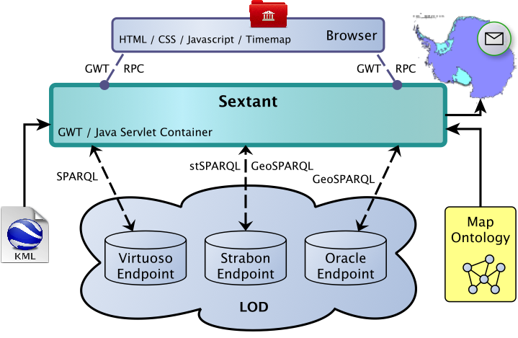
The architecture of Sextant

Slide 14
Map ontology

Slide 15
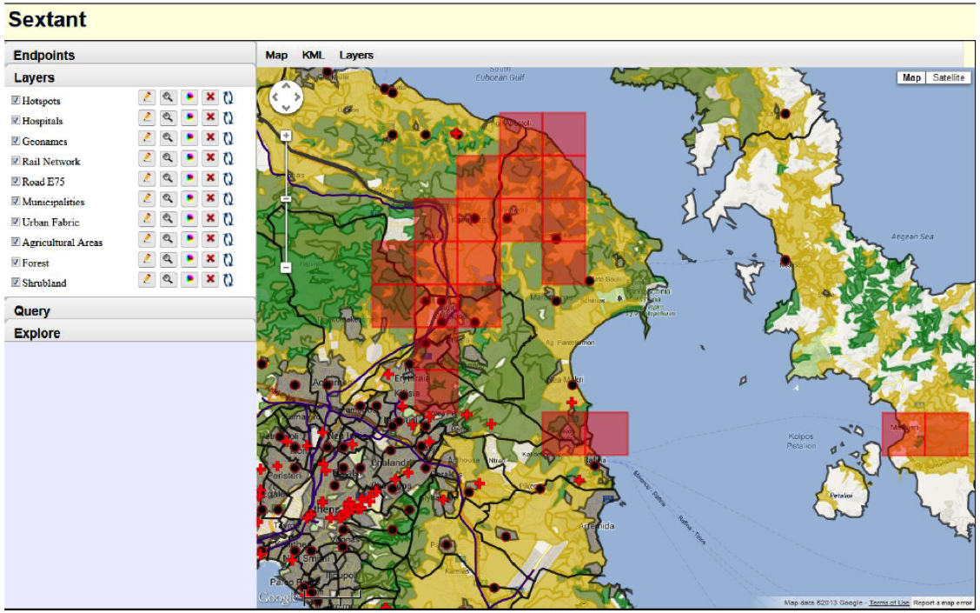



Sextant in real-world applications
Rapid mapping
http://bit.ly/sextant-rapid-mapping-attica

Slide 16
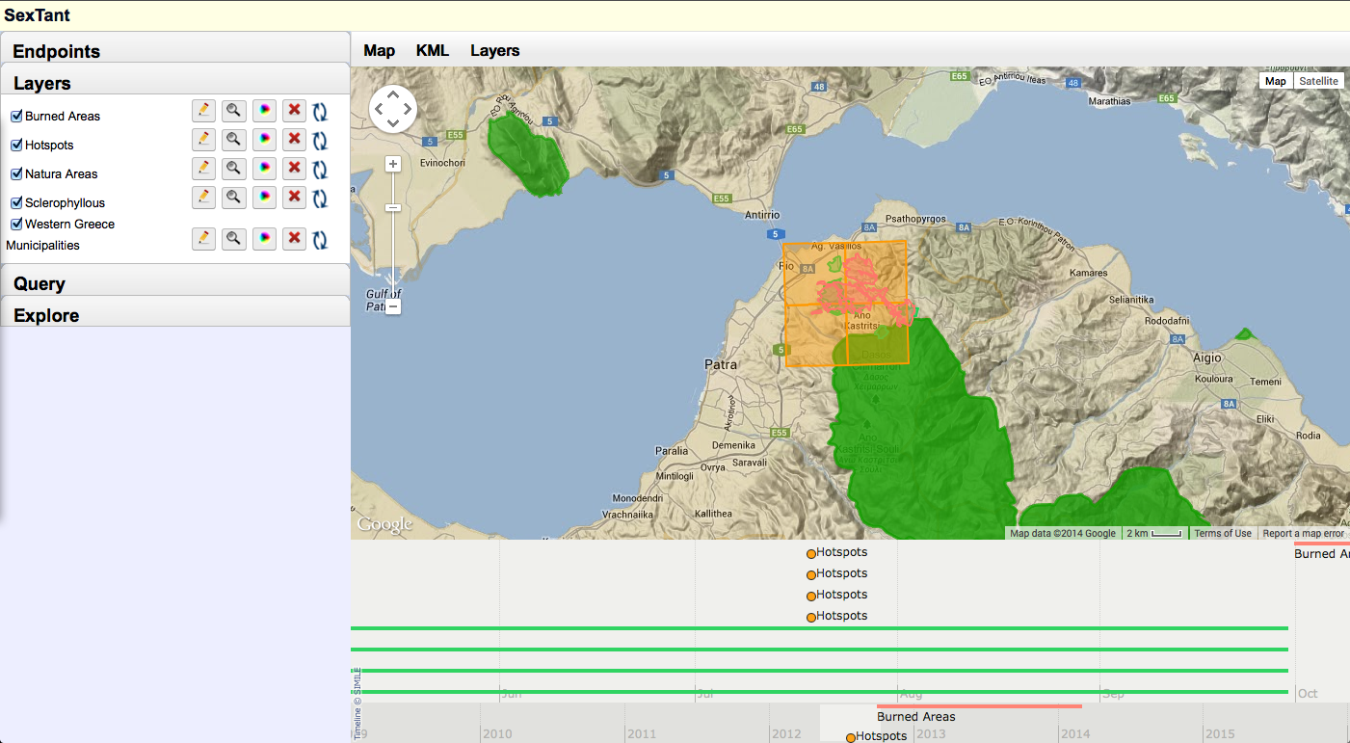
Sextant in real-world applications
Evolution of land cover
http://bit.ly/sextant-land-cover-evolution

Slide 17
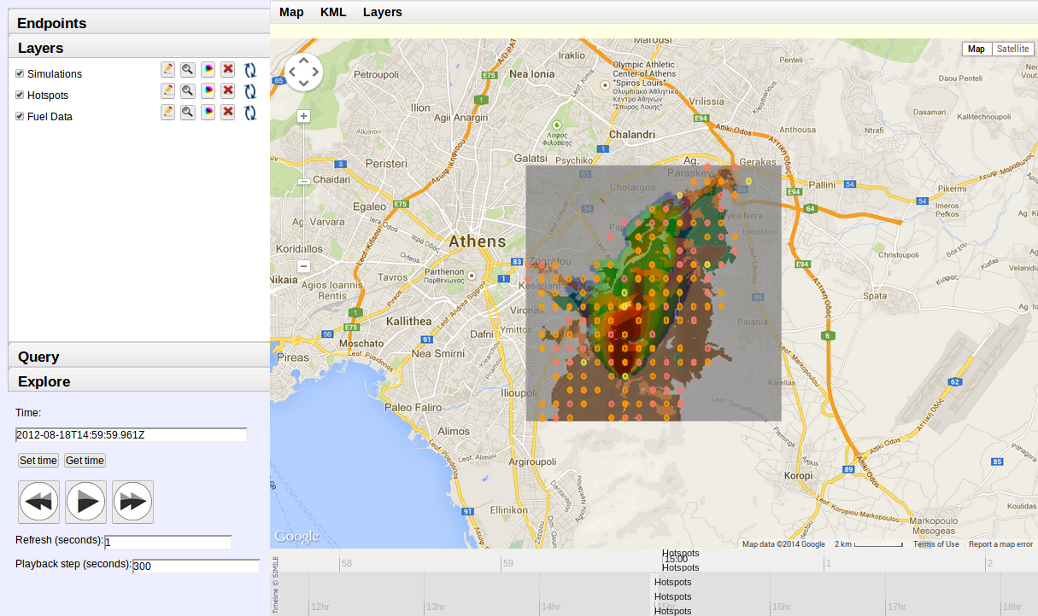
Sextant in real-world applications
Simulation of fire spread
http://bit.ly/sextant-fire-front-monitor
SWeFS

Slide 18

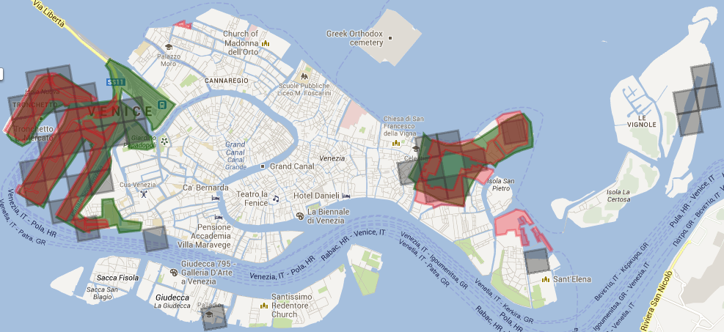

Sextant in real-world applications
Semantic annotation of Earth Observation images
negative examples for port areas
CLC
DLR
UA
http://bit.ly/sextant-venice-ports

Slide 19
Sextant is being extended
Map registry
Legend information
Production of statistical maps
Development of appropriate interfaces for mobile platforms
Query builder integration
Support of more file formats: ESRI shapefiles, JPEG JFIF, FITS, etc.
Tell us about your needs!

Slide 20
Thanks

Slide 21
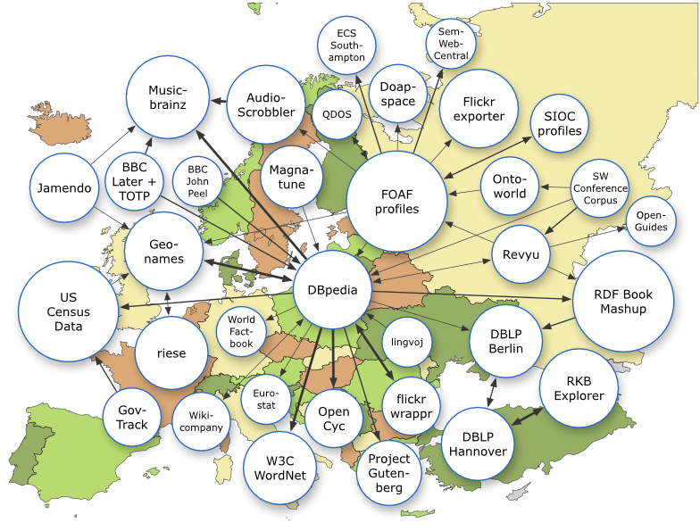

Useful links
Sextant
http://sextant.di.uoa.gr/
Strabon
http://strabon.di.uoa.gr/
LEO project
http://linkedeodata.eu/
TELEIOS project
http://earthobservatory.eu/
Linked EO data
http://datahub.io/organization/teleios

