Slide 1
Software Installation

Slide 2
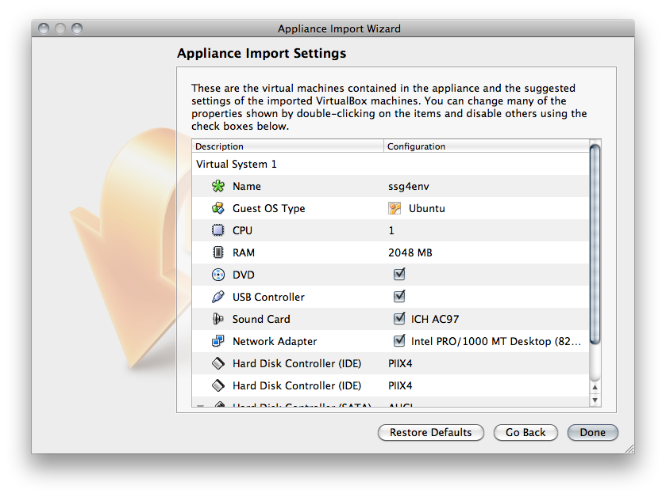
Import Image
Startup Virtual Box
File -> Import Appliance
Choose image: ssg4env.ova
Uncheck USB Controller
Select Done
Image will import
~10 minutes

Slide 3
Start Virtual Machine
Select image
Click on Start

Slide 4
Login
Select User
Password: user

