Slide 1
Semantic Sensor Web Components
ESWC 2011 Tutorial
29 May 2011

Slide 2
Presentation Goals
To provide an overview of a semantic sensor web architecture.
To describe how the different components interact.
To illustrate how the architecture supports application functionality with reference to a flood response planning application demonstrator.

Slide 3
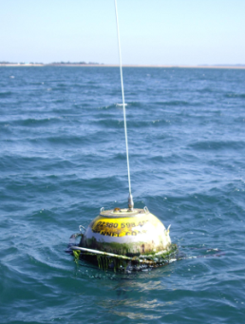
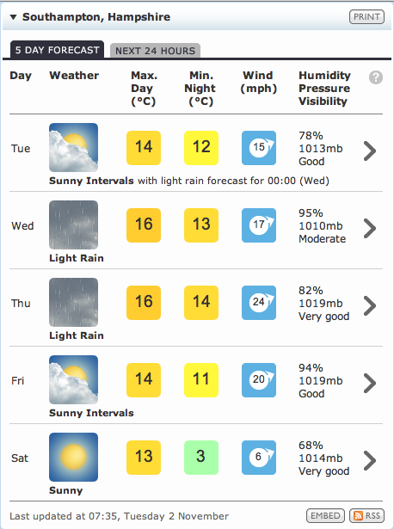
Flood Detection and Response
“Detect overtopping events in the Solent region”
sea-level > sea-defence
Sea-level: sensors
Defence heights: databases
“Provide contextual information”
Web feeds
Other sources: maps, models
Real-time
sensor data
Wave,
Wind,
Tide
Flood defences data (database)
Meteorological forecasts
Other sources:
Maps, models, …
Notes:
Overtopping: a wave or tide exceeds the height of the sea defence
Sensor data provides current sea-state conditions
National Flood and Coastal Defences Database (NFCDD) provides height of sea walls, etc
Contextual Data
Weather feed provides predicted wind speed and direction,
contextual streaming data
Maps -> contextual visual data
Report data in a form understandable to the user, ontology

Slide 4
Sensor Web Requirements
“Provide flood risk details of overtopping events in the Solent region with high wind speed observations”
“Provide flood risk details of overtopping events in the Solent region with high wind speed observations”
“Provide flood risk details of overtopping events in the Solent region with high wind speed observations”
“Provide flood risk details of overtopping events in the Solent region with high wind speed observations”
“Provide flood risk details of overtopping events in the Solent region with high wind speed observations”
“Provide flood risk details of overtopping events in the Solent region with high wind speed observations”
Accurate characterisation of conditions that define an event
Correlation of data of differing modalities
Integrating data from heterogeneous data models
Discovery of relevant data sources
Presentation and control of information
Notes:
R1: Describe data of interest, system discovers where data is located and how to connect it
R2: Identifying overtopping events requires streaming and stored data
R3: Autonomous, pre-existing data sources with own views/expression of data
R4: Identify sources on spatiotemporal and thematic content
R5: GUI and mashups -> evolving needs through a flooding event

Slide 5
SemSorWeb Architecture
Applications
Application
Services
Application Tier
Semantic Registry
Semantic Integrator
Middleware Tier
Data Source
Data Tier
Connectivity Bridge
Concrete Resource
Notes:
Following points remain true:
Any service can call any other service!
Any service can be called by an application
Middleware adds value by using Semantics

Slide 6
Features of the Architecture
Interfaces define types and operations:
Examples: Service, Registration, Discovery, Query, Integration, Subscription, Notification.
Services expose subsets of the interfaces.
Streaming Data Service:
Service, Query, Data Access, Subscription, Subscription Manager.
Services consume subsets of the interfaces:
Streaming Data Service:
Notification.
Service implementations make the rubber hit the road:
Streaming data services that expose sensor data or that expose query results.
Stored data services that expose sensor data archives

Slide 7
Ontology Network: Reconcile Terminology
Upper
DOLCE UltraLite
SWEET
SSG4Env
infrastructure
SSN
Service
Schema
External
FOAF
Ordnance Survey
Flood domain
Role
Coastal Defences
Additional Regions
Notes:
Provides common terminology
Reuse of standard ontologies: SSN, DOLCE, SWEET, FOAF, Ordnance Survey
Bottom tier domain specific

Slide 8
Flood Application Deployment
Flood Web application
Application
Services
Application Tier
Semantic Registry
Semantic Integrator
Middleware Tier
DQP-WS
Data Tier
OGC WMS
OGC WFS
WaveNet
CCO-WS
CCO-StoredData
Connectivity Bridge
Connectivity Bridge
Connectivity Bridge
WaveNet sensor network
CCO sensor network
External
Internal
Notes:
Diagram showing actual data calls, not potential calls.
OGC WMS and OGC WFS are dashed since they represent multiple actual services conforming to that type.
OGC WMS – Web Mapping Service – returns geo-referenced map image
ODC WFS – Generic Feature Interface – getGapabilities,getFeature
Lines in green represent registration of sources in the registry.

Slide 9
User Login: Locate Relevant Data
User logs in selecting:
Role
Region
Task
These values are used to parameterise the registry lookups that look for suitable data sources for use in future screens.
Notes:
Selecting role, region, and data type affects what data is retrieved from the registry

Slide 10
Architecture Interaction: Locate Relevant Data
Web Application
Application Services
Registry
GET http://…/qp?query=xxx&resource=yyy&format=zzz
Query describes data need:
Region
Role
Task
SPARQLExecute(registry, query)
SPARQLResultSet
JSON array
For external sources, the result from the registry lookup is a collection of endpoint references (EPRs) for OGC Web Map Services

Slide 11
Initial User View Showing Internal and External Data
Display details of main roads.
Initial area displayed is region from login screen.
Notes:
Story: This is the screen that the user sees after logging in. The user selects which layers to display, e.g. main roads. The roads data comes from a OGC Web Map -Service which returns data in GML.

Slide 12
Architecture Interaction: Display External Data
Layers containing external data can be obtained from the OGC Web Mapping Services, the EPRs of which were obtained from the registry.
Display road layer.
Web Application
OGC WMS
GET http://www.channelcoast.org/services/spatial/wms?LAYERS=uk%2Cuk_roads%2Curban_areas&SERVICE=WMS&VERSION=1.1.1&REQUEST=GetMap&STYLES=&EXCEPTIONS=application%2Fvnd.ogc.se_inimage&FORMAT=image%2Fjpeg&SRS=EPSG%3A27700&BBOX=298559.5703125,36513.671875,603979.4921875,210830.078125&WIDTH=625&HEIGHT=357
GML
For required region.
Notes:
OGC WMS = Web Map Service

Slide 13
User View: Wave Height Sensed Data
Selecting sensed data shows most recent value.
Notes:
Story: User has selected to display continuous sensor data readings

Slide 14
Integrating Data: Overtopping Detection
Web Application
Application Services
Integrator
DQP
CCO-WS
CCO-Stored
GET http://…/geojson?interval=xxx&resource=yyy&query=zzz
SPARQLExecuteFactory(integrator, query)
GenericQueryFactory(snee, pull, query)
EPR
EPR
SQLExecute(cco, query)
URL
WebRowSet
GET URL
GetStreamItem(cco:<stream>, <pos>)
GetStreamItem(int:<stream>, <pos>)
WebRowSet
JSON
SPARQLResultSet
GetStreamItem(snee:pull:<stream>, <pos>)
WebRowSet
GetStreamItem(cco:<stream>, <pos>)
WebRowSet
GetStreamItem(snee:pull:<stream>, <pos>)
WebRowSet
GET URL
GetStreamItem(int:<stream>, <pos>)
GetStreamItem(cco:<stream>, <pos>)
JSON
SPARQLResultSet
WebRowSet
Notes:
Web application forces Application Services to set up a query to the Integrator.
Integrator returns an endpoint reference to the resource for retrieving answers.
Application Services returns a URL from which the latest values can be retrieved
Application periodically polls Application Services using the URL for new data which is returned as a JSON array
When the integrator receives the SPARQLExecuteFactory call it initiates a query call to the SNEE-WS, for the example query shown this integrated data from the streaming and stored sources. Periodically the integrator makes request for data items from the last item seen.
When SNEE-WS receives the GenericQueryFactory call, it makes a suitable query call to the stored data service to retrieve the “static data”. It also starts pulling the relevant streams from the CCO-WS. The GetStreamItem calls from SNEE-WS to CCO-WS are done on a per relevant stream basis and periodically repeated based on the rate of the specific data stream. The SQLExecute call is repeated, probably once a day.
The integrator periodically pulls data from the SNEE-WS.
Finally, the Web application periodically makes calls to the Application Services using the URL provided in the initial interaction which then pulls the data from the integrator resource.
Note, the periodicity of the polling calls Integrator->SNEE-WS and SNEE-WS->CCO-WS are not determined by responses to service calls. Data is cached at the various intermediary services to make it more instantly available.

Slide 15
Questions?

