Slide 1
Building Semantic Sensor Webs and Applications Querying Streaming Data through Ontologies
Jean-Paul Calbimonte
Universidad Politécnica de Madrid
ESWC Tutorial
Heraklion, 29 May 2011

Slide 2
Outline
Introduction
Sensor Streaming Data
Ontology-based data access
Mapping streams to RDF
SPARQL-Stream queries
Semantic Integrator
Hands-on

Slide 3
Streaming Data Access
Sensor Data Streams
Continuously appended data
Potentially infinite
Time-stamped tuples
Continuous queries
Changes of values over time
Latest used in queries
Integration issues
Heterogeneous source
Knowledge about schemas and content
Interoperability, Interpretation
Reuse and discovery

Slide 4
Motivation
Expose sensor data as observations in terms of an Ontology
Achieve logical transparency in access to data.
Hide to the user where and how data are stored.
Present to the user a conceptual view of the data.
Use a semantically rich formalism for the conceptual view.
Need to provide solution for:
Establish mappings between ontological models and streaming data source schemas
Access streaming data sources through queries over ontology models

Slide 5
Ontology-based Streaming Data Access
Query
Translation
SPARQL_{Sream} algebra(S₁ S₂ S_{m})
Sensor Network (S₁)
SPARQL_{Stream} (O₁ O₂ O_{n})
q’
Distributed Query Processing
Relational DB (S₂)
Client
Stream-to-Ontology
mappings
Stream Engine (S₃)
RDF Store (S_{m})
Data
Translation
triples
tuples
Ontology-based Streaming Data Access Service

Slide 6
SPARQL_{Stream}
Example:
“provide me with the wind speed observations over the last minute in the Solent Region ”
...
...
( <s_{i-1},p_{i-1}, o_{i-1}>, t_{i-1} ),
( <s_{i}, p_{i}, o_{i}>, t_{i} ),
( <s_{i+1},p_{i+1}, o_{i+1}>, t_{i+1} ),
...
...
RDF-Stream
STREAM <http://www.semsorgrid4env.eu/ccometeo.srdf>
cd:Observation
...
...
( <ssg4e:Obs1,rdf:type, cd:Observation>, t_{i} ),
( <ssg4e:Obs1,cd:observationResult,”34.5”>, t_{i} ),
( <ssg4e:Obs2,rdf:type, cd:Observation>, t_{i+1} ),
( <ssg4e:Obs2,cd:observationResult,”20.3”>, t_{i+1} ),
...
...
cd:observationResult
xsd:double

Slide 7
SPARQL_{Stream}
Example:
“provide me with the wind speed observations over the last minute in the Solent Region ”
PREFIX cd: <http://www.semsorgrid4env.eu/ontologies/CoastalDefences.owl#>
PREFIX sb: <http://www.w3.org/2009/SSN-XG/Ontologies/SensorBasis.owl#>
PREFIX rdf: <http://www.w3.org/1999/02/22-rdf-syntax-ns#>
SELECT ?waveheight ?wavets
FROM NAMED STREAM <http://www.semsorgrid4env.eu/waves.srdf>
[ NOW – 1 MINUTE TO NOW – 0 MINUTES ]
WHERE
{
?WaveObs a cd:Observation;
cd:observationResult ?waveheight;
cd:observationResultTime ?wavets;
cd:observedProperty ?waveProperty;
cd:featureOfInterest ?waveFeature.
?waveFeature a cd:Feature;
cd:locatedInRegion cd:SouthEastEnglandCCO.
?waveProperty a cd:WaveHeight.
}
cd:Observation
cd:observationResult
cd:observedProperty
xsd:double
cd:Property
cd:featureOfInterest
cd:Feature
cd:locatedInRegion
cd:Region

Slide 8
R2RML
W3C RDB2RDF working group
Standardize RDB2RDF mappings
:BoscombeWaveHeight a rr:TriplesMapClass;
rr:tableName "envdata_boscombe";
rr:subjectMap [ rr:template
"http://semsorgrid4env.eu/ns#WaveHeight/CCO/{DateTime}";
rr:class ssn:ObservationValue; rr:graph ssg:waves.srdf ];
rr:predicateObjectMap [ rr:predicateMap [ rr:predicate ssn:hasQuantityValue ];
rr:objectMap[ rr:column "Hs" ] ]; .
<http://semsorgrid4env.eu/ns#/WaveHeight/CCO/2011-05-20:20:00 >
a ssn:ObservationValue
<http://semsorgrid4env.eu/ns#/WaveHeight/CCO/2011-05-20:20:00 >
ssn:hasQuantityValue " 4.5"

Slide 9
Query Translation
Queries:
SELECT ?y
WHERE
{ ?x a cd:Observation;
cd:observationResult ?y. }
SELECT ?y
FROM STREAM < STREAM <http://www.semsorgrid4env.eu/waves.srdf>
[ NOW – 1 MINUTE TO NOW MINUTES ] >
WHERE
{ ?x a cd:Observation;
cd:observationResult ?y. }
Notes:
q(x)\leftarrow Observation(x) \wedge observationResult(x,y)\\
q(\vec{x})\leftarrow \phi(\vec{x},\vec{y}))
\mathit{\Psi \leadsto \Phi}

Slide 10
Query Translation
Mappings:
query
algebra expression over sources
cd:Observation
envdata_milford
cd:observationResult
Datetime: long
Hs : float
Lon: float
Lat: float
xsd:double
Datetime
Hs
envdata_milford
Notes:
(Observation(x) \wedge \\observationResult(x,y))[t_i,t_f,\delta]\\

Slide 11
Query Translation
envdata_boscombe
Datetime: long
Hs : float
Lon: float
Lat: float
U
cd:Observation
envdata_milford
Datetime: long
Hs : float
Lon: float
Lat: float
cd:observationResult
DateTime
Hs
U
xsd:double
envdata_hornsea
Datetime: long
Hs : float
Lon: float
Lat: float
U
envdata_westbay
Datetime: long
Hs : float
Lon: float
Lat: float
DateTime
Hs
DateTime
Hs
DateTime
Hs
DateTime
Hs
envdata
_boscombe
envdata
_milford
envdata
_hornsea
envdata
_westbay

Slide 12
Query Translation
v
envdata_westbay
envdata_chesil
Feature
v
v
locatedInRegion
envdata_milford
Observation
v
R2R
Mapping
hasObservationResult
Streams
envdata_hornsea
Ontologies
envdata_boscombe
observedProperty
Region
Timestamp: long
Hs : float
Lon: float
Lat: float
xsd:float
WaveHeightProperty
PREFIX cd: <http://www.semsorgrid4env.eu/ontologies/CoastalDefences.owl#>
PREFIX sb: <http://www.w3.org/2009/SSN-XG/Ontologies/SensorBasis.owl#>
PREFIX rdf: <http://www.w3.org/1999/02/22-rdf-syntax-ns#>
SELECT ?waveheight ?wavets
FROM NAMED STREAM <http://www.semsorgrid4env/waves.srdf>
WHERE
{
?WaveObs a cd:Observation;
cd:observationResult ?waveheight;
cd:observationResultTime ?wavets;
cd:observedProperty ?waveProperty;
cd:featureOfInterest ?waveFeature.
?waveFeature a cd:Feature;
cd:locatedInRegion cd:SouthEastEnglandCCO.
?waveProperty a cd:WaveHeight.
}
(SELECT timestamp,Hs FROM envdata_boscombe) UNION
(SELECT timestamp,Hs FROM envdata_hornsea) UNION
(SELECT timestamp,Hs FROM envdata_milford) UNION
(SELECT timestamp,Hs FROM envdata_chesil) UNION
(SELECT timestamp,Hs FROM envdata_perranporth) UNION
(SELECT timestamp,Hs FROM envdata_westbay) UNION
(SELECT timestamp,Hs FROM envdata_pevenseybay)
SPARQL_{STR}
SNEEql

Slide 13
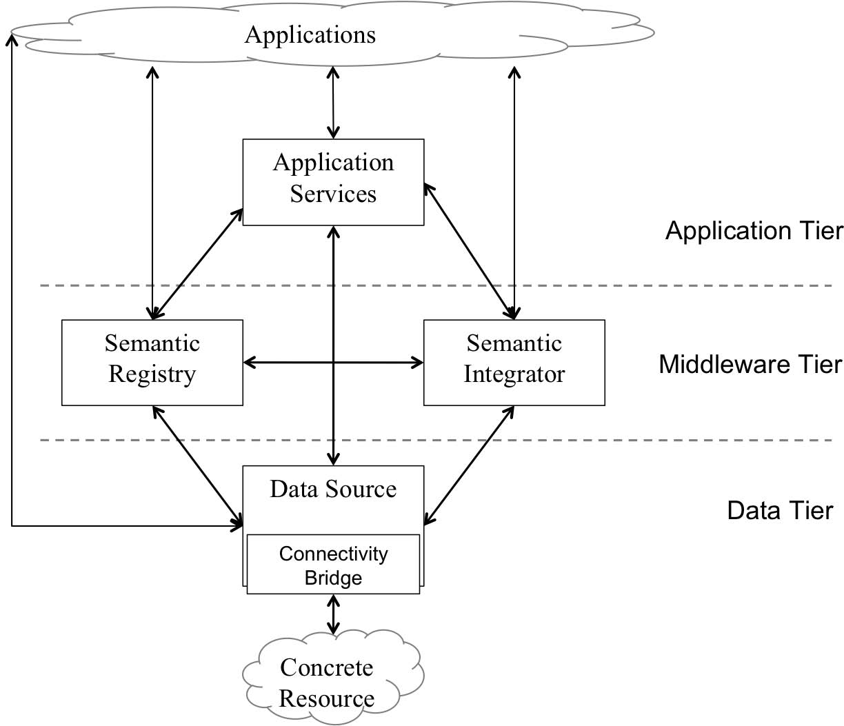
Semantic Integrator in SemSorGrid4Env
13

Slide 14
Semantic Integrator IQS
R2R
mappings
repository
Integration
Query Service
IQS
IntegrationInterface
Translator
Client
SNEE-WS
CCO-WS
QueryInterface
PullInterface
IntegrateAs (DataResourceAddressList, R2R document)
addSource
DataResourceAddress
SPARQLQueryFactory (DataResourceName, SPARQL_{Sream} )
addQuery
(SNEEql)
DataResourceAddress
repeat
GetStreamNewestItem(DataResourceName )
getResultSet
DataSet

Slide 15
Hands-on
Integrating and Querying streaming data through Ontologies
Use the SemSorGrid4Env Integration and Query Service (IQS)
Create an integrated resource from existing streams
Create a mapping document in R2RML
Use the IntegrateAs operation
Query the integrated resource
Write SPARQL-Stream queries over an ontology
Launch continuous queries (create a pull data resource)
Pull data periodically from a resource

Slide 16
Demo Environment
Locally installed IQS:
http://localhost:9090/iqs-ws/services
Embedded SNEE query processor
Access the service through a Java console client:
/home/developer/iqs/iqs-client
Simulated wave data sources
CCO: Channel Coast Observatory
WaveNet
Simulated through a Java tuple generator:
/home/developer/iqs/demo-client

Slide 17
Demo Environment
IQS Interfaces available:
http://localhost:9090/iqs-ws/services
Launch the Java console client:
>cd /home/developer/iqs/iqs-client
>java -cp target/classes:target/dependency/* eu.semsorgrid4env.service.iqs.client.IntegrationServiceClient
Connect to IQS:
-connect http://localhost:9090/iqs-ws

Slide 18
Use Case: Waves at Boscombe?
Wave data sources
CCO
WaveNet
<stream name="envdata_boscombe" type="push">
<column name="timestamp">
<type class="timestamp"/>
</column>
<column name="stream_name">
<type class ="string"/>
</column>
<column name="Hs">
<type class ="float"/>
</column>
<column name="Tsea">
<type class ="float"/>
</column>
<column name="Lat">
<type class ="float"/>
</column>
<column name="Lon">
<type class ="float"/>
</column>
</stream>

Slide 19
Creating R2RML Mappings
Simple mapping:
iqs/iqs-client/mappingSimple.ttl
:boscombeWaveObsMapping a rr:TriplesMapClass;
rr:SQLQuery "";
rr:subjectMap [
rr:template "http://semsorgrid4env.eu/ns#Obs/WaveHeight/boscombe/{timestamp}";
rr:class ssn:Observation;
rr:graph ssg:waves.srdf];
rr:tableName "envdata_boscombe";
<http://semsorgrid4env.eu/ns#Obs/WaveHeight/bosocmbe/2011-05-20:20:00 >
a ssn:Observation

Slide 20
Integrating the sources
Client
IntegrationInterface
IQS
IntegrateAs (DataResourceAddressList, R2R document)
DataResourceAddress
Integrate configuration:
iqs/iqs-client/integrate.properties
integrated.resource.name = obsResource
integrated.resource.mapping = mappingSimple.ttl
integrated.resource.list = http://webgis1.geodata.soton.ac.uk:8080/CCO/services/PullStream?wsdl,
http://webgis1.geodata.soton.ac.uk:8080/WaveNet/services/PullStream?wsdl
Integrate:
-integrate integrate.properties

Slide 21
Integrated resources
After IntegrateAs:
Virtual integrated resource created
Queryable using SPARQL
Underlying data resources mapped through R2RML
List available integrated resources:
-li
Resource Address: obsResource

Slide 22
Querying the new Resource
Client
QueryInterface
IQS
SPARQLQueryFactory (DataResourceName, SPARQL_{Stream} )
DataResourceAddress
Sample query
iqs/iqs-client/querySimple.sparql
SELECT ?obs
WHERE
{
?obs a ssn:Observation;
}
Launch continuous query
-query querySimple.sparql obsResource

Slide 23
Pulling Data
Client
PullInterface
IQS
repeat
GetStreamNewestItem(DataResourceName )
DataSet
Pulling data from the new resource
-pull obsResource1
<?xml version="1.0" encoding="UTF-8" standalone="yes"?>
<sparql xmlns="http://www.w3.org/2007/SPARQL/results#">
<head>
<variable name="obs"/>
</head>
<results>
<result>
<binding name="obs">
<uri>http://semsorgrid4env.eu/ns#Obs/WaveHeight/boscombe/1306497537858</uri>
</binding>
…..
List pull resources
-lp

Slide 24
Tuple generator
Launch the Tuple generator:
>cd /home/developer/iqs/demo-client
> java -cp target/classes:target/dependency/* es.upm.fi.dia.oeg.integrator.client.TupleGenerator

Slide 25
More on Mappings
Adding predicates to the Observation
:boscombeWaveObsMapping a rr:TriplesMapClass;
rr:SQLQuery "";
rr:subjectMap [
rr:template "http://semsorgrid4env.eu/ns#Obs/WaveHeight/boscombe/{timestamp}";
rr:class ssn:Observation; rr:graph ssg:waves.srdf];
rr:tableName "envdata_boscombe";
rr:predicateObjectMap
[rr:predicateMap [ rr:predicate ssn:observationResult ];
rr:objectMap [ rr:column "Hs" ]],
[rr:predicateMap [ rr:predicate ssn:observationResultTime ];
rr:objectMap [ rr:column "timestamp" ]],
[rr:predicateMap [ rr:predicate ssn:observedProperty ];
rr:objectMap [ rr:object cd:WaveHeight ]];
.

Slide 26
Create another Integrated resource
Integrate configuration, change resource name:
iqs/iqs-client/integrate.properties
integrated.resource.name = waveResource
integrated.resource.mapping = mappingSimple.ttl
integrated.resource.list = http://webgis1.geodata.soton.ac.uk:8080/CCO/services/PullStream?wsdl,
http://webgis1.geodata.soton.ac.uk:8080/WaveNet/services/PullStream?wsdl
Integrate:
-integrate integrate.properties

Slide 27
A more complex SPARQL query
Sample query
iqs/iqs-client/queryDemo.sparql
SELECT ?obs ?waveHeight ?wavetime
WHERE
{
?obs a ssn:Observation;
ssn:observationResult ?waveHeight;
ssn:observedProperty cd:WaveHeight;
ssn:observationResultTime ?wavetime.
FILTER (?waveHeight > 0.2)
}
Launch continuous query
-query queryDemo.sparql waveResource
Pull data
-pull waveResource1

Slide 28
Mapping other Sources, other Properties
More complex mapping:
iqs/iqs-client/demoMapping.ttl
The WaveNet Source: poolebay wave data:
:poolebayWaveObsMapping a rr:TriplesMapClass;
rr:SQLQuery "";
rr:subjectMap [ rr:template "http://semsorgrid4env.eu/ns#Obs/WaveHeight/poolebay/{timestamp}";
rr:class ssn:Observation; rr:graph ssg:waves.srdf];
rr:tableName "envdata_wavenet_poolebay";
rr:predicateObjectMap
[ rr:predicateMap [ rr:predicate ssn:observationResult ];
rr:objectMap [ rr:column "Hs" ]],
[ rr:predicateMap [ rr:predicate ssn:observationResultTime ];
rr:objectMap [ rr:column "timestamp" ]],
[ rr:predicateMap [ rr:predicate ssn:observedProperty ];
rr:objectMap [ rr:object cd:WaveHeight ]];
.

Slide 29
Integrate, Query, Pull
Integrated resource:
Can query observations from both CCO and WaveNet
Integrate:
-integrate integrate.properties
Launch continuous query
-query queryDemo.sparql newResource
Pull data
-pull newResource1

Slide 30
Mapping other Sources, other Properties
Sea temperature observations:
:boscombeTseaObsMapping a rr:TriplesMapClass;
rr:SQLQuery "";
rr:subjectMap [ rr:template "http://semsorgrid4env.eu/ns#Obs/Temperature/boscombe/{timestamp}";
rr:class ssn:Observation; rr:graph ssg:waves.srdf];
rr:tableName "envdata_boscombe";
rr:predicateObjectMap
[ rr:predicateMap [ rr:predicate ssn:observationResult ];
rr:objectMap [ rr:column "Tsea" ]],
[ rr:predicateMap [ rr:predicate ssn:observationResultTime ];
rr:objectMap [ rr:column "timestamp" ]],
[ rr:predicateMap [ rr:predicate ssn:observedProperty ];
rr:objectMap [ rr:object cd:SeaTemperature ]];
.

Slide 31
Modify the Query: Get Temperature
Sample query
SELECT ?obs ?value ?time
WHERE
{
?obs a ssn:Observation;
ssn:observationResult ?value;
ssn:observedProperty cd:SeaTemperature;
ssn:observationResultTime ?time.
FILTER (?value > 0.2)
}
Launch continuous query
-query queryDemo.sparql newResource
Pull data
-pull newResource2

Slide 32
Refining the output: RDF Observations
ssn:isProducedBy
ssn:SensorOutput
ssn:Sensor
ssn:observedBy
ssn:observationResult
ssn:hasValue
ssn:Observation
ssn:ObservationValue
ssn:observes
ssn:featureOfInterest
quantityValue
ssn:observedProperty
ssn:FeatureOfInterest
xsd:datatype
ssn:Property
ssn:hasProperty

Slide 33
Construct Queries
Sample query
CONSTRUCT
{
?obs a ssn:Observation;
ssn:observationResult [
a ssn:SensorOutput;
ssn:hasValue [ a ssn:ObservationValue;
ssg:hasQuantityValue ?waveHeight ]];
ssn:observedProperty cd:WaveHeight;
ssn:observationResultTime ?wavetime.
}
WHERE
{
?obs a ssn:Observation;
ssn:observationResult ?waveHeight;
ssn:observedProperty cd:WaveHeight;
ssn:observationResultTime ?wavetime.
FILTER (?waveHeight > 0.9)
}

Slide 34
Pull RDF Observations
Pull data
-pull newResource5
<rdf:Description rdf:about="http://semsorgrid4env.eu/ns#Obs/WaveHeight/boscomb
e/1306624735493-1916241349527545207">
<j.1:observationResultTime>1306624735493</j.1:observationResultTime>
<j.1:observedProperty rdf:resource="http://www.semsorgrid4env.eu/ontologies/
CoastalDefences.owl#WaveHeight"/>
<j.1:observationResult rdf:nodeID="A2"/>
<rdf:type rdf:resource="http://purl.oclc.org/NET/ssnx/ssn#Observation"/>
</rdf:Description>
<rdf:Description rdf:nodeID="A2">
<j.1:hasValue rdf:nodeID="A1"/>
<rdf:type rdf:resource="http://purl.oclc.org/NET/ssnx/ssn#SensorOutput"/>
</rdf:Description>
<rdf:Description rdf:nodeID="A1">
<j.0:hasQuantityValue>0.9518465</j.0:hasQuantityValue>
<rdf:type rdf:resource=http://purl.oclc.org/NET/ssnx/ssn#ObservationValue/>
</rdf:Description>

Slide 35
Ontology-based Streaming Data Querying
SPARQL interface for Sensor data
User queries over the SSN Ontology
Transparently adding new sources
User unaware of underlying source schema details
Query translation mechanism and delegation of query execution to streaming data processor
Integrated virtual sources available for higher tier applications

