Slide 1
Sensor Data and Semantic Mashups
ESWC 2011 Tutorial
29th May 2011

Slide 2
Context
Sensor Network
Applications
Middleware
Notes:
Diagram showing general flow of data, and the focus of this part of the tutorial.

Slide 3
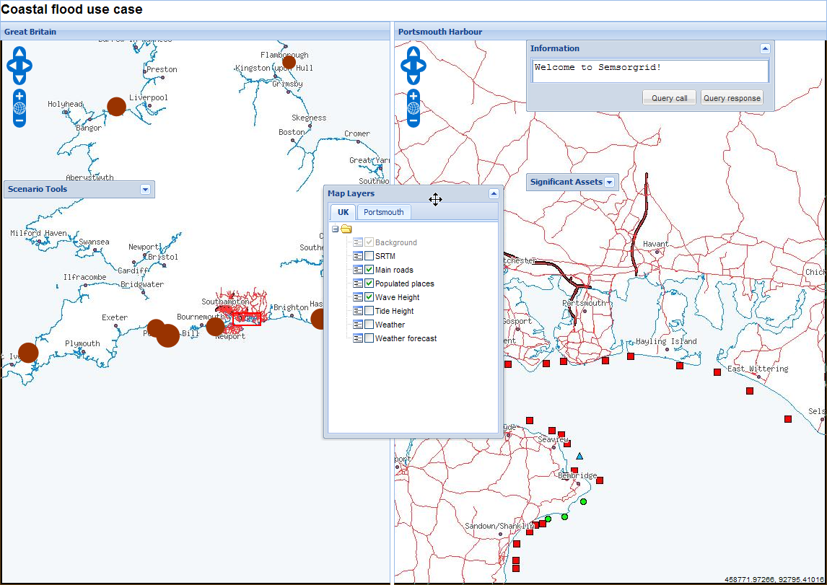
Larger, more detailed and sophisticated applications…
…are not the focus of this presentation
Notes:
Although valid and interesting, they are not what we will concentrate on here.

Slide 4
Sensor Data and Semantic Mashups
How can we incorporate sensor data in quick, easy to write, web applications and mashups?
How can we take advantage of semantic sensor networks when doing this?
How can we link to and from other useful semantic data sources?

Slide 5
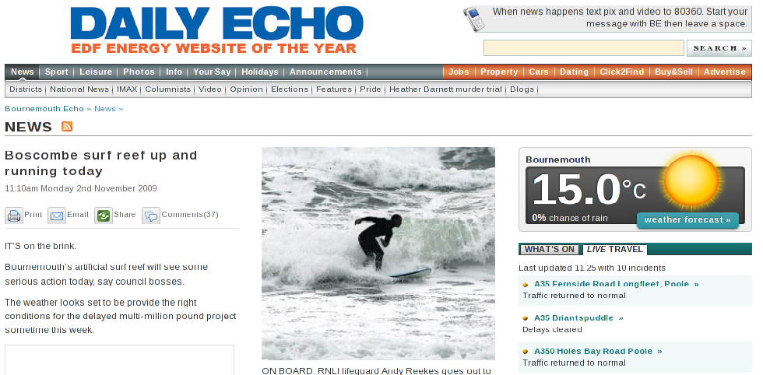
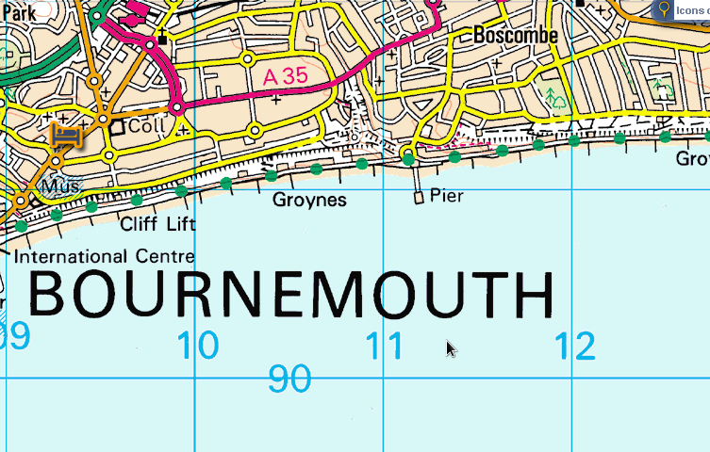
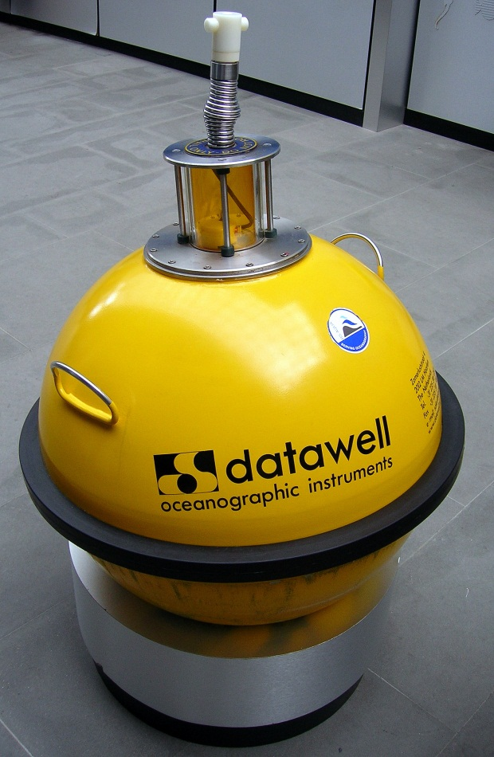
Is the surf any good today?…
Were can I park?…
Will my car be safe there?…
Where can I get tea, cake, beer(!) afterwards?…
Notes:
Example slide: Surf mashup (which way to the beach, facilities, map, newpaper clippings, waverider sensor)

Slide 6
Context
Applications
Web APIs and Linked Data
Semantic Mashups
Notes:
Diagram of detail within applications: break down of API and example applications, including HLAPI engine and the API it exposes.

Slide 7
Structure of the tutorial
REST and Linked Data APIs
An API for Sensor Observations
Writing an example mashup

Slide 8
REST and Linked Data APIs
General Principles

Slide 9
REST
everything is a resource which is addressable
resources have multiple representations
relationships between resources are expressed through hyperlinks
all resources share a common interface with a limited set of operations
client-server communication is stateless.

Slide 10
Linked Data
use URIs as names for things
use HTTP URIs so that people can look up those names
when someone looks up a URI, provide useful information, using the standards (RDF*, SPARQL)
include links to other URIs, so that they can discover more things

Slide 11
Commonalities
The Primacy of Resources
Identification of resources is the key abstraction in REST and RDF where it is also the means to express relationships
Linking is not optional
Links to other URIs to discover more things (Linked Data); and as the engine of application state (REST)
Segregation of Semantics
Semantics have their place (and it's not in the resource addressing/URIs)

Slide 12
Adaptability
Both approaches can evolve over time…
REST: state transitions can be changed by modifying the links returned by representations
modifying the hyperstructure
Linked Data: assertions about the same resource can be made at different times, in different places, using different ontologies
modifying the hyperstructure

Slide 13
Differences
or complementarity?

Slide 14
Model or API
What purpose are the commonalities put to?
Resources and their relationships are used to:
REST: identify data and transition to other resources; the means to develop an application; an API
Semantic Web: encapsulate the underlying data model; link to more related data using the model

Slide 15
Domain Driven Design
Both the information model and API design are driven by the domain requirements
This focuses differentiation and complexity where it should be: around those issues specific to the domain
A common model can be shared between the data and the API

Slide 16
So…
Are all Linked Data applications today RESTful?
Are there lots of RESTful systems using Linked Data?

Slide 17
Tensions
Are the remaining differences fundamental mismatches or artefacts of current use?
SPARQL
Content negotiation
Information and non-information resources
303 overhead

Slide 18
REST and Linked Data: in summary
REST and Linked Data are complementary in the domain
but there are important differences
especially model vs. API
They present an opportunity to build powerful domain centric systems with a common API and data model

Slide 19
An API for Sensor Observations
Notes:
Applying the principles of the previous section

Slide 20
Context
Semantic Mashups
Service
API
Service providing API
API for Sensor Observations
Notes:
Diagram of detail within applications: break down of API and example applications, including HLAPI engine and the API it exposes.

Slide 21
Domain Model
Observation model from the SSN XG ontology
Roots in the OGC O&M data model
Consumer (vs. producer) centric
crucial link between observations and more detailed domain concepts

Slide 22
Resources
Observations
our primary resources
http://id.semsorgrid.ecs.soton.ac.uk/observations/cco/boscombe/Hs/20110101#140500
can be very dependent on the data set or service
Collections of Observations
e.g. All measurements of wave height in the last hour; all measurements of wind speed from the Boscombe sensor
http://id.semsorgrid.ecs.soton.ac.uk/observations/cco/boscombe/Hs/20110101
Remember, there are no accessible semantics in the URIs!

Slide 23
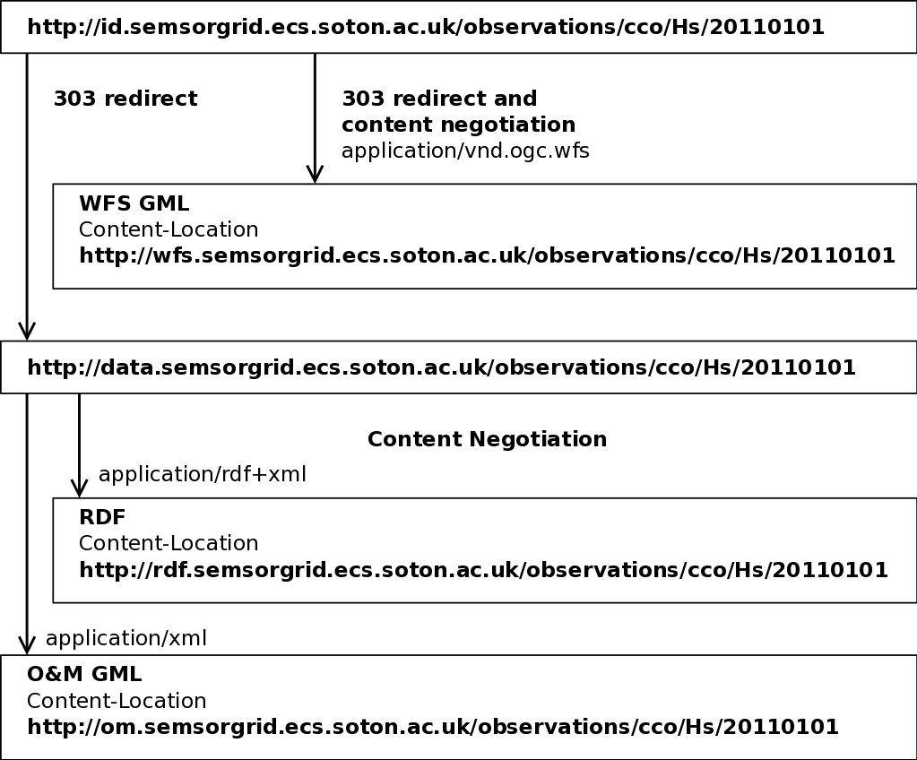
Representations
RDF (Observations)
Primary representation, also sent to a triplestore for SPARQL querying
O&M GML XML (OGC)
SOS GetObservation() & Xlinks
HTML
WFS GML XML (OGC)
OGC compatibility
GeoJSON
…?

Slide 24
Web API extensions
/latest : within each observation collection
“next” and “previous” for each observation and collection
Links from constituent observations and collections to broader collections (“up”)
/summary: for each collection, max/min values, frequencies, averages, units of measurements, descriptive metadata
/sensors: collections for sensors too

Slide 25
Services to provide APIs
(briefly)
Notes:
Applying the principles of the previous section

Slide 26
Context
Semantic Mashups
Service
API
Service providing API
API for Sensor Observations
Notes:
Diagram of detail within applications: break down of API and example applications, including HLAPI engine and the API it exposes.

Slide 27
High-Level API for Observations service

Slide 28
Questions? (before the hands-on)
Kevin Page
University of Southampton
krp@ecs.soton.ac.uk
Huge thanks to the Southampton SemSorGrid4Env team:
Alex Frazer
Bart Nagel
Kirk Martinez

Slide 29
Context
Semantic Mashups
Service
API
Service providing API
API for Sensor Observations
Notes:
Diagram of detail within applications: break down of API and example applications, including HLAPI engine and the API it exposes.

Slide 30
Hands-on objectives
To demonstrate different ways of accessing, navigating, and linking the observation data
Retrieving and manipulating RDF representations
Following links for RESTful applications
Querying the Observation API using SPARQL
Bridging to other Linked Data sources
Using latitude & longitude
Using a named position

