Slide 1

Big Linked Geospatial Data and its Application to Earth Observation
Manolis Koubarakis
Talk at Fraunhofer IAIS September 21, 2017

Slide 2
Outline
Motivation (long!)
Applications
The life-cycle of big linked geospatial data in Earth Observation data centers
Tools for supporting the life-cycle
Technical contributions
Open questions for future work

Slide 3
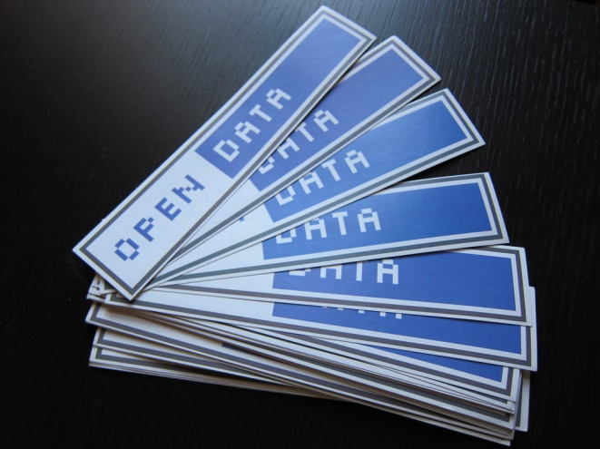
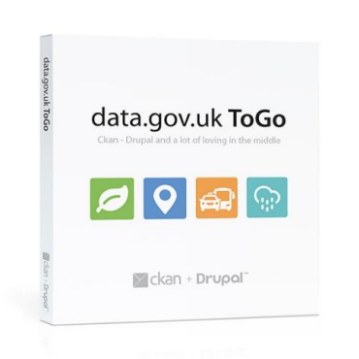


Motivation – Open Government Data
Lots of public sector data has been made open and freely available recently through various government portals.

Slide 4
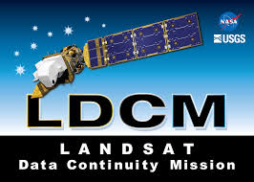

Motivation – Big Earth Observation Data
Lots of Earth Observation (EO) data has also been made freely available recently in Europe and the United States.
Europe is a pioneer in this area with its flagship Earth Observation Programme Copernicus.

Slide 5
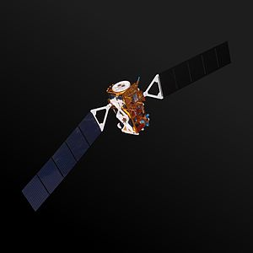
Some Information about Copernicus (http://www.copernicus.eu/)
Copernicus is the European programme for Earth Observation.
Copernicus collects data about our planet using a set of dedicated satellites (the Sentinel families) and contributing missions (existing commercial and public satellites).
The first satellite (Sentinel-1A) was launched in 2014. Almost 20 satellites will be deployed by 2030.
Copernicus also collects information from in-situ systems such as ground stations, which deliver data acquired by a multitude of sensors on the ground, at sea or in the air.

Slide 6
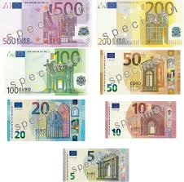
Economic Impact
The most recent study of the European Commission predicts that the cumulative economic value of Copernicus in the years 2008-2020 will be in the range of EUR 13.5 billion.
See http://copernicus.eu/news/commission-releases-first-copernicus-market-report.

Slide 7
The Five Vs of Copernicus Big Data
Volume: the Copernicus Open Access Hub (https://scihub.copernicus.eu/) had an estimated storage of 4,490 TB in 2016.
Velocity: By the end of 2016, 6 TB a day were generated and 100 TB of data were disseminated from the Copernicus Open Access Hub.
Variety:
  The Sentinel satellites comprise different type of sensors (e.g. optical, radar and thermal) and different levels of processing (from raw to advanced products).
  Datasets used for geospatial applications can be composed not only by satellite data but also by aerial imagery, in-situ data and other collateral information (e.g. media data, public government data, etc.).
  This wealth of data is processed by EO actors to extract information and knowledge. This information and knowledge is also Big and similar Big Data challenges apply. For example, 1PB of Sentinel data may consist of about 750.000 datasets which, when processed, about 450TB of content information and knowledge (e.g. classes of objects detected) can be generated.

Slide 8
The Five Vs of Copernicus Big Data (cont’d)
Veracity: Decision-making and operations require reliable sources. Thus, assessing the quality of the data is important for whole information extraction chain.
Value: The Copernicus programme has big economic impact as we discussed earlier.

Slide 9






Copernicus Services
Copernicus Services transform the wealth of satellite and in-situ Copernicus data into value-added products by processing and analysing the data.
There are six Copernicus services covering the following thematic areas: Atmosphere, Marine, Land, Climate, Emergency and Security.

Slide 10






Current Project
Copernicus App Lab (http://www.app-lab.eu/).
Make Copernicus Services data available as linked data to increase their use by mobile developers.
App Camp at ESA/ESRIN in Frascati last week. See http://www.app-camp.eu/frascati/ .

Slide 11


Two Examples of Copernicus Services Products
The CORINE land cover dataset (available at http://land.copernicus.eu/pan-european/corine-land-cover).
Global solar UV index forecast (available at http://atmosphere.copernicus.eu/catalogue#/).

Slide 12
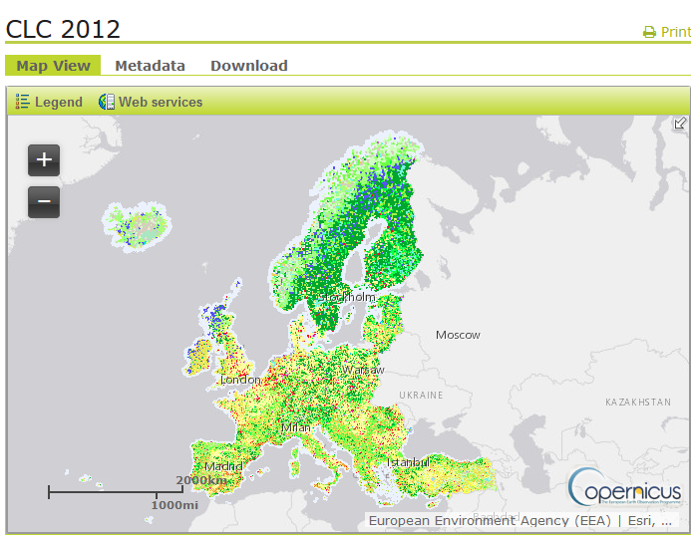
The CORINE Land Cover Dataset of 2012
It covers 39 European countries.
Land cover is characterized using a 3-level hierarchy of classes (e.g., olive groves or vineyards) with 44 classes in total at the 3rd level.
The minimum mapping unit is 25 hectares for areal phenomena and 100 meters for linear phenomena.
It is made available in raster (GeoTIFF) and vector (ESRI/SQLite geodatabase) formats.

Slide 13
Let us try to find some information regarding this dataset
Question: Is there a land cover dataset produced by the European Environmental Agency covering the area of Chania, Crete, Greece?
Google it!

Slide 14
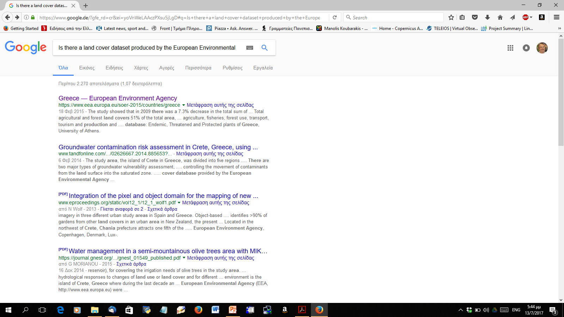
Answer

Slide 15
Let us try the same with famous actors!
Question: Is there an actor that comes from Scotland and has played James Bond?
Google it!

Slide 16
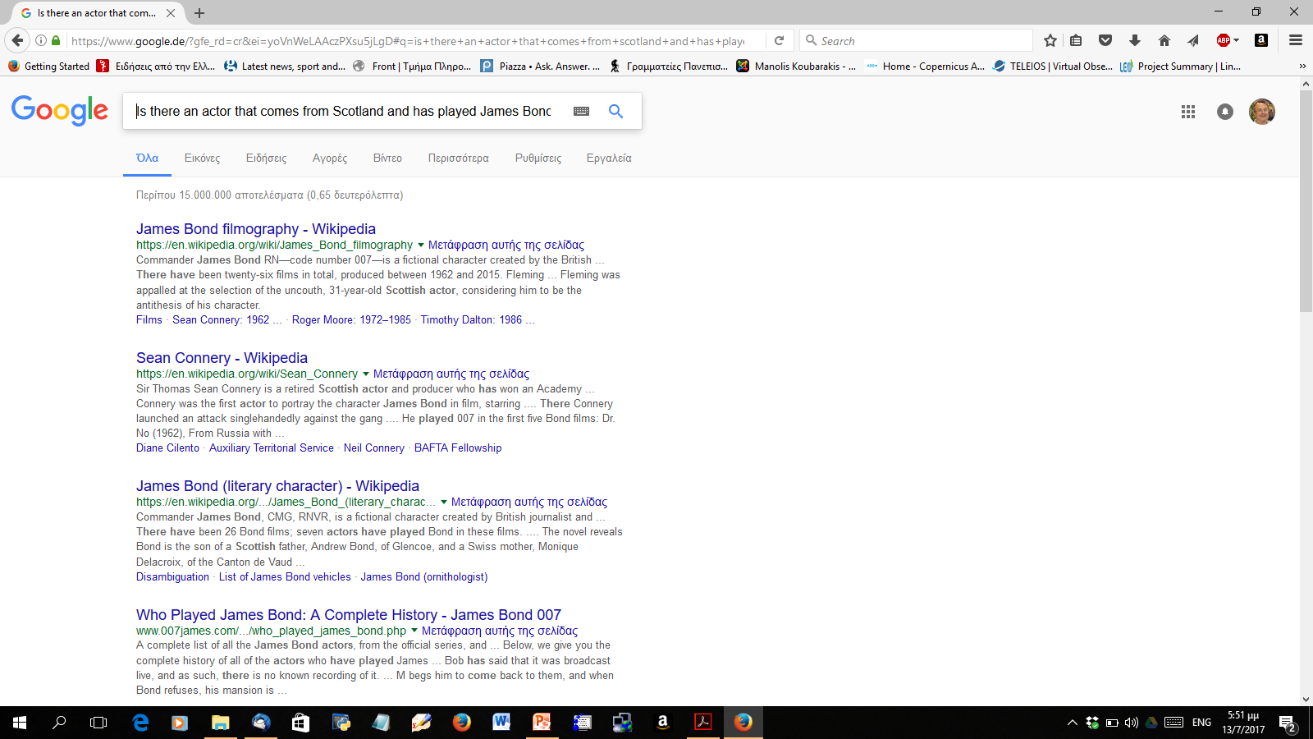
Answer

Slide 17

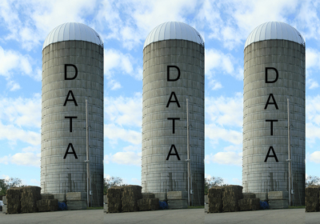

What is the problem?
All Copernicus data still exists in different data silos (e.g., different EO archives or portals).
Current search engines do not index this data in a useful way.

Slide 18
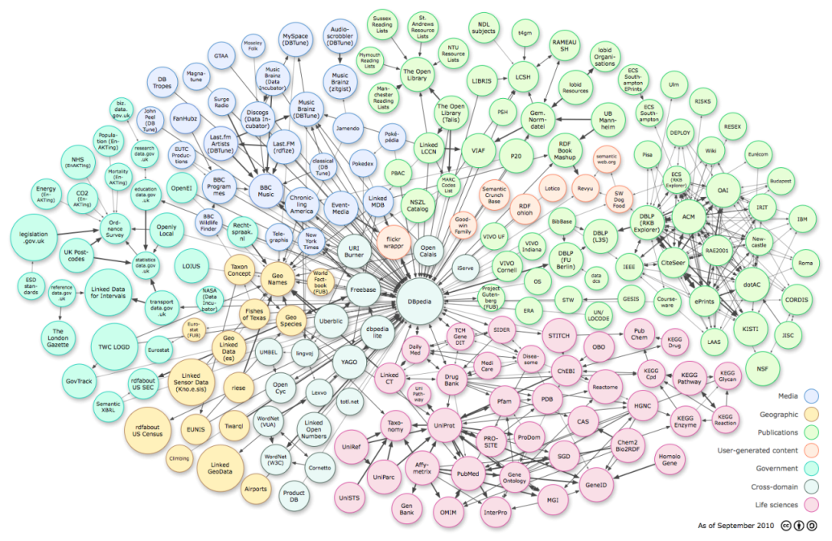

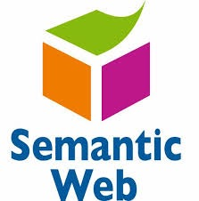
Main Objective of our Work
Open up EO data silos by moving their data and/or metadata over to the linked data paradigm.

Slide 19
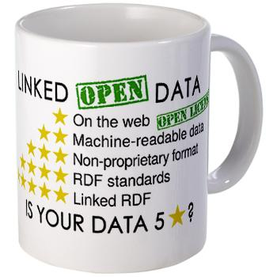

Why Linked Data?
The vision of linked data is to go from a Web of documents to a Web of data:
Unlock open data dormant in their silos
Make it available on the Web using Semantic Web technologies (HTTP, URIs, RDF, SPARQL)
Interlink it with other data (e.g., from the European data portal)

Slide 20
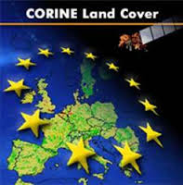
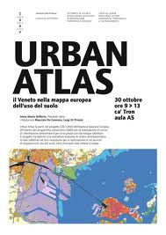

Examples of Linked Open EO Data
CORINE land cover of the year 2000
https://datahub.io/dataset/corine-land-cover
Urban Atlas of 2006
https://datahub.io/dataset/urban-atlas

Slide 21

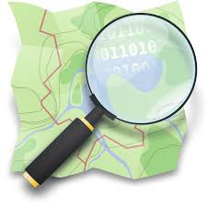

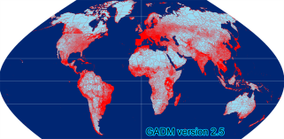
Examples of Interesting Linkages
The CORINE land cover dataset can be usefully linked with the following datasets:
  GeoNames
  Global Administrative Areas
  DBpedia
  OpenStreetMap

Slide 22
Google is also Working on These Issues
Google has issued guidelines for annotating public datasets so they can more easily discovered by search engines.
See the blogpost and guidelines:
  https://research.googleblog.com/2017/01/facilitating-discovery-of-public.html
  https://developers.google.com/search/docs/data-types/datasets
So if one does this, then …

Slide 23
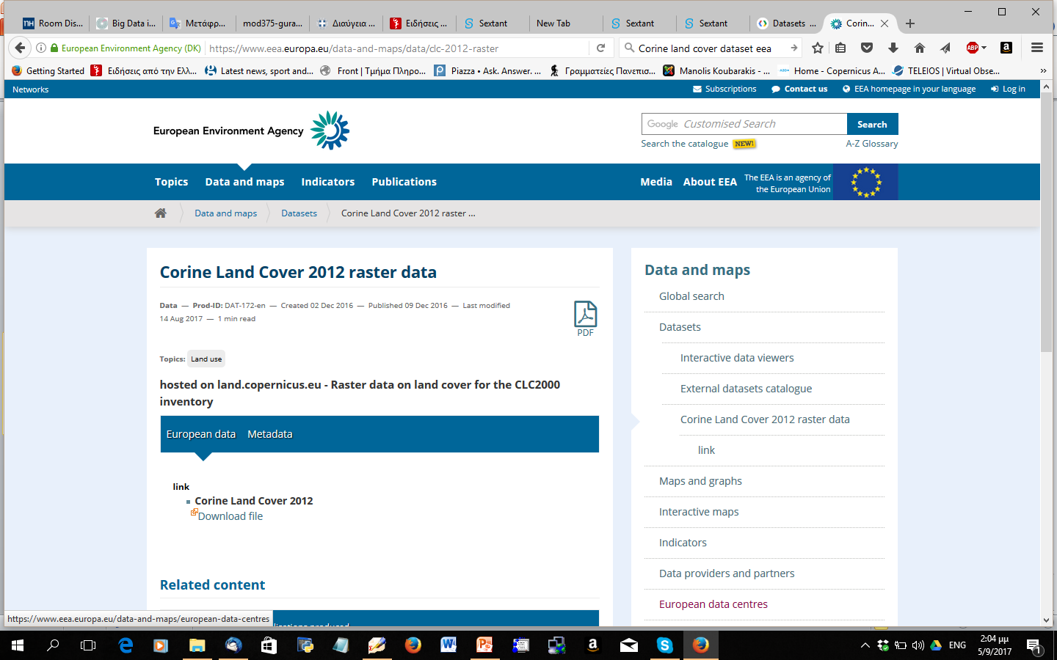
… Google will Find the Correct Answer

Slide 24
What Kind of CORINE Land Cover Classes we Have for the Area of Chania?
PREFIX corine: <http://geo.linkedopendata.gr/corine/ontology#>
PREFIX strdf: <http://strdf.di.uoa.gr/ontology#>
SELECT ?lu (COUNT(?lu) AS ?instances)
WHERE
{
?area corine:hasLandUse ?lu .
?area corine:hasGeometry ?geometry .
FILTER (strdf:intersects(?geometry, "POLYGON ((24.28 35.42, 23.89 35.42, 23.89 35.61, 24.28 35.61, 24.28 35.42))"^^strdf:WKT)) .
}
GROUP BY ?lu

Slide 25
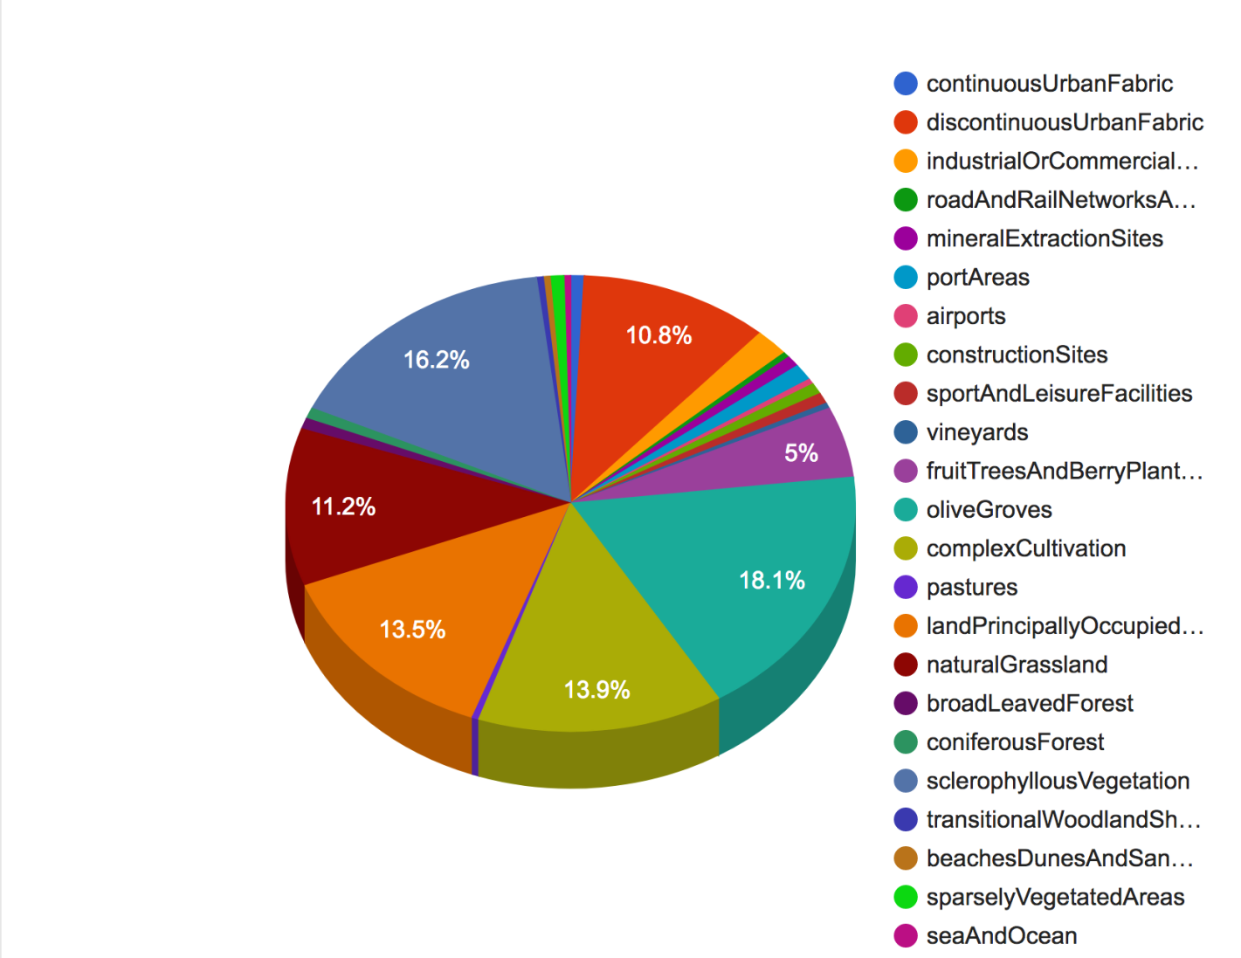
Answer

Slide 26
Copernicus Data and Metadata as Open Linked Data: Benefits
Make Copernicus data more easily discoverable by search engines by using technologies such as schema.org for encoding the metadata. schema.org is now used by all major search engines.
Once datasets are transformed into linked data (e.g., the CORINE land cover dataset), we can interlink them with other open linked data sources (e.g., GADM, OpenStreetMap or DBpedia data) to build geo-knowledge graphs.
Enable semantics-based querying and visualization of these graphs.
This works for static but also dynamic (frequently changing) datasets.
Therefore: enable easier utilization e.g., by software developers who may not be specialists in Earth Observation.

Slide 27
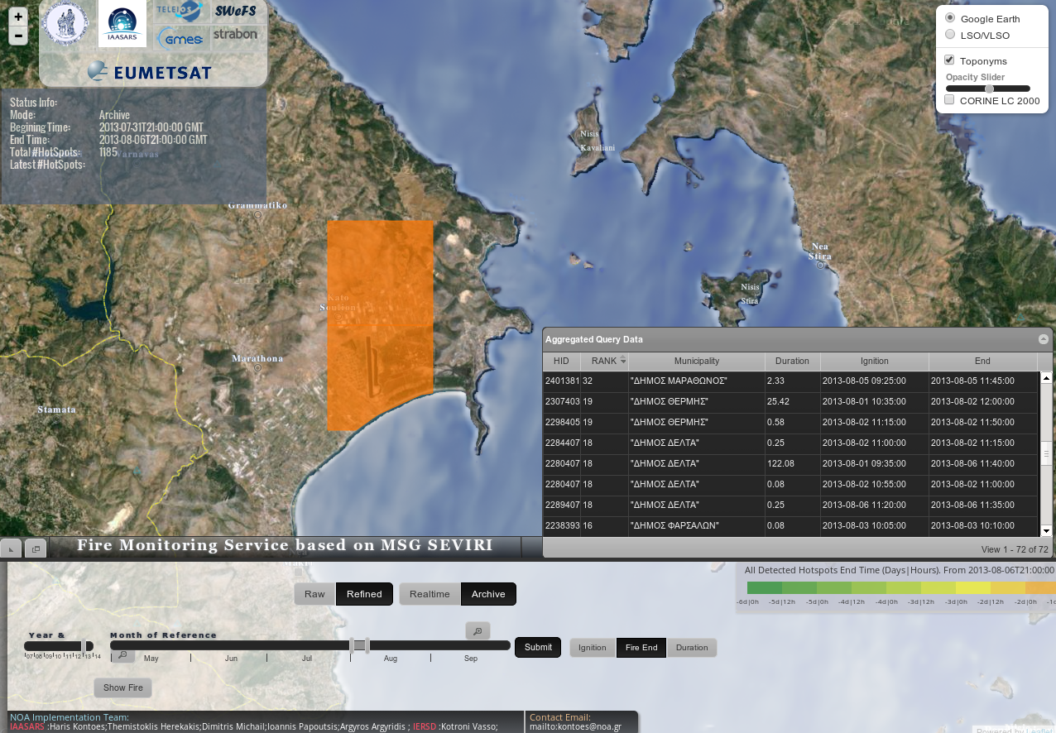
Example Application: the FIREHUB service of NOA (EDBT 2013)

Slide 28
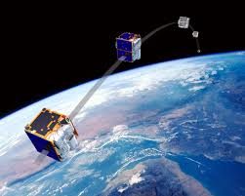


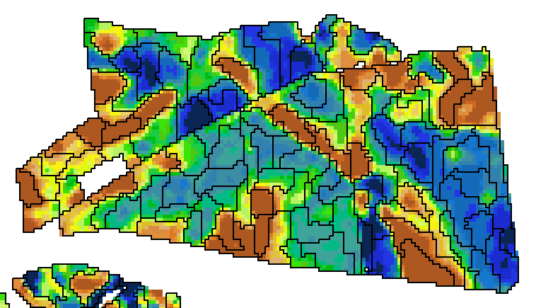
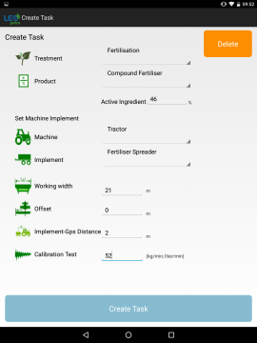
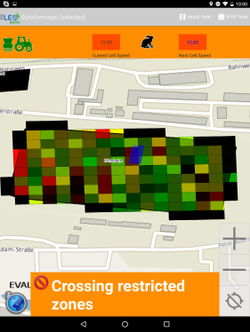


Example Application: Precision Farming (HAICTA 2017)
RapidEye, Landsat, Sentinel 2 images
Processing
Water bodies
Protected areas
Legal regulations
Biomass Map
Fertilization Map
Precision Farming
Application

Slide 29
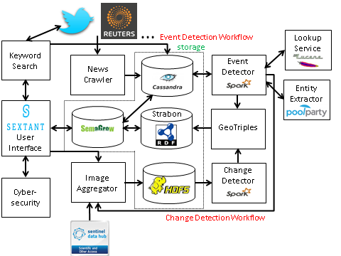
Example Application: Change Detection Pilot in BigDataEurope (ICWE 2017)
Notes:
Three workflows:
Bottom level: The Change Detection workflow collects images from SciHub, stores them in HDFS and applies a set of image processing operators using Spark for their parallelization.
Top level: The Event Detection gathers tweets and news articles from Reuters, stores them in Cassandra and periodically clusters them into events that are associated with geolocations and URIs of the persons they involve.
Middle level: The activation workflow converts event summaries and areas with changes into RDF, stores them in Strabon so that the users can query them through Sextant and SemaGrow.

Slide 30

Other Applications
TerraSAR-X semantic data catalogue
Improving Greenhouse Gas Emission Inventories
Management of Urban Growth Challenges
Providing Economic and Ecological Advice to Farmers
Assessing the Quality of European Seas
Monitoring Desertification
Hazard Information Services
Marine Services based on AIS Data
Groundwater modeling

Slide 31
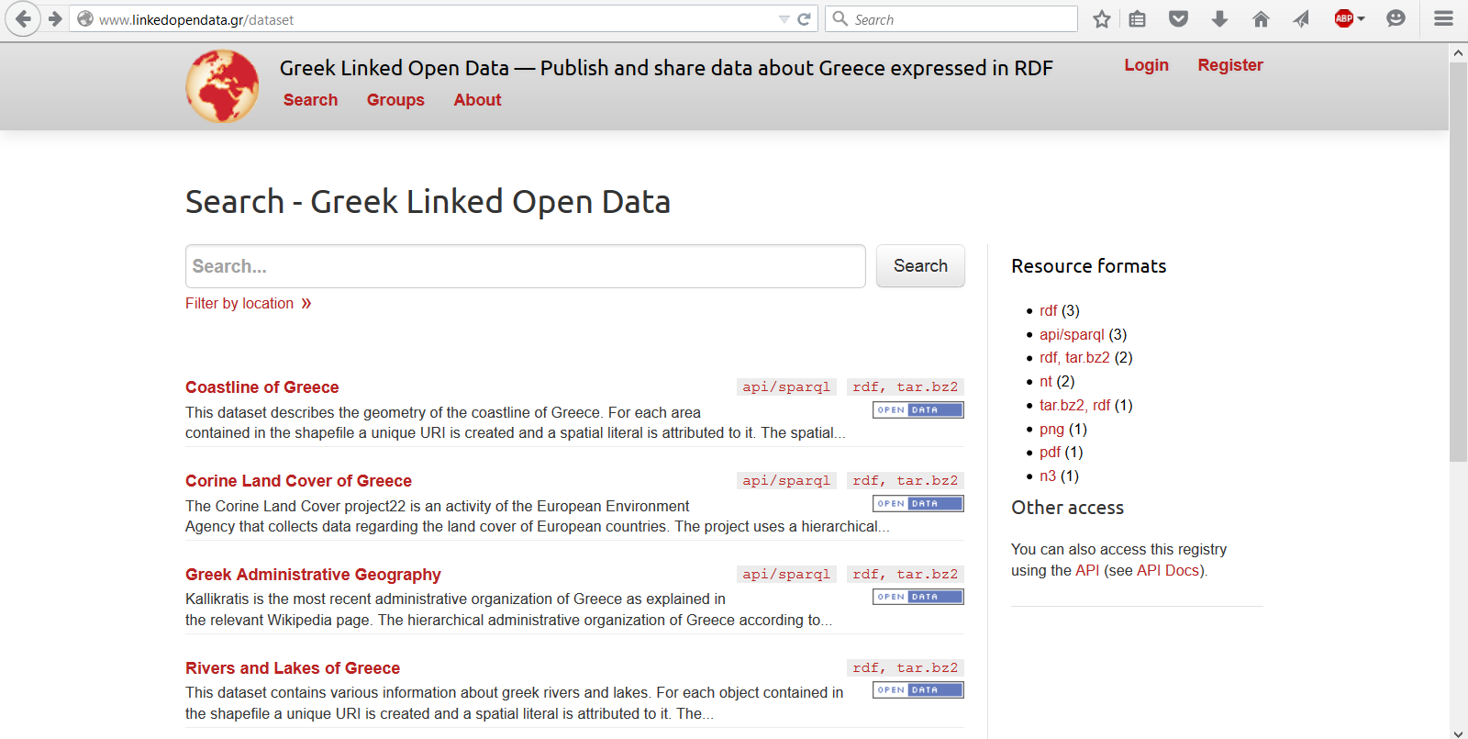
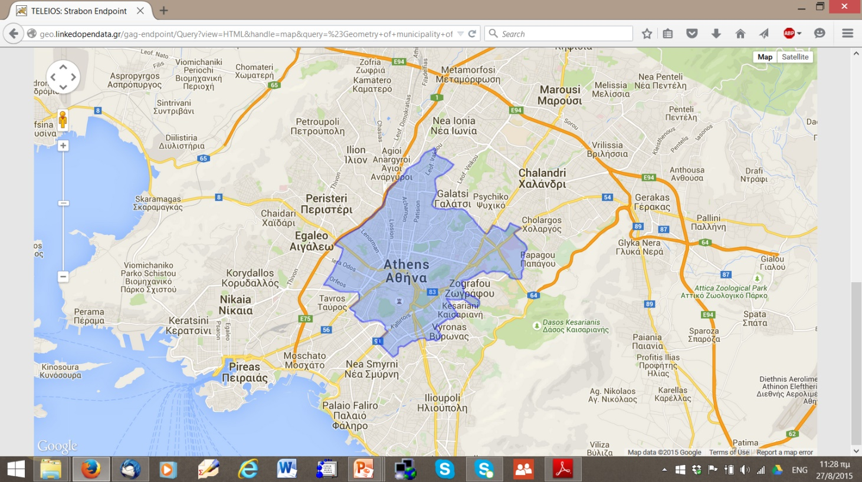
http://linkedopendata.gr/

Slide 32
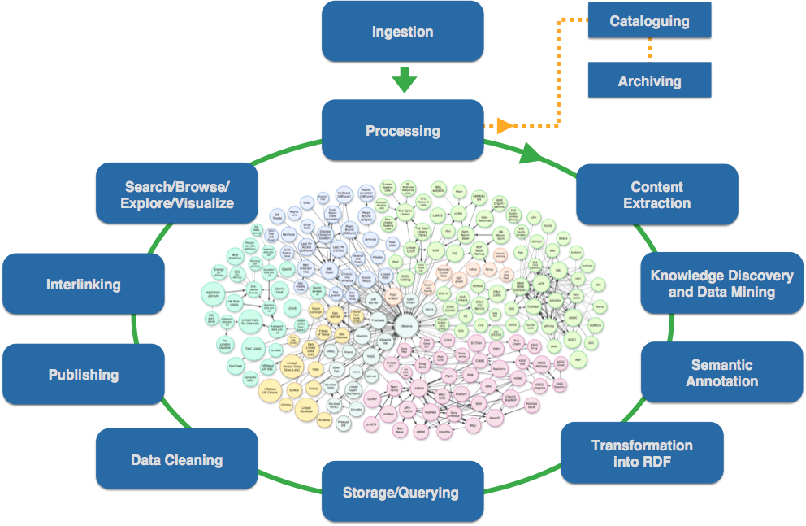
Life Cycle of Linked Open EO Data (IEEE GRSM 2016)

Slide 33

Our Linked Data Technologies
GeoTriples
Silk (temporal and spatial extensions)
Strabon
Ontop-spatial
Sextant

Slide 34

Publishing geospatial data
as RDF graphs

Slide 35
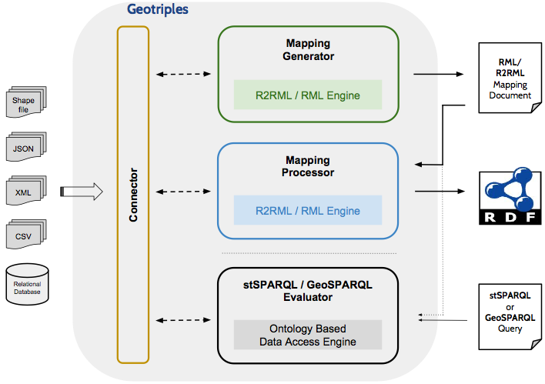
GeoTriples (Terra Cognita 2014, JWS submission)
Find more at: https://geotriples.di.uoa.gr

Slide 36

Discovering Spatial and Temporal Links among RDF Data

Slide 37
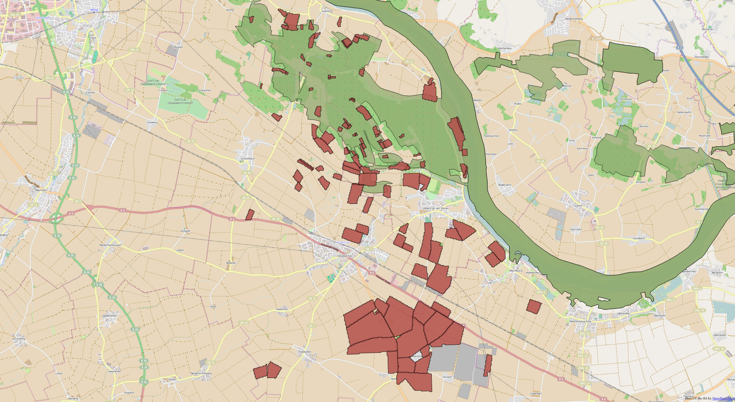
Silk (LDOW 2016)
Find more at: http://silk.di.uoa.gr/
intersects
close
Natura Protected Areas - Field Boundaries Field Boundaries - OSM Water Bodies

Slide 38

A state-of-the-art
spatiotemporal RDF store

Slide 39
Strabon (ISWC 2012, ISWC 2013)
Find more at: http://strabon.di.uoa.gr
WKT
GML
stRDF
graphs
stSPARQL/
GeoSPARQL
queries

Slide 40
The Model stRDF
An extension of RDF for the representation of geospatial information that changes over time.
Geospatial dimension:
  Two spatial data types are introduced.
  Geospatial information is represented using spatial literals of these datatypes.
  OGC standards WKT and GML are used for the serialization of spatial literals.
Temporal dimension (more later)

Slide 41
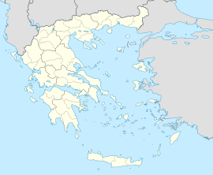
Example of stRDF (geospatial dimension)
  gag:Olympia
  rdf:type gag:MunicipalCommunity;
  gag:name "Ancient Olympia";
  gag:population "184"^^xsd:int;
  strdf:hasGeometry "POLYGON((21.5 18.5,23.5 18.5, 23.5 21,21.5 21,21.5 18.5));
  http://www.opengis.net/def/crs/OGC/1.3/CRS84"^^strdf:WKT.
Ancient Olympia

Slide 42
The Query Language stSPARQL (geospatial dimension)
It is an extension of SPARQL 1.1
It offers families of functions for querying geometries.
The functions are taken mostly from the OGC standard “OpenGIS Simple Feature Access - Part 2: SQL Option”.
They are similar to the ones offered by spatially-enabled relational database management systems (e.g., PostGIS).

Slide 43

Example of stSPARQL (geospatial dimension)
Query: Compute the parts of burnt areas that lie in coniferous forests
SELECT ?burntArea (strdf:intersection(?baGeom,
strdf:union(?fGeom)) AS ?burntForest)
WHERE { ?burntArea rdf:type noa:BurntArea;
strdf:hasGeometry ?baGeom.
?forest rdf:type clc:Region;
clc:hasLandCover clc:ConiferousForest;
clc:hasGeometry ?fGeom.
FILTER (strdf:intersects(?baGeom,?fGeom)) }
GROUP BY ?burntArea ?baGeom

Slide 44
The OGC Standard GeoSPARQL (2012)
Core
Topology Vocabulary
Extension
- relation family
Geometry Extension
- serialization
- version
Geometry Topology
Extension
- serialization
- version
- relation family
Query Rewrite
Extension
- serialization
- version
- relation family
RDFS Entailment
Extension
- serialization
- version
- relation family

Slide 45
GeoSPARQL vs. stSPARQL
Core
Topology Vocabulary
Extension
- relation family
Geometry Extension
- serialization
- version
Geometry Topology
Extension
- serialization
- version
- relation family
sSPARQL
Query Rewrite
Extension
- serialization
- version
- relation family
RDFS Entailment
Extension
- serialization
- version
- relation family

Slide 46
Example of the Topology Vocabulary Extension
Triples:
gag:Olympia rdf:type gag:MunicipalCommunity .
gag:OlympiaMunicipality rdf:type gag:Municipality .
gag:WesternGreece rdf:type gag:Region .
gag:Olympia geo:sfWithin gag:OlympiaMunicipality .
gag:OlympiaMunicipality geo:sfWithin gag:WesternGreece .
Query: Find the municipality in which Ancient Olympia is located.
Answer: gag:OlympiaMunicipality

Slide 47
Example of the Topology Vocabulary Extension
Triples:
gag:Olympia rdf:type gag:MunicipalCommunity .
gag:OlympiaMunicipality rdf:type gag:Municipality .
gag:WesternGreece rdf:type gag:Region .
gag:Olympia geo:sfWithin gag:OlympiaMunicipality .
gag:OlympiaMunicipality geo:sfWithin gag:WesternGreece .
Query: Find the region in which Ancient Olympia is located.
Answer: gag:WesternGreece
Method: By transitivity of geo:sfWithin.
Not supported by GeoSPARQL!

Slide 48
The Query Rewrite Extension
Enables the translation of qualitative topological information appearing in a query to quantitative.
This is done by rewriting of queries with triple patterns involving topological relations into queries with topological functions on geometries.
The rewriting is based on RIF rules.

Slide 49
Beyond the Topology Vocabulary Extension
Triples:
ex:region1 strdf:hasGeometry “POLYGON(A)”^^strdf:WKT .
ex:region2 strdf:hasGeometry “POLYGON(B)”^^strdf:WKT .
_:region3 geo:sfWithin ex:region2
Query: Is region3 contained in region1?
B
A
_region3

Slide 50
Beyond the Topology Vocabulary Extension (cont’d)
Triples:
ex:region1 strdf:hasGeometry “POLYGON(A)”^^strdf:WKT .
ex:region2 strdf:hasGeometry “POLYGON(B)”^^strdf:WKT .
_:region3 geo:sfWithin ex:region2
Query: Is region3 contained in region1?
Answer: Yes
Not supported by GeoSPARQL.
B
A
_region3

Slide 51
The Framework RDF^{i} (RR2013, AIJ 2016)
Extension of RDF with incomplete information.
New kind of literals (e-literals) for each datatype.
  Property values that exist but are unknown or partially known.
Partial knowledge: captured by constraints
(appropriate constraint language L).
RDF graphs extended to RDF^{i} databases: pair (G, φ)
G: RDF graph with e-literals
φ: quantifier-free formula of L

Slide 52
The Framework RDF^{i} (cont’d)
Formal semantics for RDF^{i} and SPARQL query evaluation.
Representation Systems:
  CONSTRUCT queries
    Without blank nodes in their templates
    With monotone graph patterns (using only operators AND, UNION and FILTER).
  CONSTRUCT queries
    Without blank nodes in their templates
    With well-designed graph patterns (graph patterns using only AND, FILTER and OPT plus some intuitive conditions).
Computational Complexity:
  Query answering is coNP-complete (data complexity) for certainty queries and various interesting classes of spatial constraints. Compare this with LOGSPACE complexity for the standard SPARQL case.

Slide 53
How do we implement query processing for RDF^{i}?
We could use a DL reasoner which offers topological reasoning, e.g., for RCC-8, using path consistency:
  RacerPro (Haarslev and Möller, 2001)
  PelletSpatial (Stocker and Sirin, 2009)
We could use rules (Batsakis, 2012).
None of these approaches is expressive enough or scales to the size of the datasets we have considered (i.e., hundreds of thousands to millions of constraints).

Slide 54
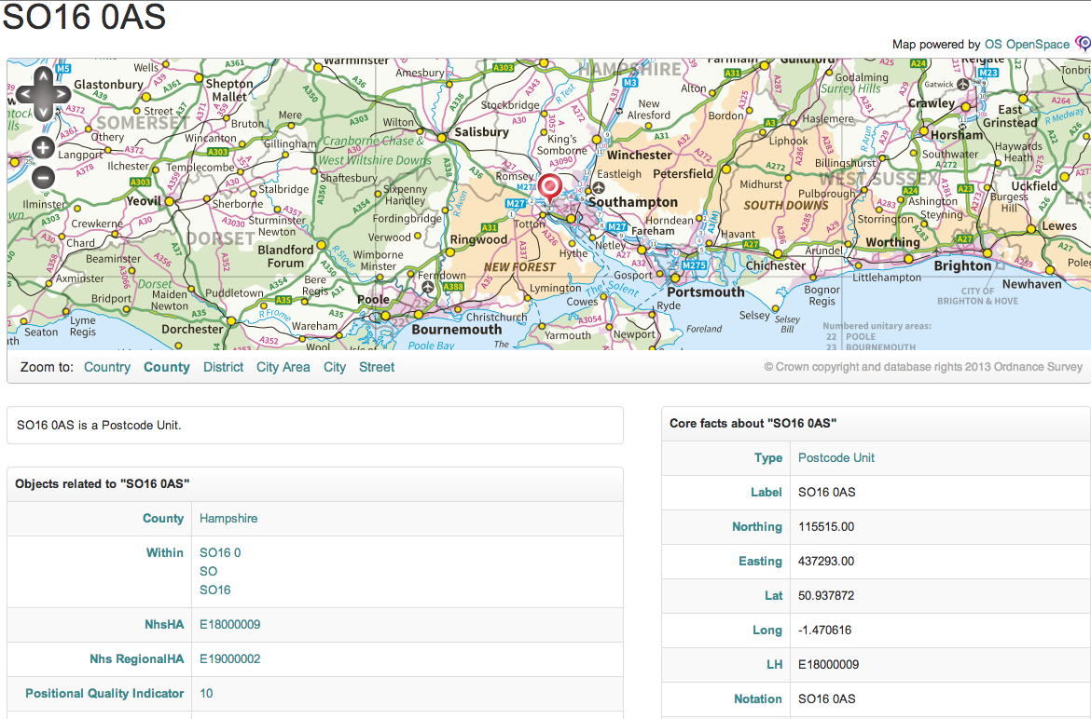
Administrative Geography of Great Britain
73,546,231 triples

Slide 55
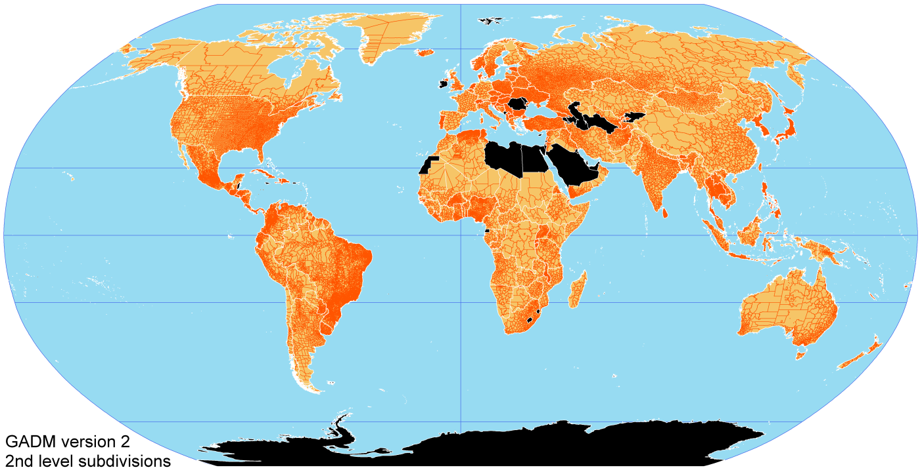
Global Administrative Areas
9,896,532
triples

Slide 56
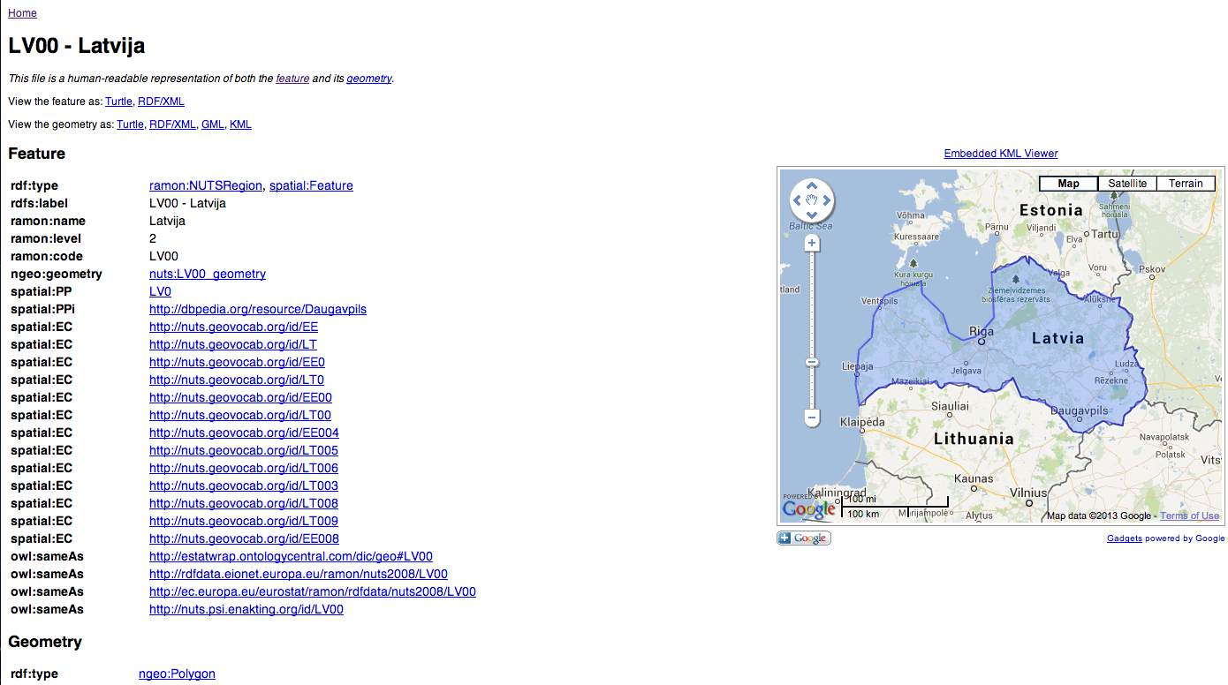
Nomeclature of Territorial Units for Statistics (NUTS)
316,246
triples

Slide 57
How do we implement query processing for RDF^{i}? (cont’d)
We have implemented our own reasoners:
  For RCC-8 using graph-partitioning (Nikolaou and Koubarakis, AAAI 2014)
  For RCC-5 and RCC-8 with landmarks/polygons (Giannakopoulou, Nikolaou and Koubarakis, AAAI 2014)
Lessons learned:
  The standard path-consistency algorithms can be significantly improved.
  Graph partitioning helps a lot in many cases.
  For the datasets we experimented with (GAG, GADM, GAU, NUTS), geometric computations dominate.
  We could handle a few hundreds of thousands of constraints but not millions.
  Simpler geometries and parallelization help a lot.
We have not implemented a complete query processing engine for RDF^{i}.

Slide 58
The Temporal Dimension of stSPARQL (valid time of triples, ESWC 2013)
The following extensions to RDF are introduced:
Timeline: the (discrete) value space of the datatype xsd:dateTime of XML-Schema.
Two kinds of time primitives are supported: time instants and time periods.
  A time instant is an element of the time line.
  A time period is an expression of the form [B, E) or [B, E] or (B, E] or (B, E) where B and E are time instants called the beginning and ending time of the period.
The new datatype strdf:period is introduced.

Slide 59
The Temporal Dimension of stRDF (cont’d)
Triples are extended to quads.
A temporal triple (quad) is an expression of the form
s p o t.
where s p o. is an RDF triple and t is a
time instant or time period called the valid
time of the triple.
The temporal constants NOW and UC (“until changed”) are introduced.

Slide 60
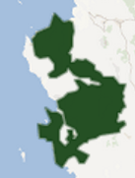

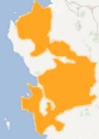
Example
clc:region1 clc:hasLandCover clc:Forest
"[2006-08-25T11:00:00+02,2007-08-25T11:00:00+02)"^^strdf:period .
noa:ba1 rdf:type noa:BurntArea
"[2007-08-25T11:00:00+02,2009-08-25T11:00:00+02)"^^strdf:period .
clc:region1 clc:hasLandCover clc:AgriculturalArea
"[2009-08-25T11:00:00+02, "UC")"^^strdf:period .
Forest
Burnt Area
Agricultural Area
Timeline

Slide 61
The Temporal Dimension of stSPARQL
The following extensions to SPARQL are introduced:
Triple patterns are extended to quad patterns (the last component is a temporal term: variable or constant)
Temporal extension functions are introduced:
  Allen's temporal relations (e.g., strdf:after)
  Period constructors (e.g., strdf:period_intersect)
  Temporal aggregates (e.g., strdf:maximalPeriod)

Slide 62
Example Query
Query: Find the current land cover of all areas in the dataset.
SELECT ?clc
WHERE {
?R rdf:type clc:Region .
?R clc:hasLandCover ?clc ?t1 .
FILTER (strdf:during("NOW", ?t1))
}

Slide 63

Creating virtual RDF graphs
on top of geospatial databases
S atial

Slide 64
Ontop-spatial (ESWC 2016, ISWC 2016, FOSS4G-E 2017)
Find more at: http://ontop-spatial.di.uoa.gr
Ontology
Application
Source

Slide 65
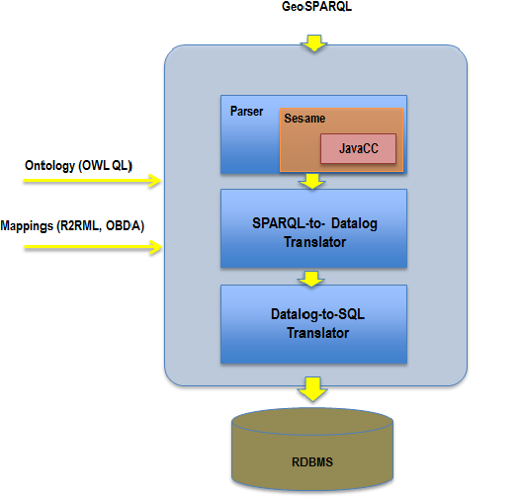
Architecture overview (extending Ontop)

Slide 66
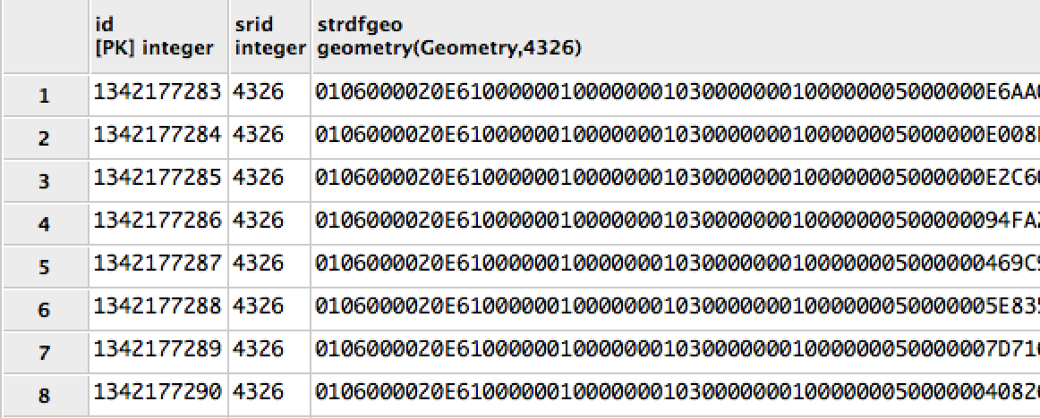
Mappings
R2RML mapping
OBDA mapping
<cl_Geometries>
a rr:TriplesMap;
rr:logicalTable [ rr:sqlQuery ""”
select id, strdfgeo from geo_values """ ];
rr:subjectMap [ rr:template npd:{id};
rr:class geo:Geometry ];
rr:predicateObjectMap [
rr:predicate geo:asWKT
rr:objectMap [
rr:column "\"strdfgeo\"" ; rr:datatype geo:wktLiteral ]].
[MappingDeclaration]
[[
mappingId mapping-767351779
target npd:{id} a geo:Geometry ;
geo:asWKT ”strdfgeo"^^geo:wktLiteral
source select id, strdfgeo from geo_values ]]
Notes:
But first, we have the mappings
Mappings encode how relational data like this table here, are mapped into RDF.
Various mapping languages exist, but R2RML became a standard.
So this minimal mapping maps columns of this table to RDF terms, and you can see how the geometries, orginally stored in WKB format are mapped to WKT GeoSPARQL literals.
This R2RML mapping is equivalent mapping of the Ontop native mapping language and encodes the same information.

Slide 67
Virtual Triples
npd:1 rdf:type geo:Geometry;
geo:asWKT “POLYGON(…)”^^geo:wktLiteral .
npd:2 rdf:type geo:Geometry;
geo:asWKT “POLYGON(…)”^^geo:wktLiteral .
…

Slide 68
Example Queries in GeoSPARQL
Overlapping geometries:
Quantitative query
SELECT ?x1 ?x2
WHERE {
?x1 geo:asWKT ?g1 .
?x2 geo:asWKT ?g2 .
FILTER(geof:sfOverlaps(?g1,?g2)) }
Qualitative query
SELECT ?x1 ?x2
WHERE {
?x1 geo:sfOverlaps ?x2 }
Ontop-spatial supports the Query Rewrite Extension of GeoSPARQL.

Slide 69
Raster Data Sources
[[ mappingId chicago
target :{rid} rdf:type :rasterCell ; :hasGeometry {rast} .
source select rid,rast from chicago;
mappingId gadm
target : {id_0} rdf:type :AdministrativeDivision; geo:hasGeometry :{gid} .
:{gid} geo:asWKT {geom}^^geo:WKTLiteral .
source select * from usa_adm2 ]]
Data sources
CHICAGO[rid | rast]
USA_ADM2[gid | id_0 | iso | name_0 | id_1 | name_1 | id_2 | name_2 |geom]
GeoTIFF image of Chicago imported in PostGIS as table (raster geometries)
Shapefile describing USA administrative divisions and boundaries (vector geometries)

Slide 70
Example Query
Retrieve administrative divisions that intersect with raster cells of the GeoTIFF image of Chicago.
SELECT ?adm
WHERE{
?r rdf:type :rasterCell .
?r :hasGeometry ?rast .
?adm rdf:type :AdministrativeDivision .
?adm geosparql:hasGeometry ?g .
?g geo:asWKT ?geom .
FILTER(geof:sfIntersects(geom,rast))
Vector geometries will be bound
Raster geometries will be bound
Notes:
It is exactly the same query we would pose if we had only vector geometries.

Slide 71
Performance Evaluation and Scalability of Strabon and Ontop-spatial
Defined and used the benchmark Geographica (http://geographica.di.uoa.gr/).
Strabon has better performance and functionality than Parliament, uSeekM, System X, Virtuoso, GraphDB Free and System Y (longer version of ISWC 2013 paper).
Ontop Spatial has better performance than Strabon and GraphDB Free (long version of ISWC 2016 paper).

Slide 72
Evaluation
Notes:
Cold cache experiments. Spatial selections and spatial joins. If a system has no measurements it times out for the corresponding query.

Slide 73
Performance Evaluation: Strabon vs. Ontop-spatial on a 30 GB dataset
Operation (geof:intersects) | Selectivity | Geometry types | Strabon | Ontop-spatial | Remarks
Spatial Selection | high | * (irrelevant) | 100 msecs | 100 msecs
Spatial Selection | low | Point-Polygon | 100 msecs | 100 msecs
Spatial Selection | low | Polygon-Polygon | 500 msecs | 100-200 msecs
Spatial Join | high | Point - Polygon | < 1000 msecs | < 1000 msecs
Spatial Join | high | Polygon-Polygon | 100000 msecs | 100000 msecs
Spatial Join | low | Polygon-Polygon | >40 mins | 10 mins | Sometimes the difference here is order(s) of magnitude
Notes:
*We can say that both systems can scale up to 100 GB if the geometries are points or/and we have highly selective queries
*The differences between Strabon and Ontop-spatial are bigger when the selectivity is low, forcing a lot of intermediate results, which is the weak point of Strabon (while in Ontop-spatial the data is partitioned). In easier queries (selections, highly selective joins or joins with non complex geometries) the differencies are small

Slide 74
Scalability
We can scale to 100GB of data and answer queries in milliseconds if the geometries are points and/or the selectivity of the query is high.
More complex geometries have an impact on performance.

Slide 75

Visualizing Time-Evolving Linked Geospatial Data

Slide 76
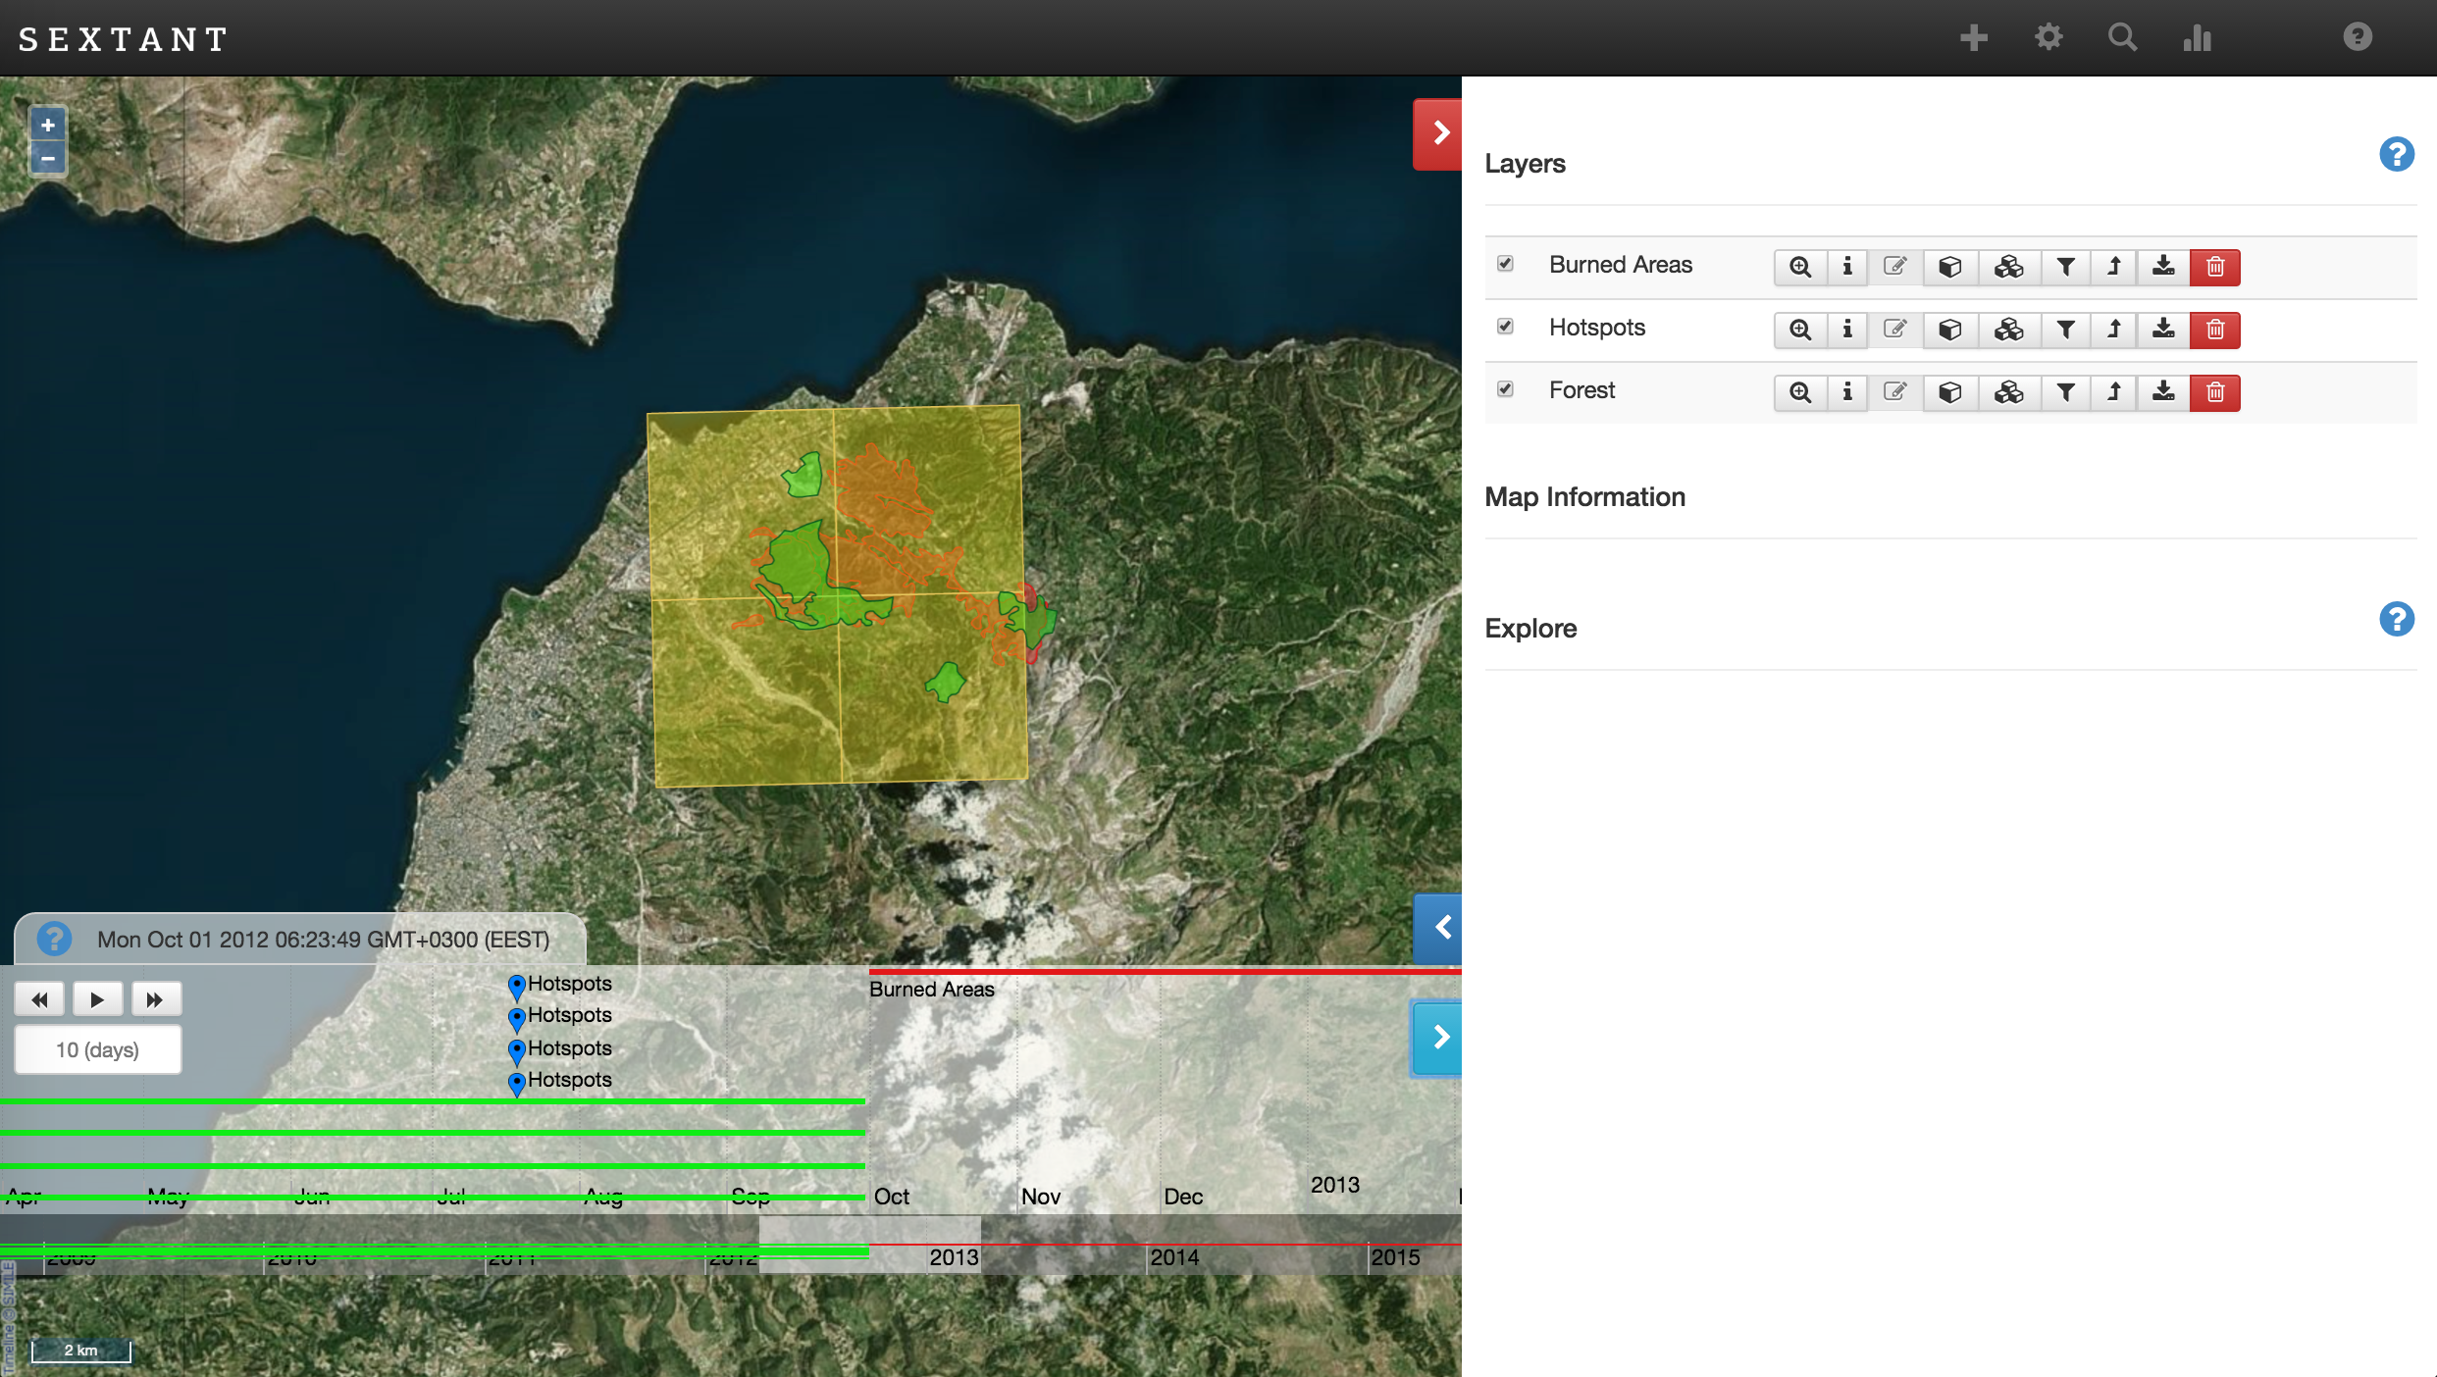
Sextant
Find more at: http://sextant.di.uoa.gr

Slide 77
Open Questions (Theory)
The data complexity of query processing for stSPARQL and GeoSPARQL has not been studied so far.
We have done so only for the original stSPARQL proposal based on constraints (ESWC 2010).
Similarly for other interesting problems such as query containment etc.
The foundations of Ontop-spatial deserve further study (comparison with the theory of spatial description logics).

Slide 78
Open Questions (Practice)
How can we built an (even more) scalable geospatial RDF store like Strabon on top of Apache big data technologies?
  Analyzed the pros and cons of using GeoSpark, SIMBA and SpatialSpark.
    GeoSpark seems to be the most mature and is continuously been improved by its developers.
How can we handle 10¹² triples with 10⁸ polygons? (the volume of geospatial data owned by a national cartographic agency)

Slide 79
Open Questions (cont’d)
How do we represent and query raster data on the Semantic Web?
  Raster extension of Ontop-spatial.
  Array database extension of Ontop-spatial.
  Work on “Coverages in Linked Data” by the OGC/W3C Spatial Data on the Web working group.

Slide 80
Other relevant research topics of interest
Natural language query processing for large geospatial knowledge bases (e.g., Yago2).
Example queries:
  Find parks in Bonn close to Fraunhofer IAIS.
  Find rivers that cross cities of Greece and their length is more than 20km.
Current work in the context of WDAqua (Answering Questions using Web Data, a Marie Sklodowska-Curie Innovative Training Network, http://wdaqua.eu/ ).

Slide 81
Other current research topics
Modeling and querying Greek legislation using Semantic Web technologies.
Developed the system Nomothesi@ (http://legislation.di.uoa.gr/) which won an award in a Greek IT4Gov contest organized by the Greek Government.
See paper at ESWC 2017.

Slide 82
Thanks! Questions?
Thanks to all my colleagues for their contributions.
For more, see the web page of my group http://kr.di.uoa.gr .

