Slide 1
Applying for a Collaborative European Research and/or Innovation Grant: A Guide for Beginners
Manolis Koubarakis
http://www.di.uoa.gr/~koubarak

Slide 2
My Previous Experience (Me)
I have participated in 12 collaborative European research and innovation projects:
Chorochronos (temporal and spatial databases)
DIET (agents)
OntoGrid (ontologies and grid technology)
Bridgemap (marine biology)
SemsorGrid4Env (sensors and grids)
TELEIOS (satellite data, linked geospatial data)
LEO (precision farming, linked geospatial data)
Melodies (environmental services, open data)
Optique (big data in the oil and gas, and energy domains)
Copernicus App Lab (Copernicus services, linked geospatial data)
BigDataEurope (big data)
WDAqua (question answering)
I co-ordinated 2 of them (TELEIOS and LEO).

Slide 3
You
You will graduate with a Ph.D. in informatics and take your first position in a European University, Research Institute or Research-Oriented Company.
You might have not participated actively in the writing of research proposals as a Ph.D. student.
If you did (great idea?), you might already know a lot!

Slide 4
Why Apply for a European Grant?
It is expected from you: academics are promoted based on their performance on Teaching, Research and Administration (with weights for the three dimensions varying from place to place).
With a grant, you will have money to pay your Ph.D. students. Smart Ph.D. students (usually) go to work with supervisors who can pay them!
You might even be able to pay yourself some extra money beyond your salary (e.g., in Greece this is the case).
It is an excellent way to broaden your research horizons and avoid keeping on working on your Ph.D. topic for ever.
European research grants might be the only grants available to you (e.g., almost true in Greece).

Slide 5
Horizon 2020
My presentation is about applying for a grant from the Horizon 2020 research programme.
This is the programme that funds WDAqua.
The core ideas/advice of the presentation will apply to future European research programmes, national programmes or programmes in other continents.

Slide 6
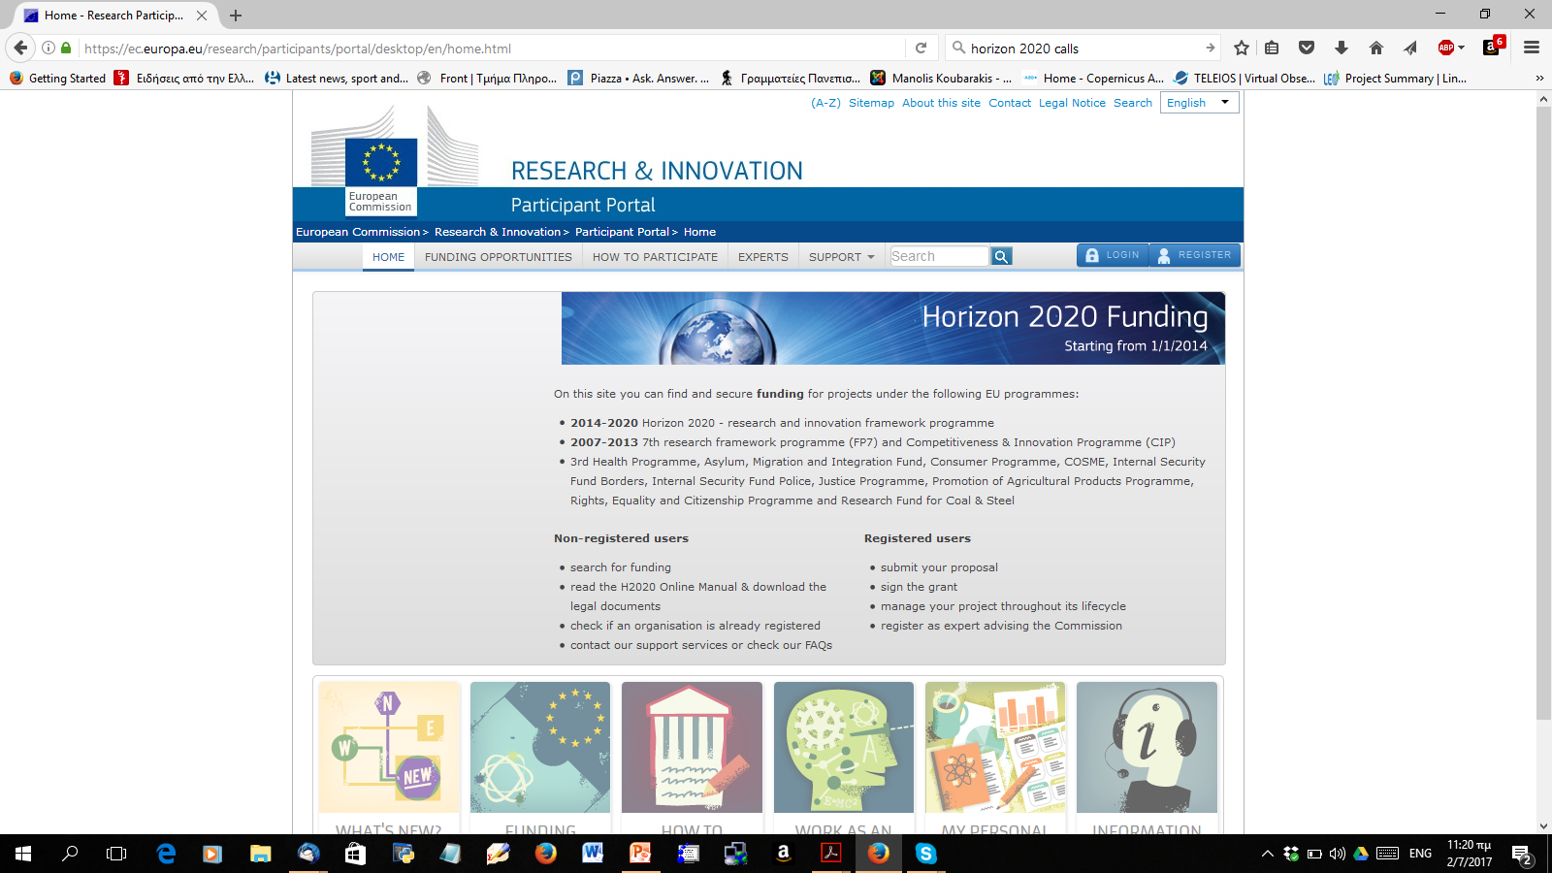
How to find an appropriate call?
Go to the Participant Portal (https://ec.europa.eu/research/participants/portal/desktop/en/home.html)

Slide 7
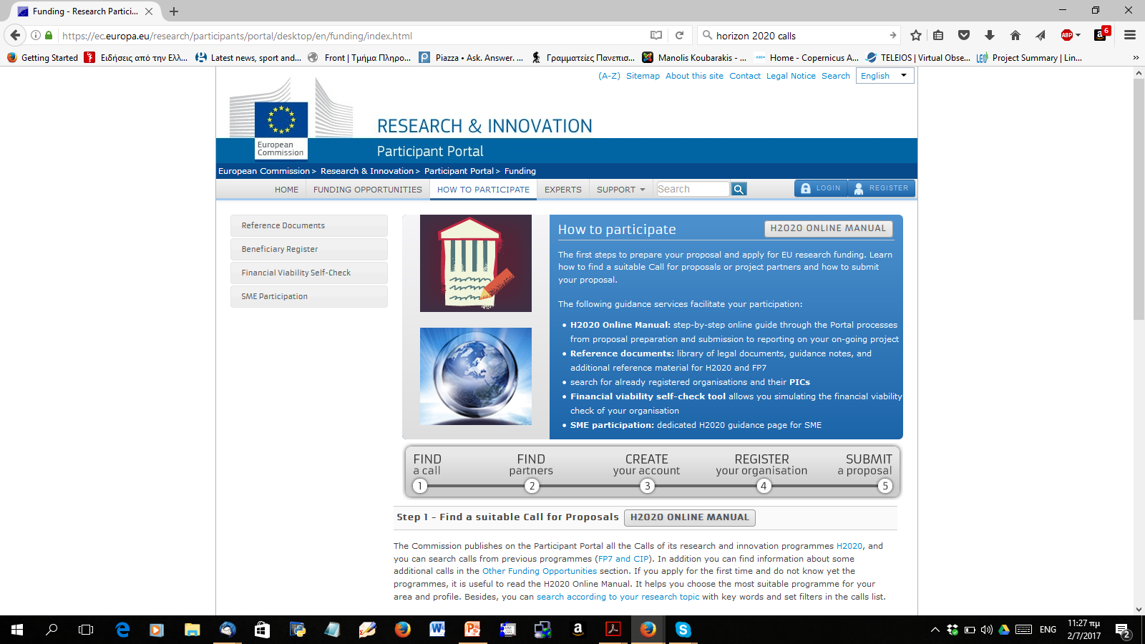
Participant portal (cont’d)
Go to topic “How to Participate”.
Read the H2020 on-line manual.

Slide 8
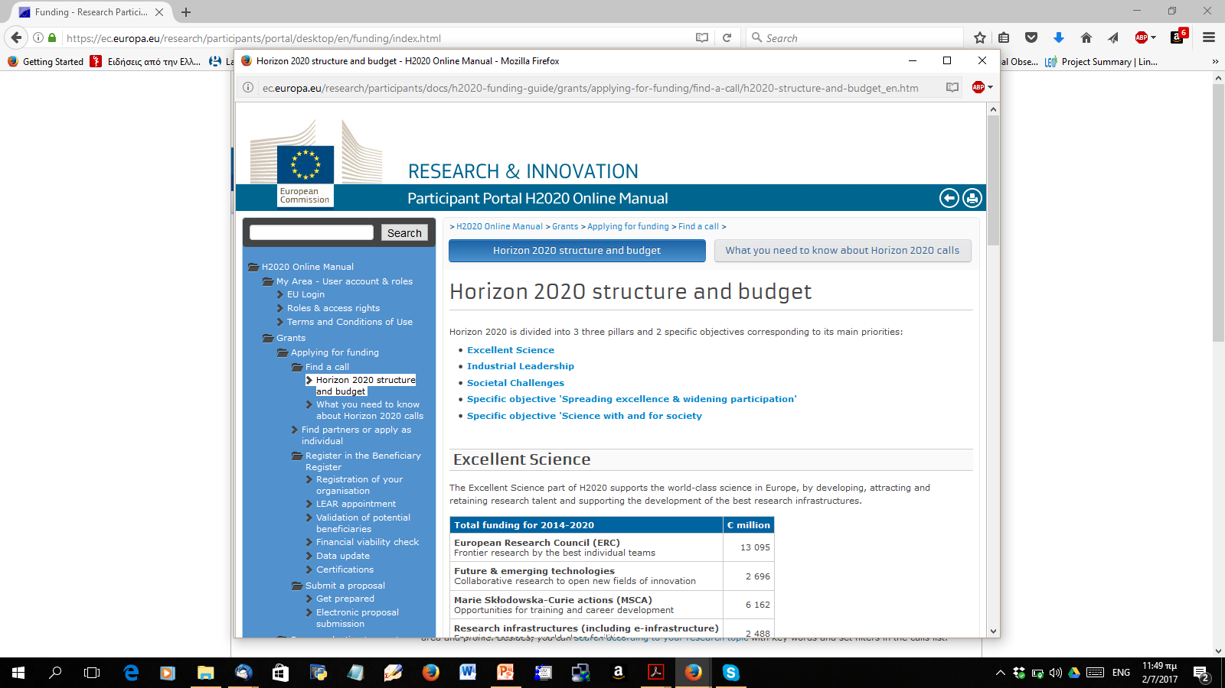
Participant Portal (cont’d)
Understand the structure of the H2020 programme.

Slide 9
The Structure of the H2020 Programme
Three pillars:
Excellent Science
Industrial Leadership
Societal Challenges
Two specific objectives (ignored in the rest of the presentation):
Spreading excellence & widening participation
Science with and for society

Slide 10
Excellent Science
Total funding for 2014-2020 | € million
European Research Council (ERC) Frontier research by the best individual teams | 13 095
Future & emerging technologies Collaborative research to open new fields of innovation | 2 696
Marie Skłodowska-Curie actions (MSCA) Opportunities for training and career development | 6 162
Research infrastructures (including e-infrastructure) Ensuring access to world-class facilities | 2 488

Slide 11
Industrial Leadership
Total funding for 2014-2020 | € million
Leadership in enabling & industrial technologies (LEITs) (ICT, nanotechnologies, materials, biotechnology, manufacturing, space) | 13 557
Access to risk finance Leveraging private finance & venture capital | 2 842
Innovation in SMEs Fostering all forms of innovation in all types of SMEs | 616

Slide 12
Societal Challenges
Total funding for 2014-2020 | € million
Health, demographic change & wellbeing | 7 472
Food security, sustainable agriculture and forestry, marine/maritime/inland water research and the bioeconomy | 3 851
Secure, clean & efficient energy | 5 931
Smart, green & integrated transport | 6 339
Climate action, environment, resource efficiency & raw materials | 3 081
Inclusive, innovative & reflective societies | 1 310
Secure societies | 1 695

Slide 13
Understand the Structure of Calls
Call page and topic page
Deadlines of topics
1-stage, 2-stage or continuously open topics
Types of action
Research and Innovation action
Innovation action
Coordination and Support action
There might be other types of actions depending on the grant e.g., for ERC grants.

Slide 14
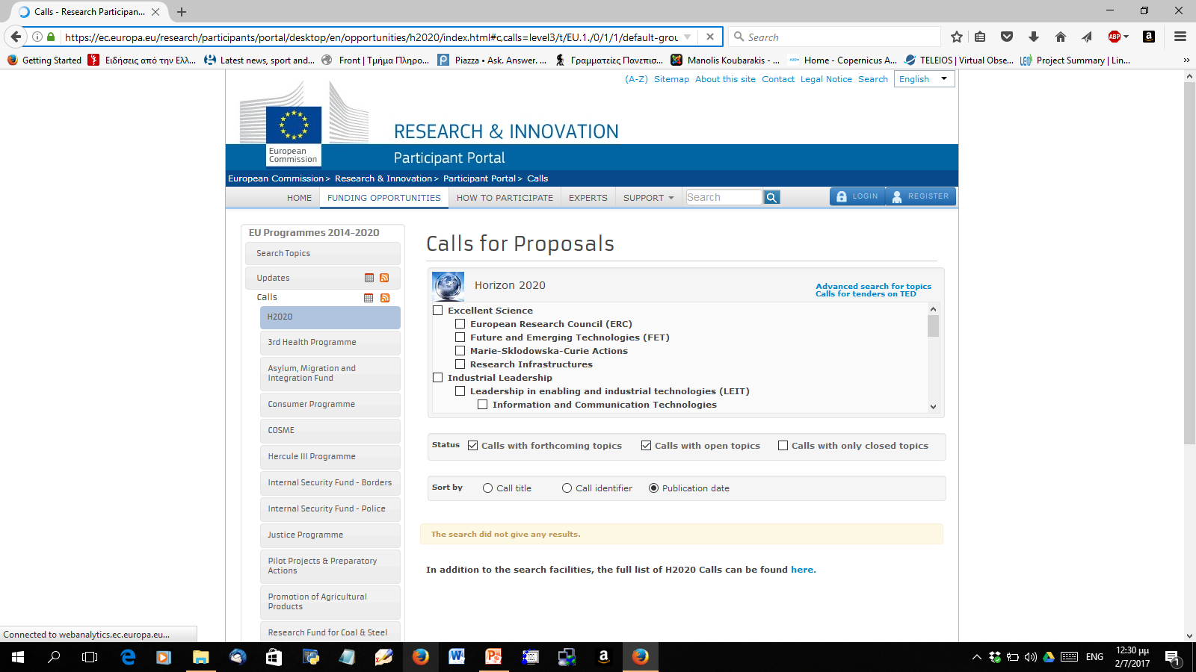
Find a Call
Go to area “Funding Opportunities” of the Participant Portal.

Slide 15
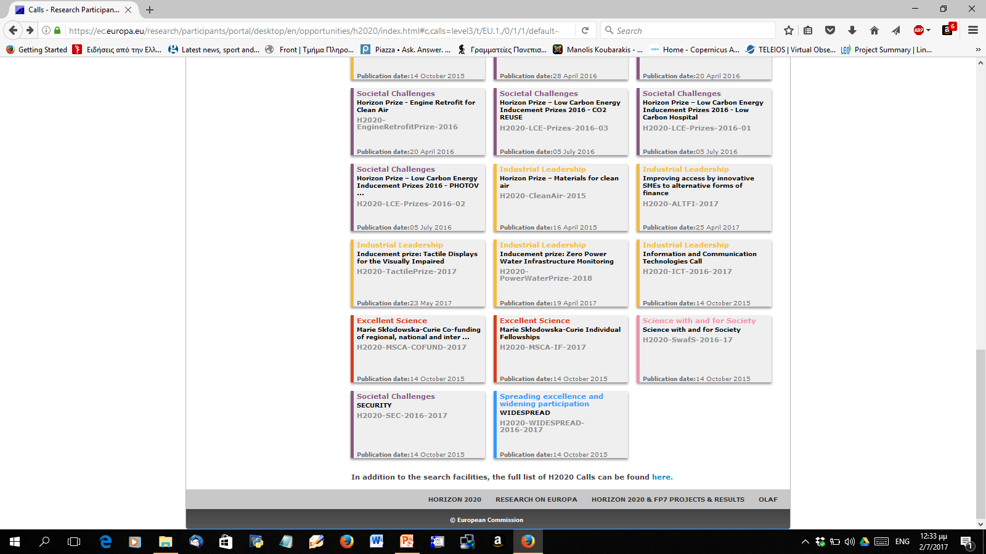
Find a Call (cont’d)
Example: Information and Communication Technologies

Slide 16
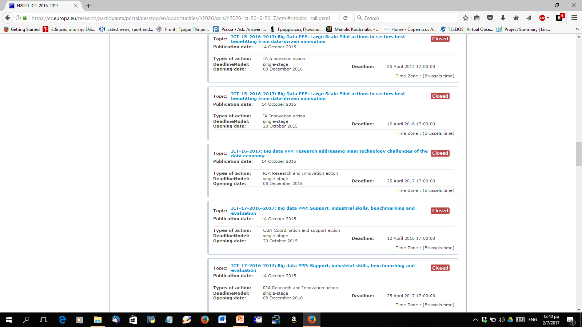
Find an Open Topic
Example: Big data PPP: research addressing main technology challenges of the data economy

Slide 17
Research and Innovation in H2020
H2020 has two relevant instruments:
Research and Innovation actions
Innovation actions
In my presentation I assume you would like to submit such a proposal.

Slide 18
Research and Innovation Action
From the H2020 web site:
Activities aiming to establish new knowledge and/or to explore the feasibility of a new or improved technology, product, process, service or solution. For this purpose they may include basic and applied research, technology development and integration, testing and validation on a small-scale prototype in a laboratory or simulated environment. Projects may contain closely connected but limited demonstration or pilot activities aiming to show technical feasibility in a near to operational environment.
EU funding rate – 100%

Slide 19
Innovation Action
From the H2020 web site:
Activities directly aiming at producing plans and arrangements or designs for new, altered or improved products, processes or services. For this purpose they may include prototyping, testing, demonstrating, piloting, large-scale product validation and market replication.
EU funding rate – 70% (except non-profit, which are still funded 100%)

Slide 20
Open Topics
Topics might open in the near future!
Ideally your university has a service that informs you about this.
But they might inform you late. It is your own responsibility to know better!
Find the preliminary work programme (e.g., now you should be looking for the work programme of 2018 and on).

Slide 21
Example
I googled “ICT work programme 2018” last Sunday.
The first two links gave me some information for the expected work programme of 2018-2020.
But I could not find a preliminary work programme.
I could have asked my National Contact Point (but it was Sunday!)
So I got it from a colleague in Norway and found out that there will be a forthcoming topic on “ICT-18-2018-2020: Big Data technologies and extreme-scale analytics“ which might be exactly what I was looking for!

Slide 22
Find More about the Topic
Go to the web page of the topic.
Read the information there:
Specific objective
Scope
Expected impact
Cross cutting priorities
If you think this is for you, download all the documents relevant to the call.

Slide 23
Important Documents
Standard proposal template (what you will have to prepare).
Standard evaluation form (what criteria will the evaluators use).
H2020 Work Programme 20xx-yy: Information and communication technologies
This is the document where the topic is described.
It is the document to rule them all.
Topic specific documents that the EC unit running the call might have prepared.

Slide 24
Other Important Information
Information days on the topic
Example: Information and Networking Days on Horizon 2020 Big Data Public-Private Partnership topics 2017
See https://ec.europa.eu/digital-single-market/en/news/information-and-networking-days-horizon-2020-big-data-public-private-partnership-topics-2017
Some EC units (e.g., Luxemburg) are extremely good at disseminating this crucial information (e.g., the above link has even videos of the presentations).
If there are topic-specific documents that the relevant EC unit has prepared, they will tell you about them during the information day.

Slide 25
Other Important Information (cont’d)
Proposers days organized by the EC.
Example: If you are interested in submitting a proposal in ICT 2018-2020, you should attend ICT Proposers' Day 2017 which will take place in Budapest in November 2017.
See https://ec.europa.eu/digital-single-market/en/events/ict-proposers-day-2017 .

Slide 26
Other Important Information
Previous successful proposals on a related topic and for the same instrument:
You might have seen at least one in the past (while doing your Ph.D.).
If not, ask a colleague who has been successful with ICT proposals for one! (Hopefully he/she will give it to you ☺).

Slide 27
Deadlines
So assume you have found and read all the important documents and you have lots of ideas about a possible proposal.
Can you meet the deadline?
Example: The call opens December 8, 2016 and closes April 25, 2017.
Question: When are you going to start planning the proposal?

Slide 28
Deadlines (cont’d)
Answer: Definitely well before December 2016! (October?)
Other chronological information that might be relevant:
Is the call deadline close to Christmas, Easter or Summer Holidays? If yes, start even earlier and plan very carefully what will be done around the time of the holidays.

Slide 29
Consortium
What can be a winning consortium for the topic of the call?
Questions to answer:
Who are the world-class European players (universities, research institutes, companies) in this area?
Are you one of them?
Do they complement each other?
Can you get them on board?
Can you join them in case they are submitting a research proposal on the same topic? (Some groups might be known to be established players in a research area.)
Do you have such a friend or colleague from a previous project or research collaboration?

Slide 30
Consortium (cont’d)
How many members?
The formal rules of H2020 say:
A consortium must consist of at least three partners from at least three EU Member States or Associated Countries.
Legal entities must be independent of each other to be considererd as different partners.
Each consortium must include a coordinating organisation, referred to as the “coordinator”.
The number of partners in a consortium will depend on the topic.
My opinion: The less partners, the better.
Radical approach: Can you implement your proposal idea with just 3 partners?
If yes, go for it! Having more partners is a waste of money and time for the coordinator.
Such a project did exist! (but I have only seen one)

Slide 31
On Friends and Other Acquaintances
It is great idea to write a proposal with a colleague that you like, trust and have worked with in a previous project.
This will also make future life easier if the proposal is accepted.
But think about complementarity !
Example: Tom is my friend but he also works in the same narrow research area as I do. Shall I include him? (My opinion: No!)

Slide 32
Consortium (cont’d)
Shall we include partners from countries that just joined the EU, poorer countries, bigger countries, our own country, countries leaving the EU etc.?
One always hears these questions when talking to people about EU projects.
My opinion: None of this matters! Just forget these questions and concentrate on building a successful consortium.

Slide 33
On Industrial Partners
Industrial partners are important!
It does not matter if they are big or small. They should be experts on the topic of the call.
Big companies might be difficult to persuade to join your consortium.
It might take a while for a big company to get internal approval for participating in an EC proposal.
Big companies might also have their own agenda on the topic and your ideas need to fit this agenda otherwise they won’t play ball with you!
Big companies might even have a strict lower bound on their share of the budget (yes, I have heard of such cases).
The participation of Small or Medium Enterprises (SMEs) might be encouraged or be a requirement in the call.
My opinion: Go for big companies if you can manage the relevant complexity. If not, go for smaller, focused companies who can demonstrate expertise in the area of the topic.
My opinion: Stay away from companies who are only known for participating in EC projects (examples can be provided during dinner).

Slide 34
On Non-European Industrial Partners
They can participate through one of their offices, research centers etc. in Europe.
Suggestion: always prefer a European industrial partner instead, except if you can demonstrate convincingly the added value for Europe of having the non-European partner in your consortium.
Sometimes you might even be encouraged by the topic guidelines to concentrate on working with European partners.
Example: “Work with European datasets.”

Slide 35
On Users
Users are important!
But they need to have a real problem that can drive the research and innovation. If you need to explain their problem to them, they are not users or the problem is of no relevance to practitioners.
Example: Hospitals and health-care professionals if your proposal is on big data in the health domain.

Slide 36
Who will be the Coordinator?
If you are to be trusted, you are well-organized and you have a strong and cohesive research group and project support from your university, go for it!
It is an excellent way to get to know the whole EC project process.
It is an excellent way to get to know the relevant EC unit.
If not, persuade a colleague that has appropriate credentials.
The Coordinator does not need to be famous (but it can become famous by the end of the project).

Slide 37
Submitting a Proposal
Create an account on the Participant Portal
Register your organization if it is not already registered.
Prepare and submit your proposal.

Slide 38
Preparation of the Proposal
This could be the subject of one more presentation!
There are nice presentations on the Web on this topic.
My favourite: A presentation by the Research Executive Agency (Brussels) that manages the Space programme of Horizon 2020.
Available at https://ec.europa.eu/research/participants/portal/doc/call/h2020/compet-2-2017/1745114-ncp_training_topic_evaluation_criteria_en.pdf .
Let us take a good look at it.

Slide 39
Proposal Evaluation
Examine carefully the evaluation form that will be used for your proposal.
Make sure all the issues touched are covered by your proposal.
Advice: Give your proposal and the evaluation form to a trusted colleague and ask him/her to evaluate it objectively.
Pray?

Slide 40
Being an Evaluator
A great way to learn how to submit successful research proposals is to become an evaluator.
See https://ec.europa.eu/research/participants/portal/desktop/en/experts/index.html

Slide 41
Final Comments
If your proposal is not accepted, do not get depressed:
Usually most of the submitted proposals are not accepted.
The competition is very high (most of the times).
If you know a topic on which high competition is not expected, go for it!
An element of luck is involved in the selection process.
It is not what you think that matters but what the reviewers think.
But try to understand the weaknesses of your proposal and avoid them in the next one.
Try, try again!

Slide 42
Final Comments (cont’d)
How to use what you learned in this presentation in the near future:
Help your supervisor with his/her proposals.
Then you will be fully trained and ready to write your own proposals after you finish your Ph.D.

Slide 43
Final Comments (cont’d)
I hope you will remember this talk when you write your first own proposal (don’t forget to include me as a partner ☺).
I hope you are successful and lead many interesting research projects after your Ph.D.
Thank you!
Questions?

Slide 44
Acknowledgements
I thank my colleague Michalis Hatzopoulos for comments and suggestions on an earlier version of this presentation.
I thank Francesco Barbato, the project officer of projects TELEIOS and LEO, for many interesting suggestions regarding how to run a successful project.

